Slide 1
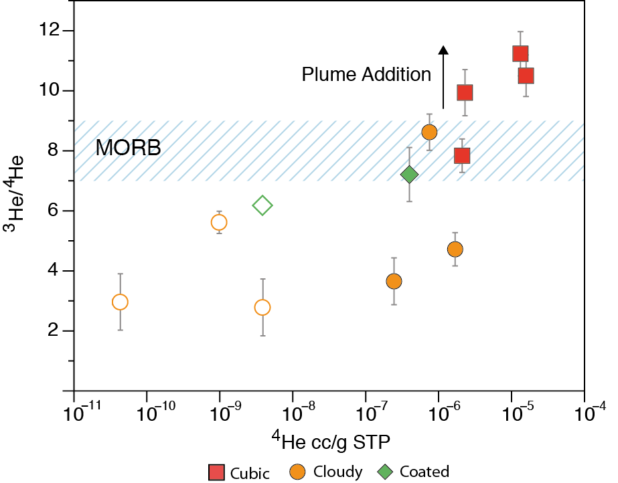
Broadley et al.
Plume-lithosphere interaction, and the formation of fibrous diamonds
Figure 2 ³He/⁴He vs. ⁴He concentrations from crushing and laser heating (open symbols) of Nyurbinskaya diamonds. ³He/⁴He from the cubic diamonds are higher than the cloudy and coated diamonds and plot above MORB values suggesting the diamond-hosted inclusions contain a mixture of lithospheric…
© 2018 The Authors
Published by the European Association of Geochemistry
under Creative Commons License CC BY-NC-ND 4.0
Broadley et al. (2018) Geochem. Persp. Let. 8, 26-30 | doi: 10.7185/geochemlet.1825
Notes:
Figure 2 ³He/⁴He vs. ⁴He concentrations from crushing and laser heating (open symbols) of Nyurbinskaya diamonds. ³He/⁴He from the cubic diamonds are higher than the cloudy and coated diamonds and plot above MORB values suggesting the diamond-hosted inclusions contain a mixture of lithospheric and deep mantle volatiles. Uncertainties shown are 1σ and for ⁴He concentrations are smaller than symbol size.

