Slide 1
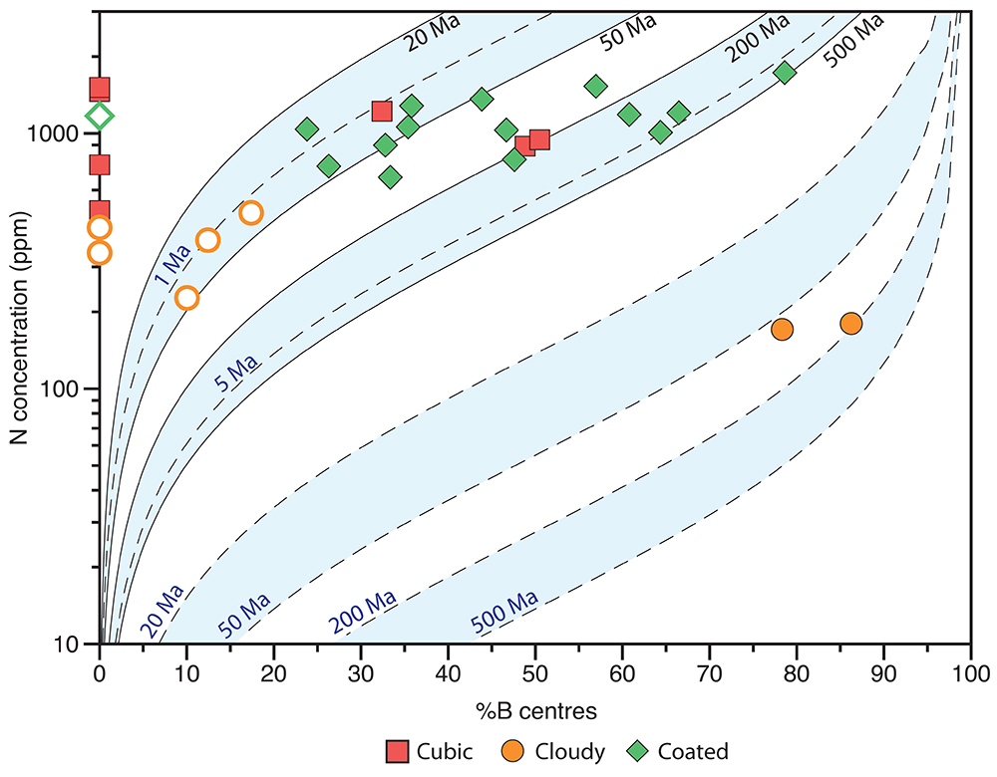
Broadley et al.
Plume-lithosphere interaction, and the formation of fibrous diamonds
Figure 4 Total nitrogen concentrations vs. the percentage of nitrogen in the B aggregated state. Each point is from the analysis of a single diamond, full symbols are from the bulk measurement, whilst open symbols are from the fibrous coat or cloudy interior of the coated and cloudy diamonds…
© 2018 The Authors
Published by the European Association of Geochemistry
under Creative Commons License CC BY-NC-ND 4.0
Broadley et al. (2018) Geochem. Persp. Let. 8, 26-30 | doi: 10.7185/geochemlet.1825
Notes:
Figure 4 Total nitrogen concentrations vs. the percentage of nitrogen in the B aggregated state. Each point is from the analysis of a single diamond, full symbols are from the bulk measurement, whilst open symbols are from the fibrous coat or cloudy interior of the coated and cloudy diamonds respectively. Isotherms are calculated assuming a temperature range between 1200 °C (solid lines) and 1300 °C (dashed lines) as reported for Udachnaya xenolith (Boyd et al., 1997) and assumed residence times between 1 Ma and 200 Ma. All diamonds indicate a residence time of less than 200 Ma at the temperature estimated for the Siberian SCLM at 360Ma (eruption age of Nyurbinskaya and Udachnaya kimberlites).

