Slide 1
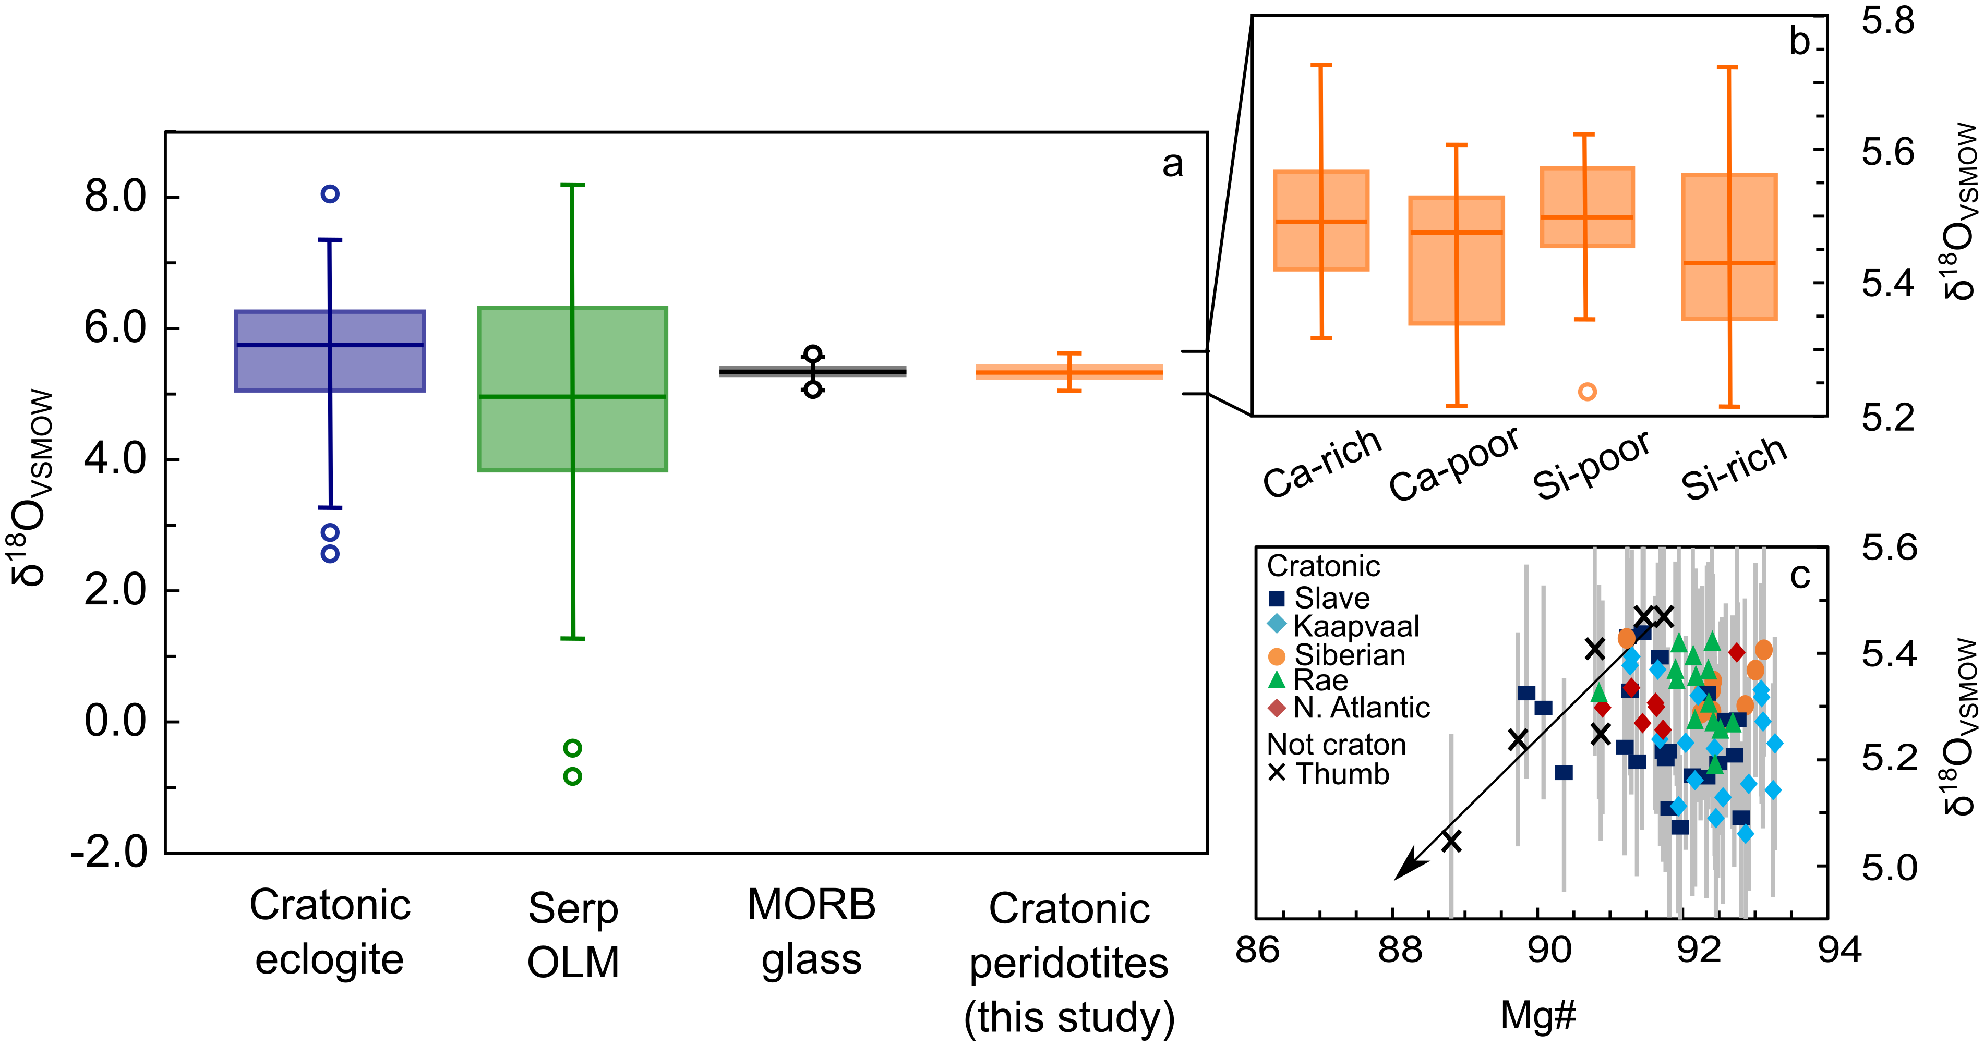
Regier et al.
An oxygen isotope test for the origin of Archean mantle roots
Figure 3 (a) Box-whisker plot of the oxygen isotopic composition of cratonic peridotites, calculated from olivine δ¹⁸O, compared to eclogitic xenoliths, serpentinised oceanic lithospheric mantle (OLM), and MORB glass (Supplementary Information). (b) A box-whisker plot of peridotite δ¹⁸O, divided into statistically insignificant chemical discriminators – Ca-rich (lherzolitic), Ca-poor (harzburgitic/dunitic) and Si-enriched (-ΔMg/Si) and depleted lithologies (+ΔMg/Si), demonstrates that there is no variation in the distribution of oxygen isotopes with bulk rock chemistry. (c) Scatter plot of olivine δ¹⁸O and Mg#. The lack of correlation in the cratonic mantle suite contrasts to the trendline of The Thumb xenoliths (r² = 0.86).
© 2018 The Authors
Published by the European Association of Geochemistry
under Creative Commons License CC BY 4.0
Regier et al. (2018) Geochem. Persp. Let. 9, 6-10 | doi: 10.7185/geochemlet.1830
Notes:
Figure 3 (a) Box-whisker plot of the oxygen isotopic composition of cratonic peridotites, calculated from olivine δ¹⁸O, compared to eclogitic xenoliths, serpentinised oceanic lithospheric mantle (OLM), and MORB glass (Supplementary Information). (b) A box-whisker plot of peridotite δ¹⁸O, divided into statistically insignificant chemical discriminators – Ca-rich (lherzolitic), Ca-poor (harzburgitic/dunitic) and Si-enriched (-ΔMg/Si) and depleted lithologies (+ΔMg/Si), demonstrates that there is no variation in the distribution of oxygen isotopes with bulk rock chemistry. (c) Scatter plot of olivine δ¹⁸O and Mg#. The lack of correlation in the cratonic mantle suite contrasts to the trendline of The Thumb xenoliths (r² = 0.86).

