Slide 1
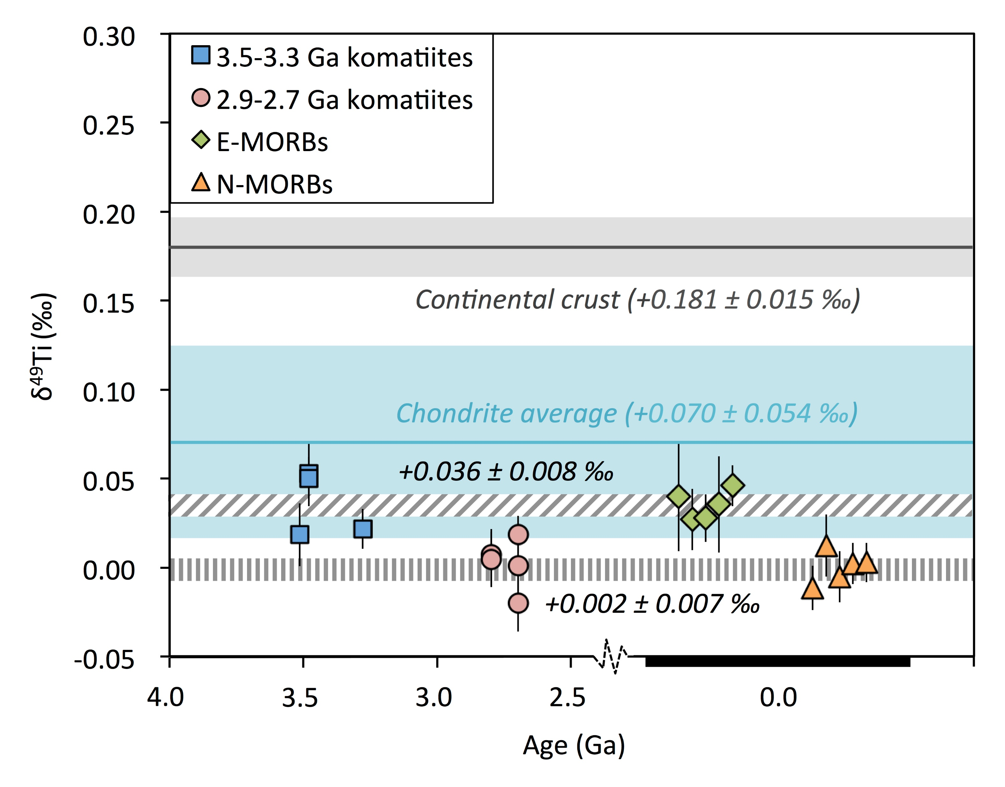
Deng et al.
Bridging the depleted MORB mantle and the continental crust using titanium isotopes
Figure 2 The change of δ⁴⁹Ti values with time for the komatiite and MORB samples. The average δ⁴⁹Ti values for the depleted and primitive groups are indicated. Also shown are the average of 12 chondrite groups with 2 sd uncertainty from Deng et al. (2018) and the continental crust value inferred from shale data from Greber et al. (2017b).
© 2018 The Authors
Published by the European Association of Geochemistry
under Creative Commons License CC BY-NC-ND.
Deng et al. (2018) Geochem. Persp. Let. 9, 11-15 | doi: 10.7185/geochemlet.1831
Notes:
Figure 2 The change of δ⁴⁹Ti values with time for the komatiite and MORB samples. The average δ⁴⁹Ti values for the depleted and primitive groups are indicated. Also shown are the average of 12 chondrite groups with 2 sd uncertainty from Deng et al. (2018) and the continental crust value inferred from shale data from Greber et al. (2017b).

