Slide 1
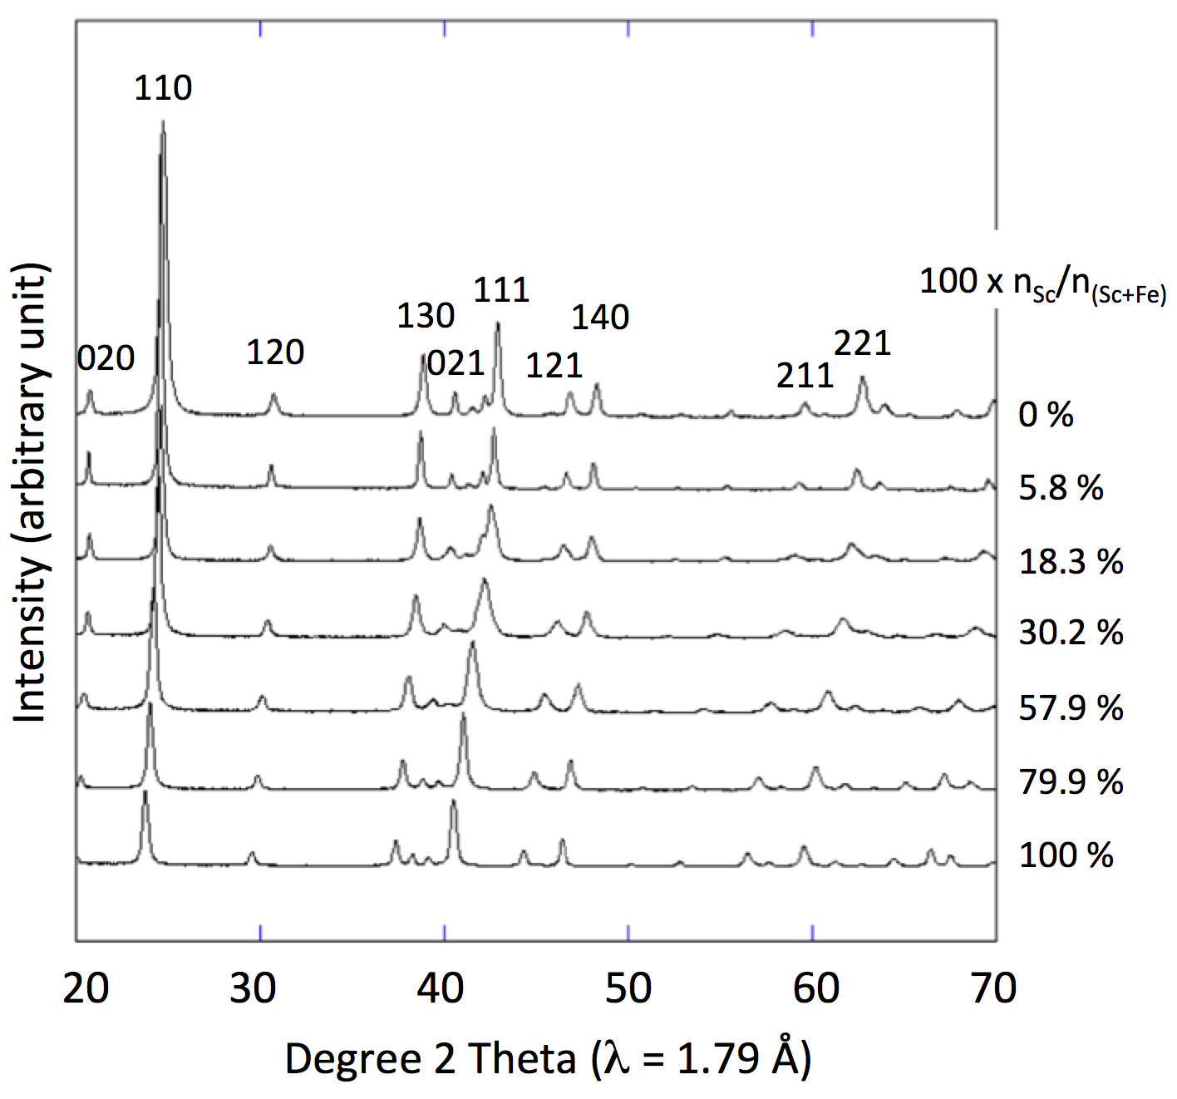
Levard et al.
Goethite, a tailor-made host for the critical metal scandium: The Fe_{x}Sc_{(1-x)}OOH solid solution
Figure 1 X-ray diffractograms for goethite, ScOOH and Sc-doped goethite samples.
© 2018 The Authors
Published by the European Association of Geochemistry
under Creative Commons License CC BY-NC-ND.
Levard et al. (2018) Geochem. Persp. Let. 9, 16-20 | doi: 10.7185/geochemlet.1832
Notes:
Figure 1 X-ray diffractograms for goethite, ScOOH and Sc-doped goethite samples.

