Slide 1
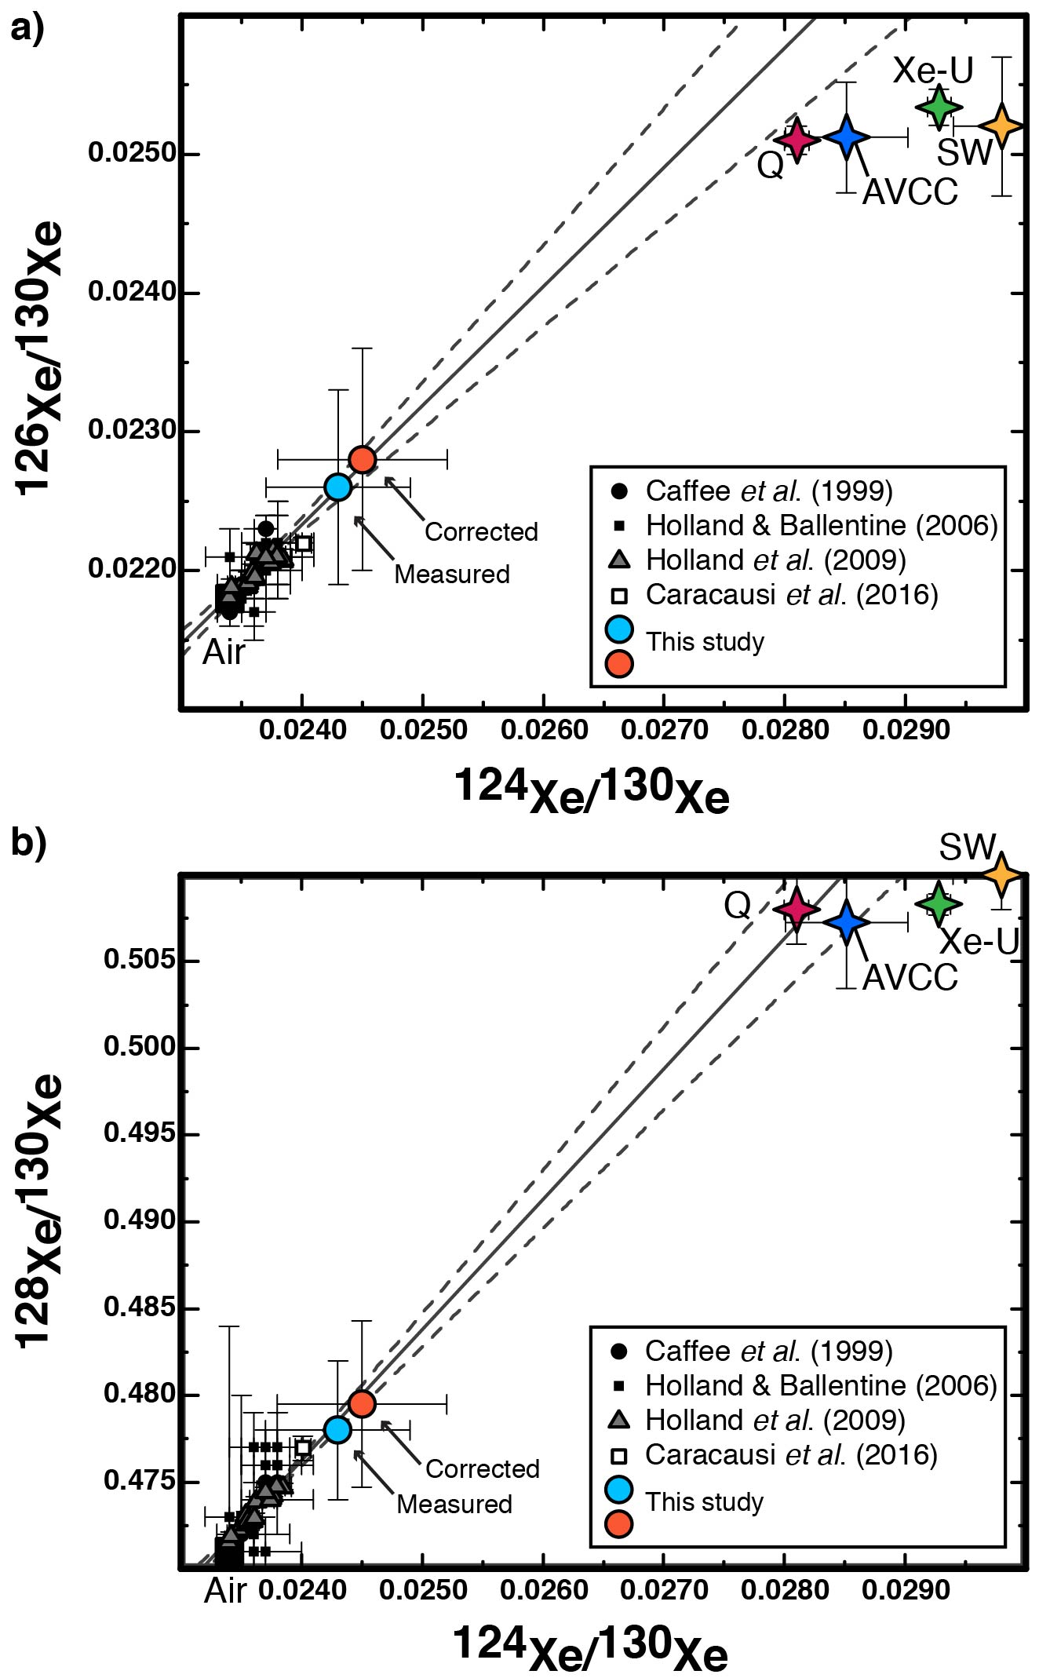
Péron and Moreira
Onset of volatile recycling into the mantle determined by xenon anomalies
Figure 1 Light xenon isotopic compositions for popping rock 2πD43. Measured data (blue dot) and corrected data for atmospheric contamination (orange dot) with a ¹²⁹Xe/¹³⁰Xe ratio of 7.6: (a) ¹²⁶Xe/¹³⁰Xe and (b) ¹²⁸Xe/¹³⁰Xe versus ¹²⁴Xe/¹³⁰Xe. For comparison, data of CO₂ well gases from Caffee et al. (1999) (black points), Holland and Ballentine (2006) (black square) and Holland et al. (2009) (grey triangles), and thermal springs from Caracausi et al. (2016) (green square) and Moreira et al. (2018) (red square) are shown. The solid line is a fit of the data, except that of Holland and Ballentine (2006). The dotted lines indicate the 95 % confidence interval. Phase Q (Busemann et al., 2000), Solar Wind SW (Meshik et al., 2014), Xe-U and AVCC (Pepin, 2003). These new data suggest a chondritic origin (Phase Q or AVCC) for upper mantle Xe.
© 2018 The Authors
Published by the European Association of Geochemistry
under Creative Commons License CC BY-NC-ND.
Péron and Moreira (2018) Geochem. Persp. Let. 9, 21-25 | doi: 10.7185/geochemlet.1833
Notes:
Figure 1 Light xenon isotopic compositions for popping rock 2πD43. Measured data (blue dot) and corrected data for atmospheric contamination (orange dot) with a ¹²⁹Xe/¹³⁰Xe ratio of 7.6: (a) ¹²⁶Xe/¹³⁰Xe and (b) ¹²⁸Xe/¹³⁰Xe versus ¹²⁴Xe/¹³⁰Xe. For comparison, data of CO₂ well gases from Caffee et al. (1999) (black points), Holland and Ballentine (2006) (black square) and Holland et al. (2009) (grey triangles), and thermal springs from Caracausi et al. (2016) (green square) and Moreira et al. (2018) (red square) are shown. The solid line is a fit of the data, except that of Holland and Ballentine (2006). The dotted lines indicate the 95 % confidence interval. Phase Q (Busemann et al., 2000), Solar Wind SW (Meshik et al., 2014), Xe-U and AVCC (Pepin, 2003). These new data suggest a chondritic origin (Phase Q or AVCC) for upper mantle Xe.

