Slide 1
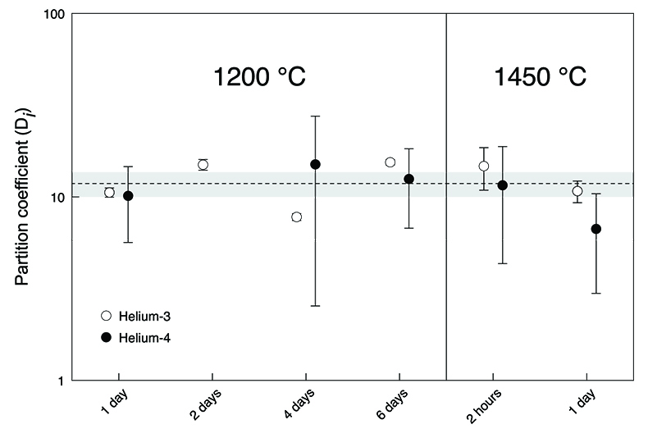
Roth et al.
The primordial He budget of the Earth set by percolative core formation in planetesimals
Figure 2 Metal-silicate (liquid-solid) partition coefficients for He. The dashed line shows the average partition coefficient D_{He} value of 11.8 (n = 11). The shaded area defines the two standard error of the mean (2 se) of 1.8. Data for the two-hour experiment are excluded and the ⁴He partition coefficient for the two-day experiment is missing. Uncertainties include only gas concentration uncertainties. Error bars are 2 sd.
© 2019 The Authors
Published by the European Association of Geochemistry
under Creative Commons License CC BY-NC-ND.
Roth et al. (2019) Geochem. Persp. Let. 9, 26-31 | doi: 10.7185/geochemlet.1901
Notes:
Figure 2 Metal-silicate (liquid-solid) partition coefficients for He. The dashed line shows the average partition coefficient D_{He} value of 11.8 (n = 11). The shaded area defines the two standard error of the mean (2 se) of 1.8. Data for the two-hour experiment are excluded and the ⁴He partition coefficient for the two-day experiment is missing. Uncertainties include only gas concentration uncertainties. Error bars are 2 sd.

