Slide 1
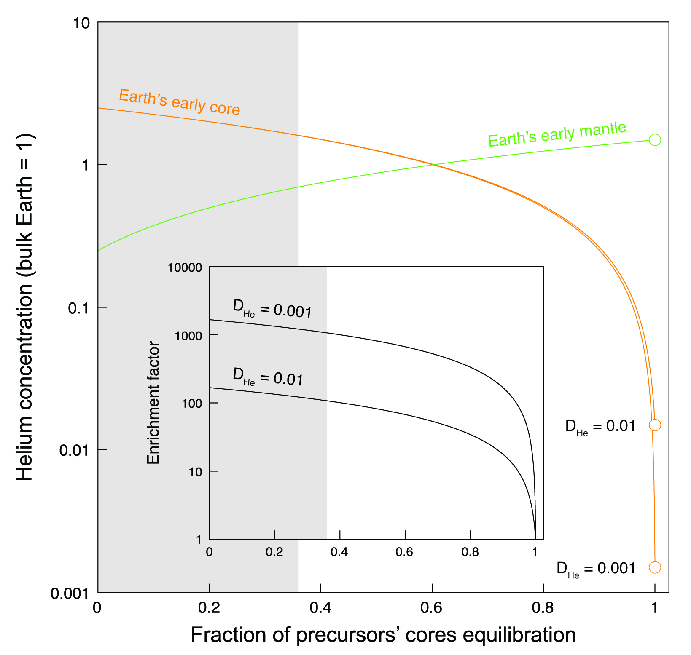
Roth et al.
The primordial He budget of the Earth set by percolative core formation in planetesimals
Figure 3 Helium concentration in the Earth’s early core and mantle as a function of the fraction of precursors’ cores equilibration with a terrestrial magma ocean. Mass balance calculations assume 1/3 metal and 2/3 silicate by mass and a He concentration in the bulk Earth that equals 1 (see Supplementary Information). Two scenarios are evaluated whereby metal and silicate (liquid-liquid) equilibrate in a shallow magma ocean (D_{He} = 0.001) and in a deep magma ocean (D_{He} = 0.01) (Bouhifd et al., 2013). Datasets for the Earth’s early mantle overlap on the diagram. The inset shows the enrichment factor, i.e. the He concentration in the Earth’s early core at any fraction of equilibration relative to that assuming full (liquid-liquid) equilibrium. The shaded areas represent the range of equilibration from 0 to 36 %, for which geochemical models do not have satisfactory matches between siderophile element abundances and isotopic constraints (Rudge et al., 2010).
© 2019 The Authors
Published by the European Association of Geochemistry
under Creative Commons License CC BY-NC-ND.
Roth et al. (2019) Geochem. Persp. Let. 9, 26-31 | doi: 10.7185/geochemlet.1901
Notes:
Figure 3 Helium concentration in the Earth’s early core and mantle as a function of the fraction of precursors’ cores equilibration with a terrestrial magma ocean. Mass balance calculations assume 1/3 metal and 2/3 silicate by mass and a He concentration in the bulk Earth that equals 1 (see Supplementary Information). Two scenarios are evaluated whereby metal and silicate (liquid-liquid) equilibrate in a shallow magma ocean (D_{He} = 0.001) and in a deep magma ocean (D_{He} = 0.01) (Bouhifd et al., 2013). Datasets for the Earth’s early mantle overlap on the diagram. The inset shows the enrichment factor, i.e. the He concentration in the Earth’s early core at any fraction of equilibration relative to that assuming full (liquid-liquid) equilibrium. The shaded areas represent the range of equilibration from 0 to 36 %, for which geochemical models do not have satisfactory matches between siderophile element abundances and isotopic constraints (Rudge et al., 2010).

