Slide 1
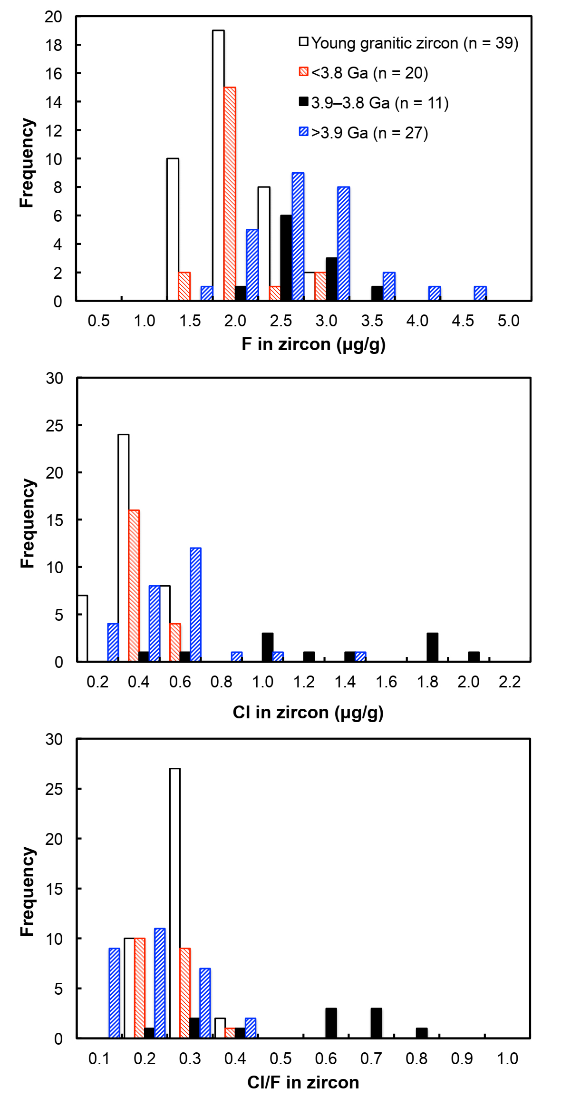
Tang et al.
Zircon halogen geochemistry: Insights into Hadean-Archean fluids
Figure 1 Fluorine concentrations in Jack Hills zircons ([F]_{average} = 2.28 ± 0.19 μg/g) are generally indistinguishable from those in young granitic zircons ([F]_{average} = 1.80 ± 0.11 μg/g). Elevated Cl concentrations observed in eight 3.9–3.8 Ga zircons (black columns) yield distinctly high Cl/F ratios (Cl/F > 0.3) when compared with other Jack Hills zircons.
© 2019 The Authors
Published by the European Association of Geochemistry
under Creative Commons License CC BY-NC-ND.
Tang et al. (2019) Geochem. Persp. Let. 9, 49-53 | doi: 10.7185/geochemlet.1905
Notes:
Figure 1 Fluorine concentrations in Jack Hills zircons ([F]_{average} = 2.28 ± 0.19 μg/g) are generally indistinguishable from those in young granitic zircons ([F]_{average} = 1.80 ± 0.11 μg/g). Elevated Cl concentrations observed in eight 3.9–3.8 Ga zircons (black columns) yield distinctly high Cl/F ratios (Cl/F > 0.3) when compared with other Jack Hills zircons.

