Slide 1
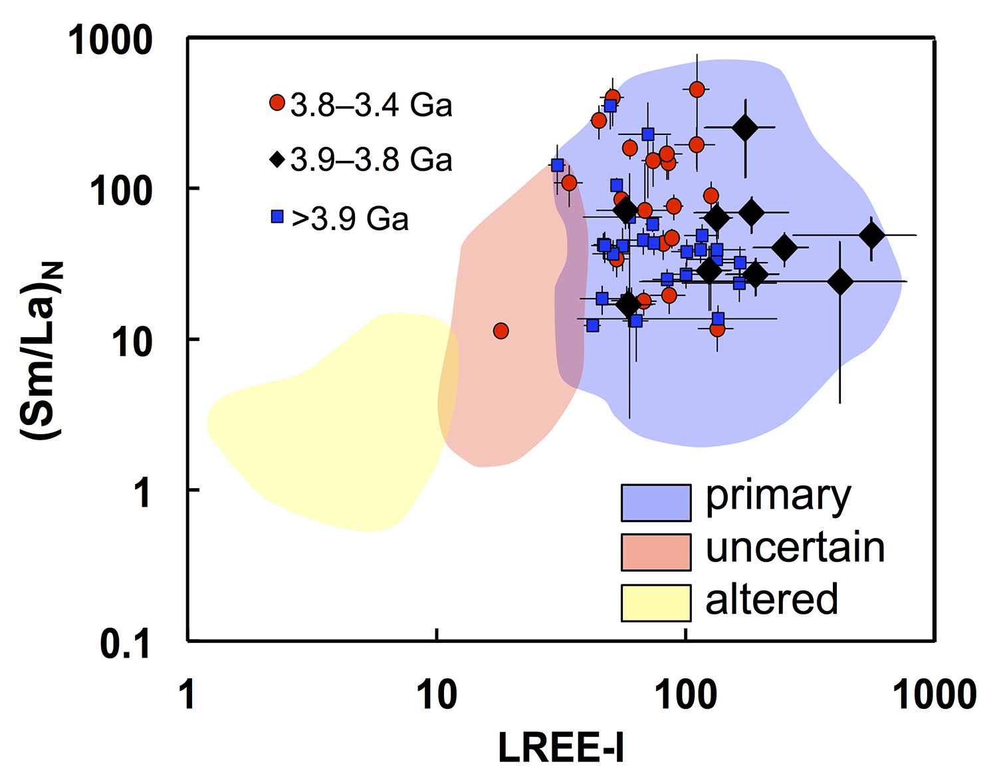
Tang et al.
Zircon halogen geochemistry: Insights into Hadean-Archean fluids
Figure 2 High values of (Sm/La)_{N} and LREE-I [(Dy/Nd) + (Dy/Sm)] in Jack Hills sample grains imply that most of samples, especially Cl-rich zircons, are primary. The elevated Cl concentrations in zircons therefore derived from primary sources.
© 2019 The Authors
Published by the European Association of Geochemistry
under Creative Commons License CC BY-NC-ND.
Tang et al. (2019) Geochem. Persp. Let. 9, 49-53 | doi: 10.7185/geochemlet.1905
Notes:
Figure 2 High values of (Sm/La)_{N} and LREE-I [(Dy/Nd) + (Dy/Sm)] in Jack Hills sample grains imply that most of samples, especially Cl-rich zircons, are primary. The elevated Cl concentrations in zircons therefore derived from primary sources.

