Slide 1
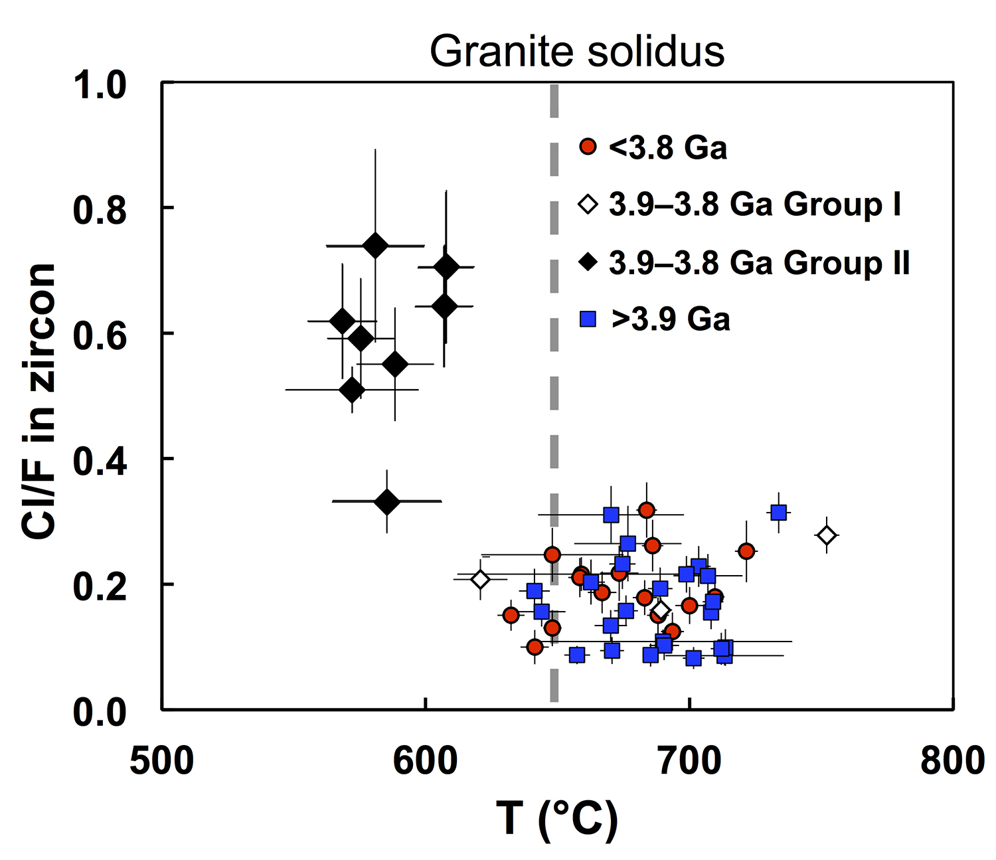
Tang et al.
Zircon halogen geochemistry: Insights into Hadean-Archean fluids
Figure 4 Chlorine-rich Group II zircons are characterised by Ti-in-zircon temperatures below granite solidus. The clearly distinguished cluster of Group II from other magmatic zircons suggests the mechanism of Group II as solid state recrystallisation involving Cl-bearing fluids.
© 2019 The Authors
Published by the European Association of Geochemistry
under Creative Commons License CC BY-NC-ND.
Tang et al. (2019) Geochem. Persp. Let. 9, 49-53 | doi: 10.7185/geochemlet.1905
Notes:
Figure 4 Chlorine-rich Group II zircons are characterised by Ti-in-zircon temperatures below granite solidus. The clearly distinguished cluster of Group II from other magmatic zircons suggests the mechanism of Group II as solid state recrystallisation involving Cl-bearing fluids.

