Slide 1
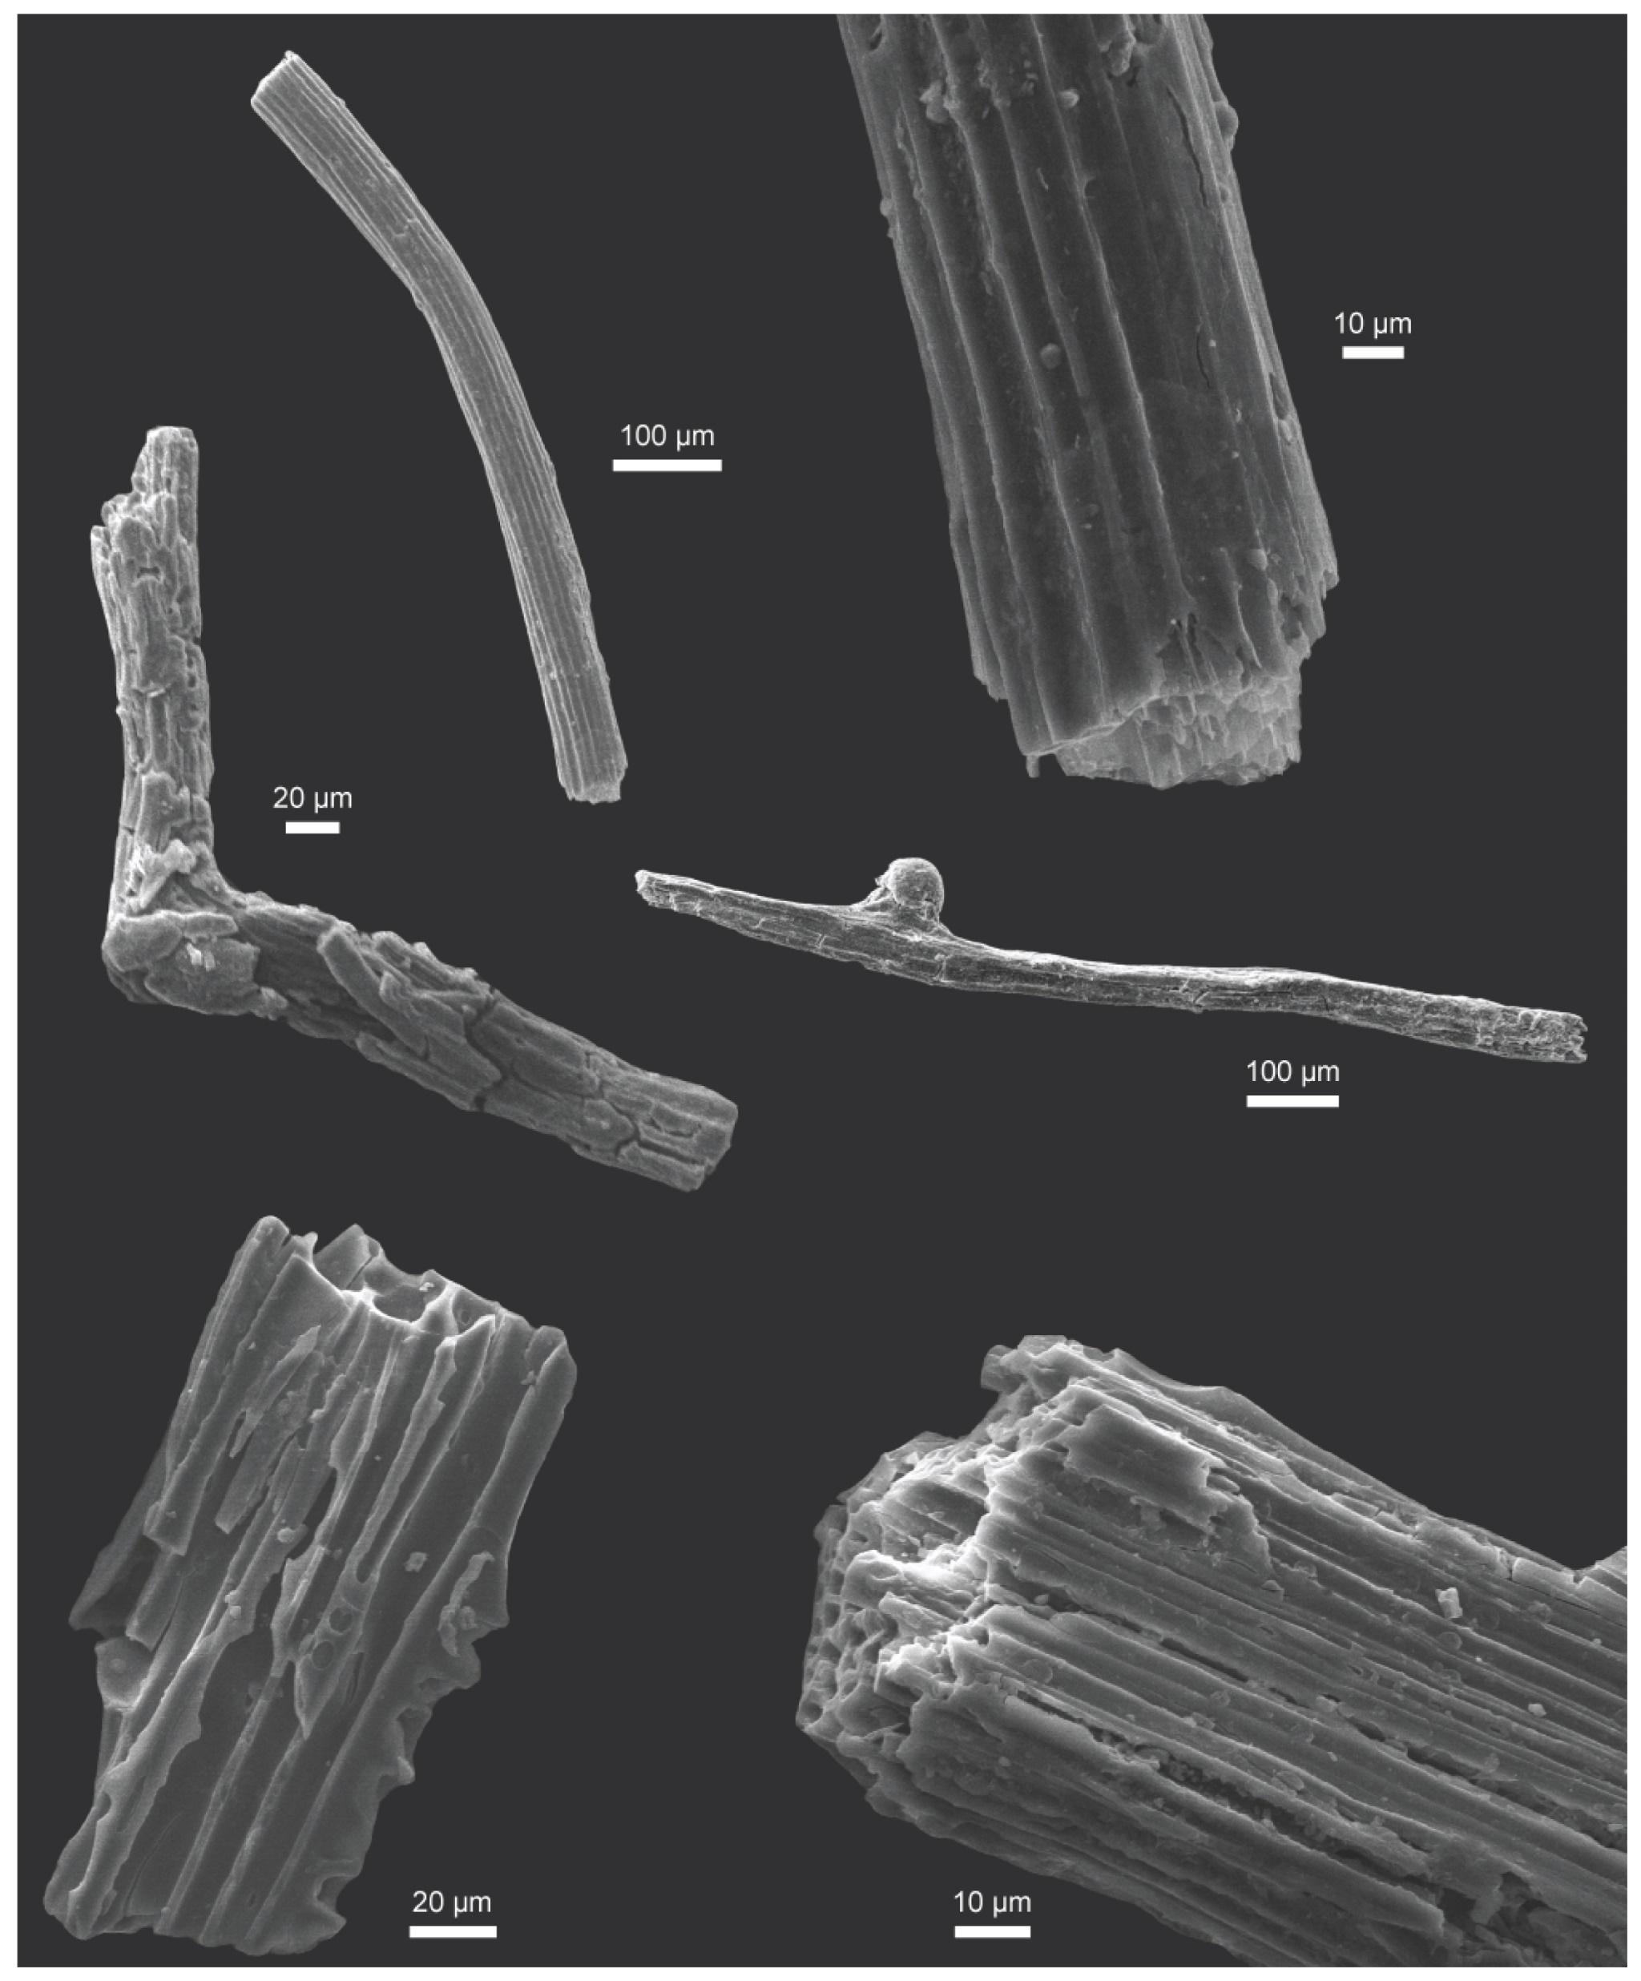
Fung et al.
Widespread and intense wildfires at the Paleocene-Eocene boundary
Figure 2 SEM images of charcoal fragments from WL and RF.
© 2019 The Authors
Published by the European Association of Geochemistry
under Creative Commons License CC BY-NC-ND.
Fung et al. (2019) Geochem. Persp. Let. 10, 1-6 | doi: 10.7185/geochemlet.1906
Notes:
Figure 2 SEM images of charcoal fragments from WL and RF.

