Slide 1
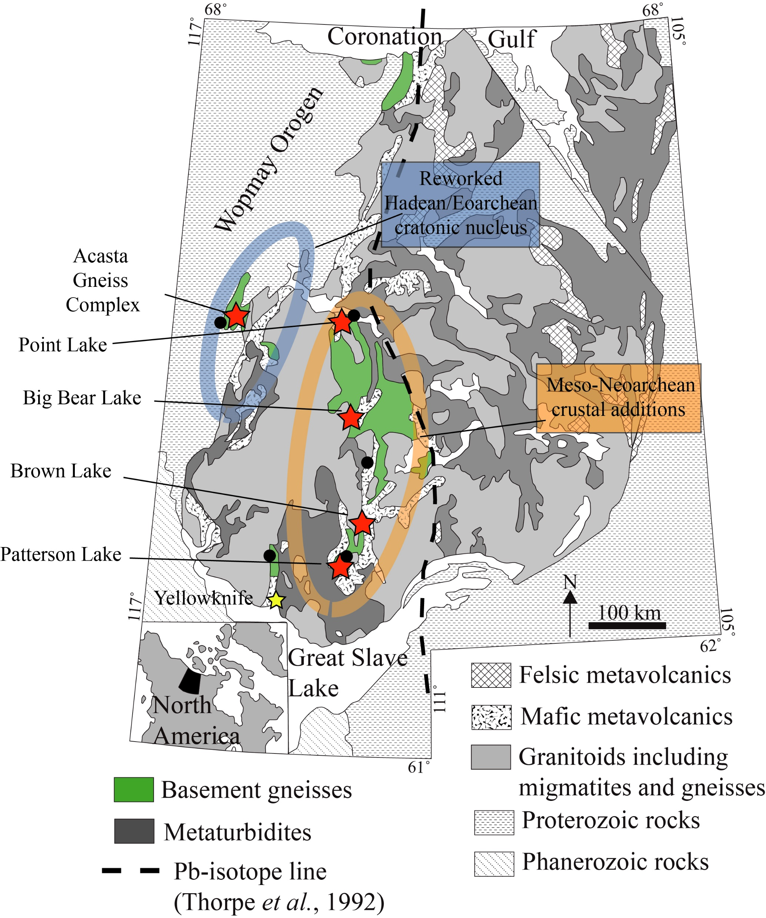
Reimink et al.
Onset of new, progressive crustal growth in the central Slave craton at 3.55 Ga
Figure 1 Geologic map of the Slave craton highlighting the major domains that contain basement gneisses. Map modified from St. Onge et al. (1988); Bleeker et al. (1999a,b). Major basement complexes are shown along with crustal province boundaries inferred from Nd and Pb isotope data (Davis and Hegner, 1992; Thorpe et al., 1992). Red stars indicate key locations sampled in this study and coloured circles are locations where detrital zircons have been analysed for their U-Pb-Hf systematics as described in Figure 3 and the Supplementary Information.
© 2019 The Authors
Published by the European Association of Geochemistry
under Creative Commons License CC BY-NC-ND.
Reimink et al. (2019) Geochem. Persp. Let. 10, 8-13 | doi: 10.7185/geochemlet.1907
Notes:
Figure 1 Geologic map of the Slave craton highlighting the major domains that contain basement gneisses. Map modified from St. Onge et al. (1988); Bleeker et al. (1999a,b). Major basement complexes are shown along with crustal province boundaries inferred from Nd and Pb isotope data (Davis and Hegner, 1992; Thorpe et al., 1992). Red stars indicate key locations sampled in this study and coloured circles are locations where detrital zircons have been analysed for their U-Pb-Hf systematics as described in Figure 3 and the Supplementary Information.

