Slide 1
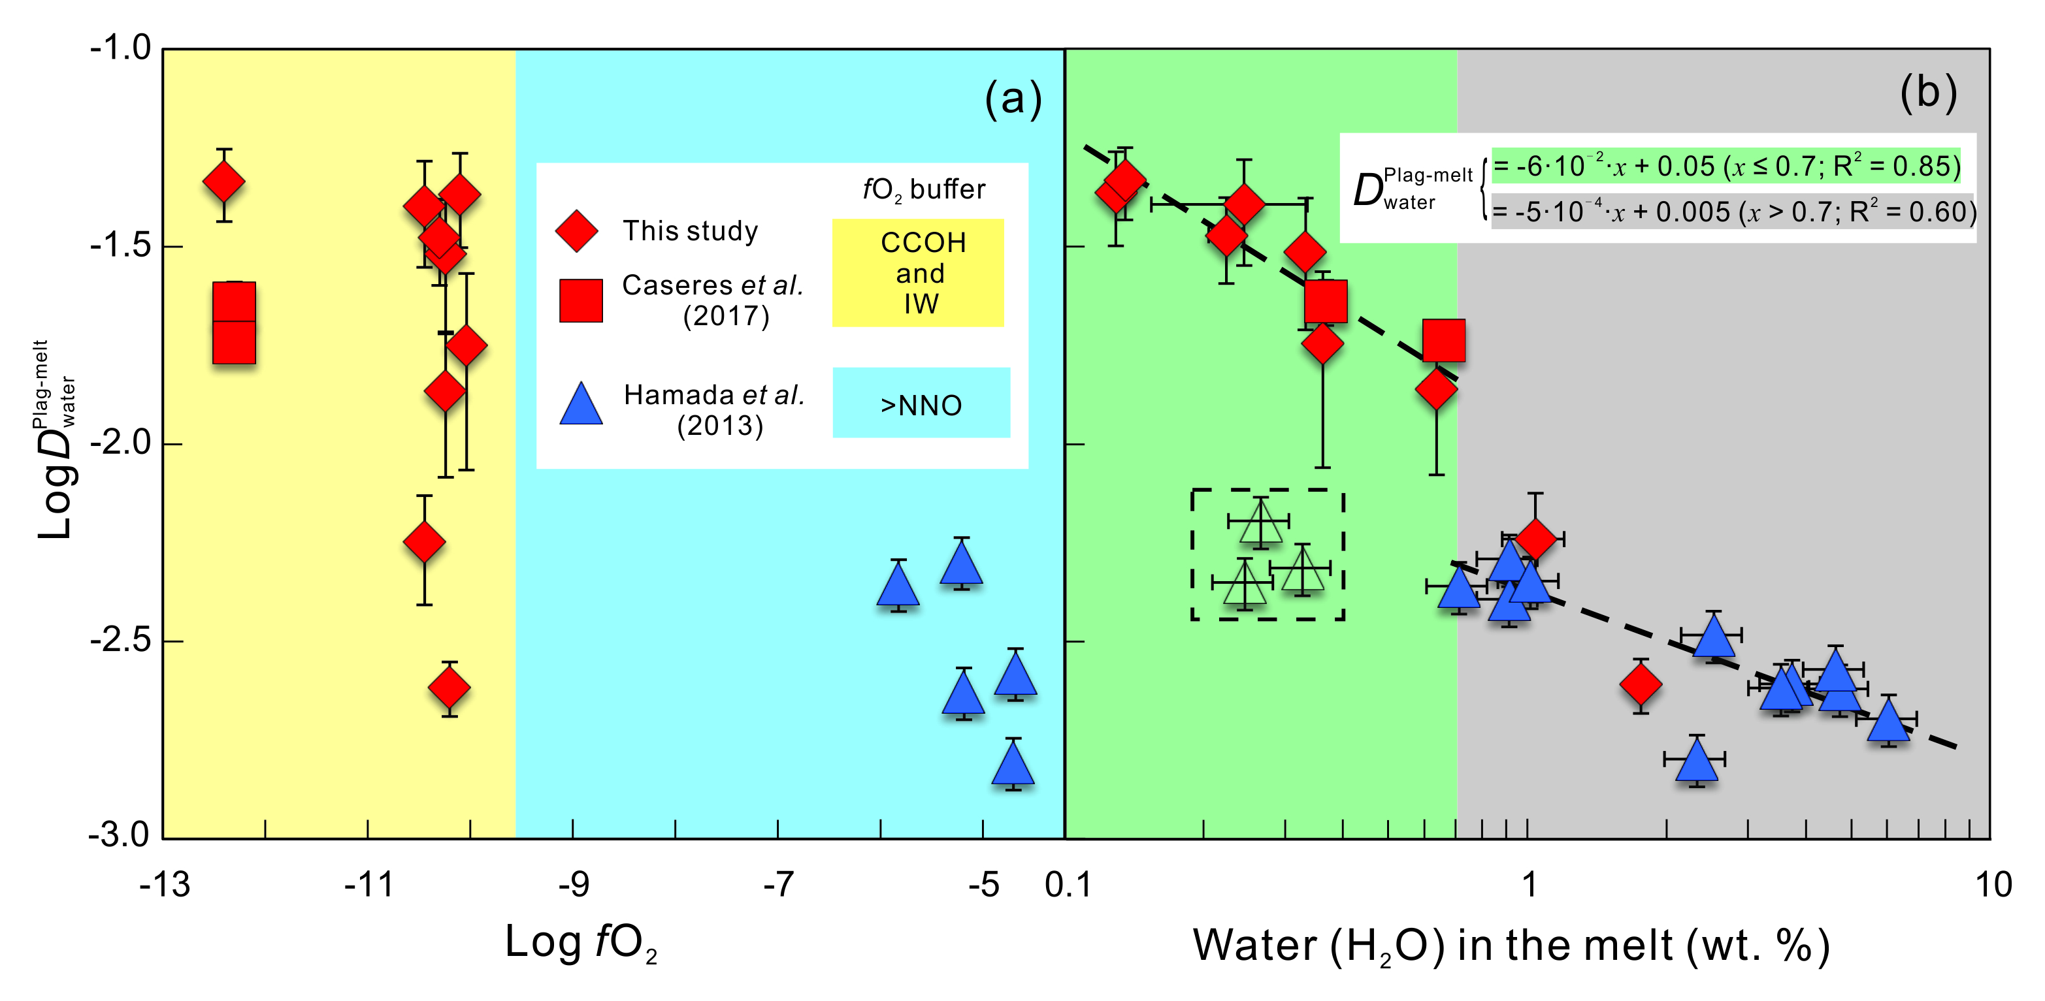
Lin et al.
A lunar hygrometer based on plagioclase-melt partitioning of water
Figure 3 Partition coefficients of water between plagioclase and melt from this study and literature data (Hamada et al., 2013; Caseres et al., 2017), plotted versus (a) oxygen fugacity, and (b) water concentration in silicate melt. Melt inclusion data (Hamada et al., 2013) in the dotted box are not used in this study because the formation temperature of these inclusions and the degree of water loss from inclusions after formation are uncertain.
© 2019 The Authors
Published by the European Association of Geochemistry
under Creative Commons License CC BY 4.0.
Lin et al. (2019) Geochem. Persp. Let. 10, 14-19 | doi: 10.7185/geochemlet.1908
Notes:
Figure 3 Partition coefficients of water between plagioclase and melt from this study and literature data (Hamada et al., 2013; Caseres et al., 2017), plotted versus (a) oxygen fugacity, and (b) water concentration in silicate melt. Melt inclusion data (Hamada et al., 2013) in the dotted box are not used in this study because the formation temperature of these inclusions and the degree of water loss from inclusions after formation are uncertain.

