Slide 1
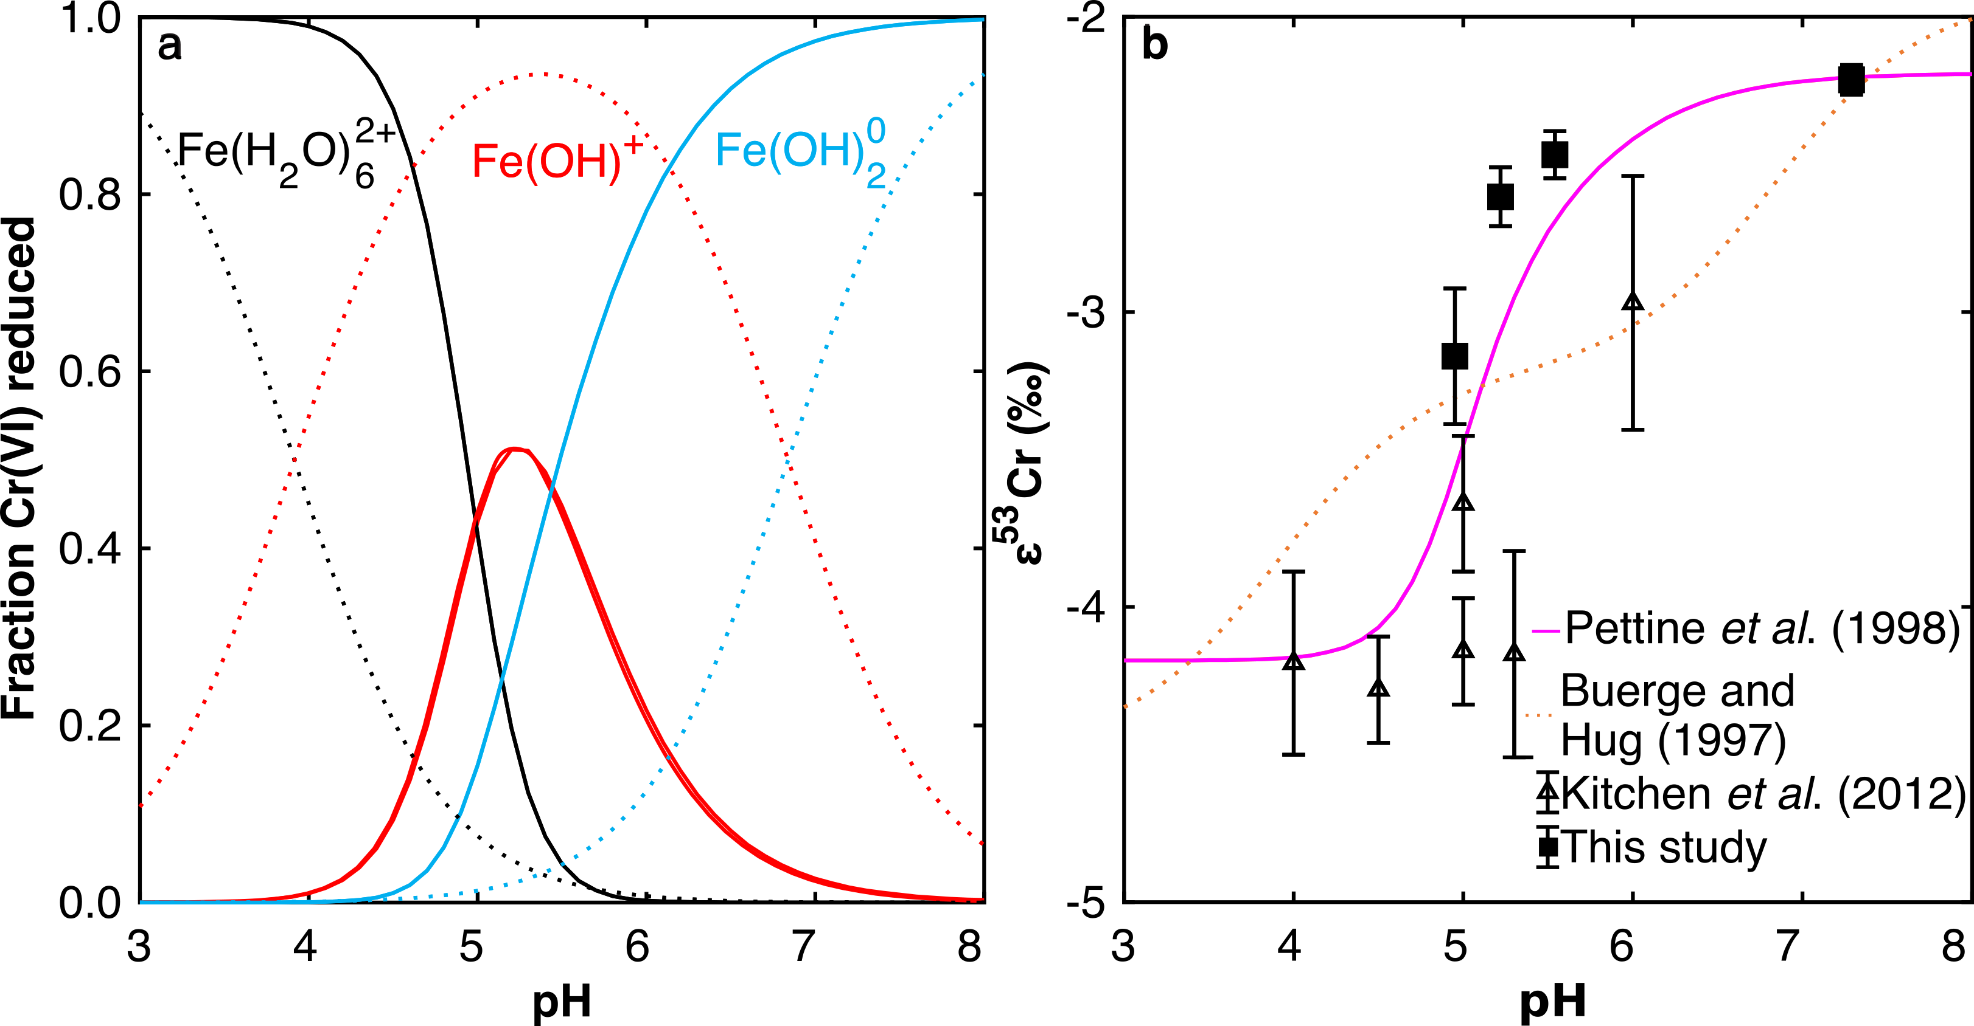
Joe-Wong et al.
Thermodynamic controls on redox-driven kinetic stable isotope fractionation
Figure 3 Effects of pH on the kinetics and isotope fractionation of Cr(VI) reduction by aqueous Fe(II). In both parts, solid lines show the model based on the rate law of Pettine et al. (1998); dashed lines show the model based on the rate law of Buerge and Hug (1997). (a) The fraction of Cr(VI) reduced by each Fe(II) species is contingent on pH-dependent Fe(II) speciation and the rate law of Cr(VI) reduction. (b) The effective fractionation factor is the weighted average of the fractionation factors for Cr(VI) reduction by each Fe(II) species. Error bars on the symbols in (b) are 2 s.d.
© 2019 The Authors
Published by the European Association of Geochemistry
under Creative Commons License CC BY-NC-ND.
Joe-Wong et al. (2019) Geochem. Persp. Let. 10, 20-25 | doi: 10.7185/geochemlet.1909
Notes:
Figure 3 Effects of pH on the kinetics and isotope fractionation of Cr(VI) reduction by aqueous Fe(II). In both parts, solid lines show the model based on the rate law of Pettine et al. (1998); dashed lines show the model based on the rate law of Buerge and Hug (1997). (a) The fraction of Cr(VI) reduced by each Fe(II) species is contingent on pH-dependent Fe(II) speciation and the rate law of Cr(VI) reduction. (b) The effective fractionation factor is the weighted average of the fractionation factors for Cr(VI) reduction by each Fe(II) species. Error bars on the symbols in (b) are 2 s.d.

