Slide 1
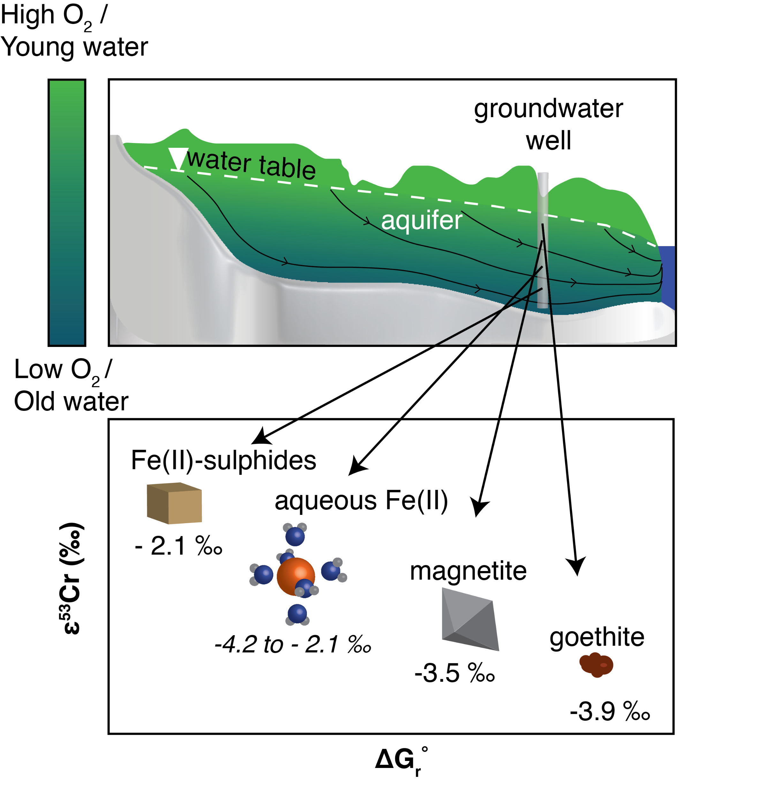
Joe-Wong et al.
Thermodynamic controls on redox-driven kinetic stable isotope fractionation
Figure 4 Schematic of Cr(VI) reduction and variations in ε_{kin} with depth, groundwater age, and oxygen levels. The dominant reductants are ordered according to their relative locations on the redox tower. Kinetic fractionation factors are taken from this study; aqueous Fe(II); Kitchen et al. (2012), aqueous Fe(II); Basu and Johnson (2012), Fe(II)-doped goethite and Fe(II) sulphide, and Ellis et al. (2002), magnetite.
© 2019 The Authors
Published by the European Association of Geochemistry
under Creative Commons License CC BY-NC-ND.
Joe-Wong et al. (2019) Geochem. Persp. Let. 10, 20-25 | doi: 10.7185/geochemlet.1909
Notes:
Figure 4 Schematic of Cr(VI) reduction and variations in ε_{kin} with depth, groundwater age, and oxygen levels. The dominant reductants are ordered according to their relative locations on the redox tower. Kinetic fractionation factors are taken from this study; aqueous Fe(II); Kitchen et al. (2012), aqueous Fe(II); Basu and Johnson (2012), Fe(II)-doped goethite and Fe(II) sulphide, and Ellis et al. (2002), magnetite.

