Slide 1
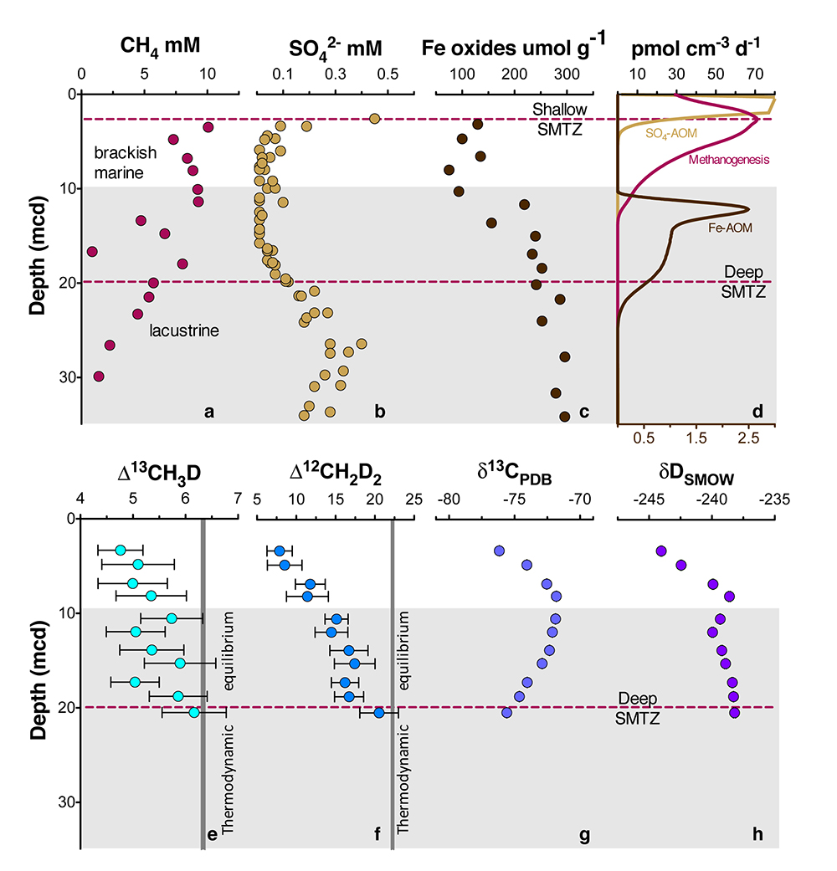
Ash et al.
Exchange catalysis during anaerobic methanotrophy revealed by ¹²CH₂D₂ and ¹³CH₃D in methane
Figure 1 Geochemical profiles (±2 σ) from Bornholm Basin from 3-35 MCD. Horizontal grey bar denotes sediments deposited during lacustrine conditions overlain with sediments deposited during brackish marine conditions. Samples were not recovered above the shallow SMTZ. Pink dashed lines denote a shallow (3.3 MCD) and deep (19.8 MCD) SMTZ; only the shallow SMTZ is shown in the bottom panel for clarity. Dark grey vertical bars in e and f denote equilibrium isotopologue compositions for the subsurface temperature of 7.8 ± 0.6 °C. Modelled CH₄ production, Fe-AOM and SO₄-AOM rates are shown in panel d (Dijkstra et al., 2018). CH₄ production (purple) and SO₄-AOM (gold) rates correspond with the upper x axis and Fe-AOM rates (brown) correspond with the lower x axis. SO₄-AOM rates above the upper SMTZ are calculated using bottom water SO₄ concentrations of 15.0 mM. Additional porewater data shown in Supplementary Information.
© 2019 The Authors
Published by the European Association of Geochemistry
under Creative Commons License CC BY-NC-ND.
Ash et al. (2019) Geochem. Persp. Let. 10, 26-30 | doi: 10.7185/geochemlet.1910
Notes:
Figure 1 Geochemical profiles (±2 σ) from Bornholm Basin from 3-35 MCD. Horizontal grey bar denotes sediments deposited during lacustrine conditions overlain with sediments deposited during brackish marine conditions. Samples were not recovered above the shallow SMTZ. Pink dashed lines denote a shallow (3.3 MCD) and deep (19.8 MCD) SMTZ; only the shallow SMTZ is shown in the bottom panel for clarity. Dark grey vertical bars in e and f denote equilibrium isotopologue compositions for the subsurface temperature of 7.8 ± 0.6 °C. Modelled CH₄ production, Fe-AOM and SO₄-AOM rates are shown in panel d (Dijkstra et al., 2018). CH₄ production (purple) and SO₄-AOM (gold) rates correspond with the upper x axis and Fe-AOM rates (brown) correspond with the lower x axis. SO₄-AOM rates above the upper SMTZ are calculated using bottom water SO₄ concentrations of 15.0 mM. Additional porewater data shown in Supplementary Information.

