Slide 1
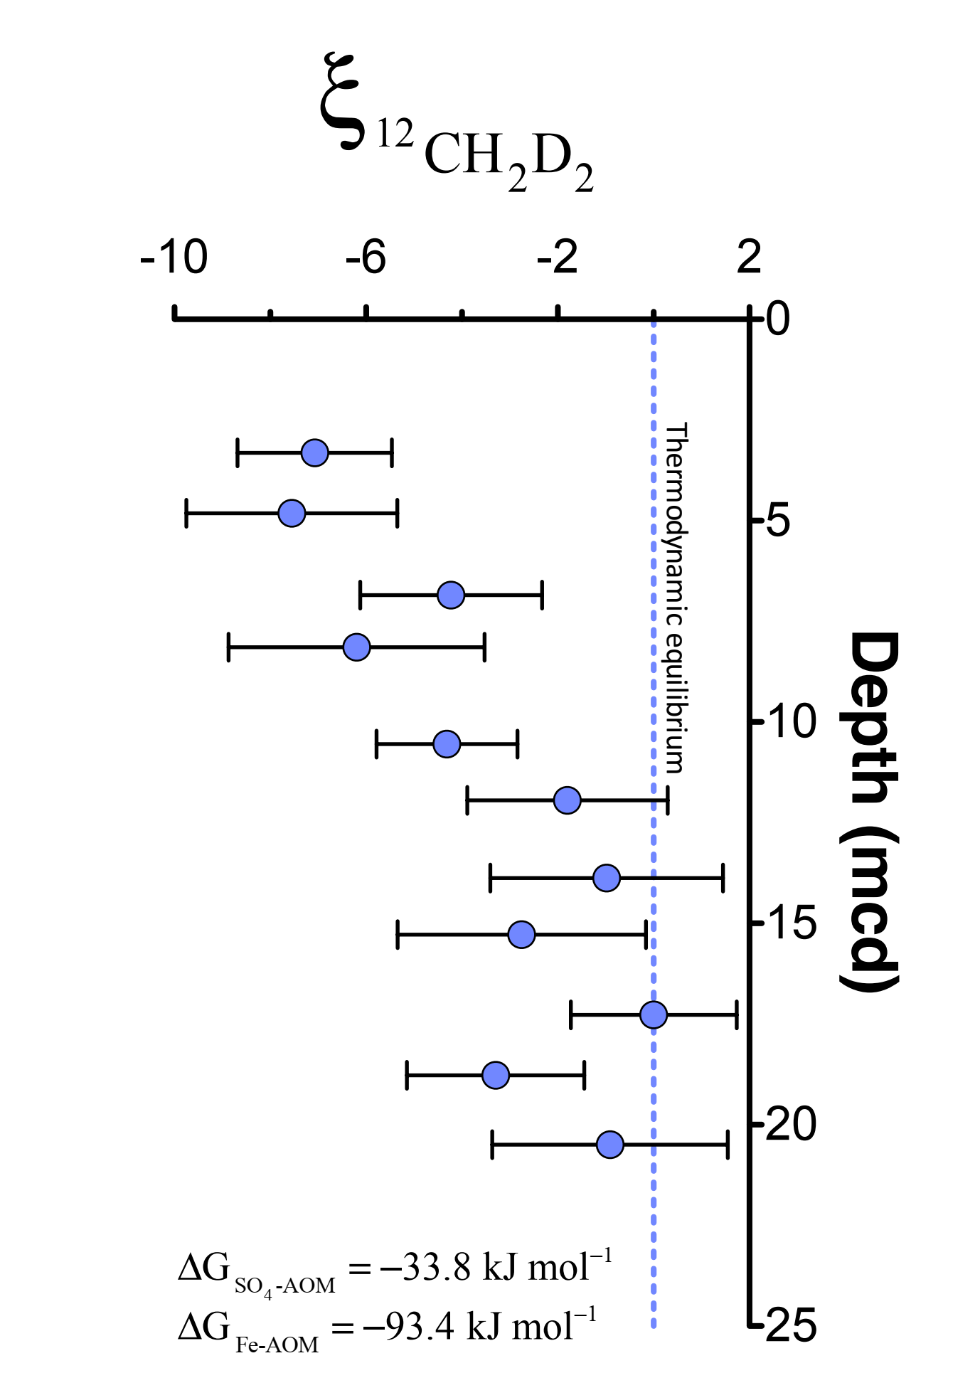
Ash et al.
Exchange catalysis during anaerobic methanotrophy revealed by ¹²CH₂D₂ and ¹³CH₃D in methane
Figure 2 ξ_{12CH2D2} values (±2 σ) are the most negative at shallow MCD, indicating the greatest departure from equilibrium and approach zero (violet dashed line) with increasing MCD, indicating an approach towards intra-species thermodynamic equilibrium. ΔG values for SO₄-AOM and Fe-AOM suggest either metabolism is capable of reversibility (see Supplementary Information).
© 2019 The Authors
Published by the European Association of Geochemistry
under Creative Commons License CC BY-NC-ND.
Ash et al. (2019) Geochem. Persp. Let. 10, 26-30 | doi: 10.7185/geochemlet.1910
Notes:
Figure 2 ξ_{12CH2D2}values (±2 σ) are the most negative at shallow MCD, indicating the greatest departure from equilibrium and approach zero (violet dashed line) with increasing MCD, indicating an approach towards intra-species thermodynamic equilibrium. ΔG values for SO₄-AOM and Fe-AOM suggest either metabolism is capable of reversibility (see Supplementary Information).

