Slide 1
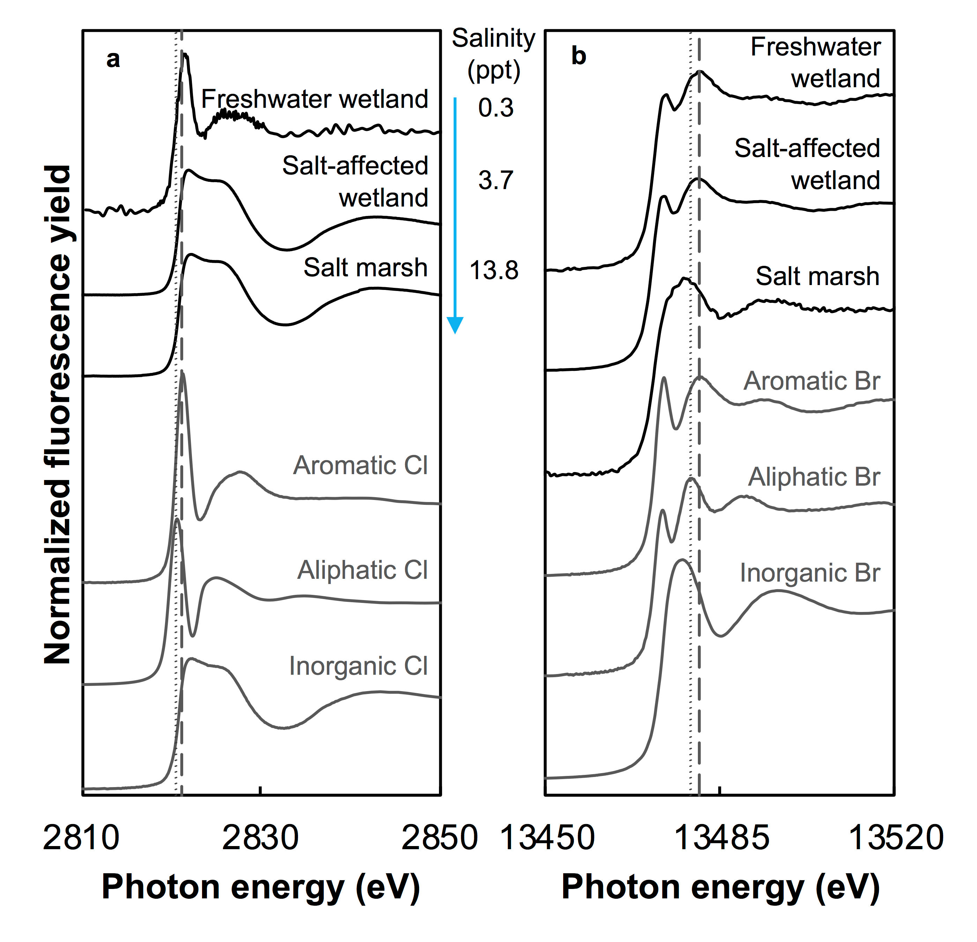
Joe-Wong et al.
Sea level rise produces abundant organobromines in salt-affected coastal wetlands
Figure 1 (a) Cl and (b) Br XANES spectra of top layer of sediments (~0-4 cm) on top (black) and standards (grey) at the bottom. Cl standards are chlorophenol red, chlorodecane, and NaCl (aq) for aromatic, aliphatic, and inorganic Cl respectively. Br standards are bromophenol blue, 1-bromoeicosane, and KBr for aromatic, aliphatic, and inorganic Br respectively. Grey dotted and dashed lines show the spectral maxima for aliphatic and aromatic organohalogen standards respectively.
© 2019 The Authors
Published by the European Association of Geochemistry
under Creative Commons License CC BY-NC-ND.
Joe-Wong et al. (2019) Geochem. Persp. Let. 10, 31-35 | doi: 10.7185/geochemlet.1911
Notes:
Figure 1 (a) Cl and (b) Br XANES spectra of top layer of sediments (~0-4 cm) on top (black) and standards (grey) at the bottom. Cl standards are chlorophenol red, chlorodecane, and NaCl (aq) for aromatic, aliphatic, and inorganic Cl respectively. Br standards are bromophenol blue, 1-bromoeicosane, and KBr for aromatic, aliphatic, and inorganic Br respectively. Grey dotted and dashed lines show the spectral maxima for aliphatic and aromatic organohalogen standards respectively.

