Slide 1
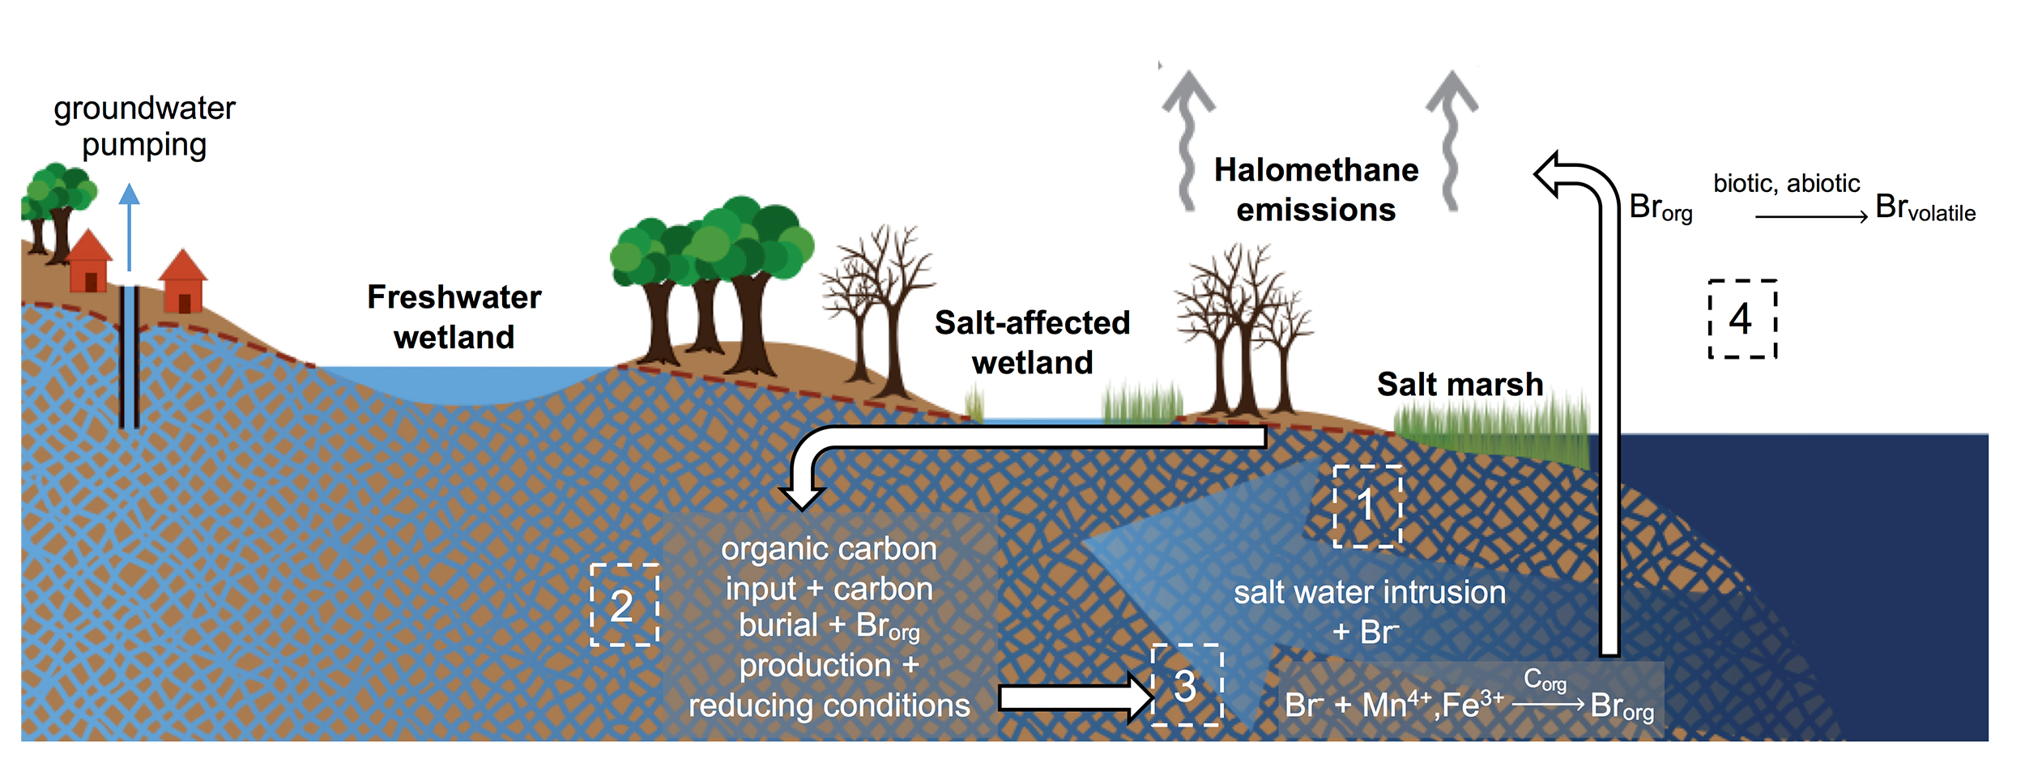
Joe-Wong et al.
Sea level rise produces abundant organobromines in salt-affected coastal wetlands
Figure 4 Schematic diagram showing organic carbon bromination and release of volatile organobromines occurring during coastal flooding by seawater. The reactions begin with seawater intrusion (1), followed by highly favourable Br_{org} production aided by geochemical conditions (2, 3), and ultimately the breakdown and release of this Br_{org} as volatile compounds into the atmosphere (4).
© 2019 The Authors
Published by the European Association of Geochemistry
under Creative Commons License CC BY-NC-ND.
Joe-Wong et al. (2019) Geochem. Persp. Let. 10, 31-35 | doi: 10.7185/geochemlet.1911
Notes:
Figure 4 Schematic diagram showing organic carbon bromination and release of volatile organobromines occurring during coastal flooding by seawater. The reactions begin with seawater intrusion (1), followed by highly favourable Br_{org} production aided by geochemical conditions (2, 3), and ultimately the breakdown and release of this Br_{org} as volatile compounds into the atmosphere (4).

