Slide 1
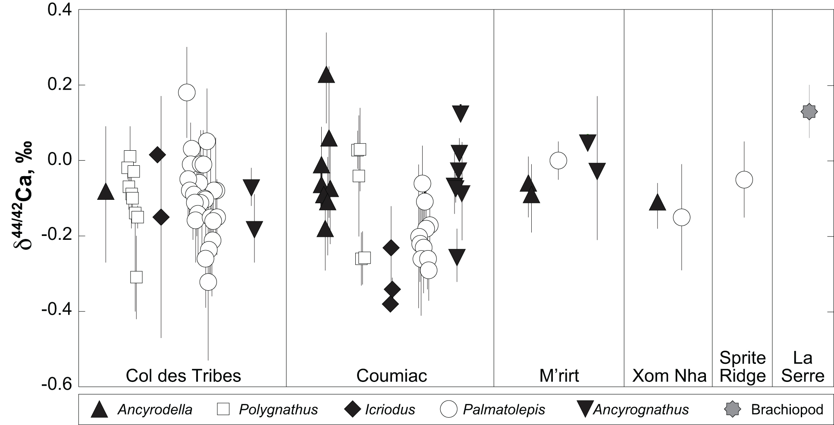
Balter et al.
Calcium stable isotopes place Devonian conodonts as first level consumers
Figure 1 Ca isotope compositions of conodonts (δ^{44/42}Ca) relative to SRM915a (‰) measured in the study.
© 2019 The Authors
Published by the European Association of Geochemistry
under Creative Commons License CC BY-NC-ND.
Balter et al. (2019) Geochem. Persp. Let. 10, 36-39 | doi: 10.7185/geochemlet.1912
Notes:
Figure 1 Ca isotope compositions of conodonts (δ^{44/42}Ca) relative to SRM915a (‰) measured in the study.

