Slide 1
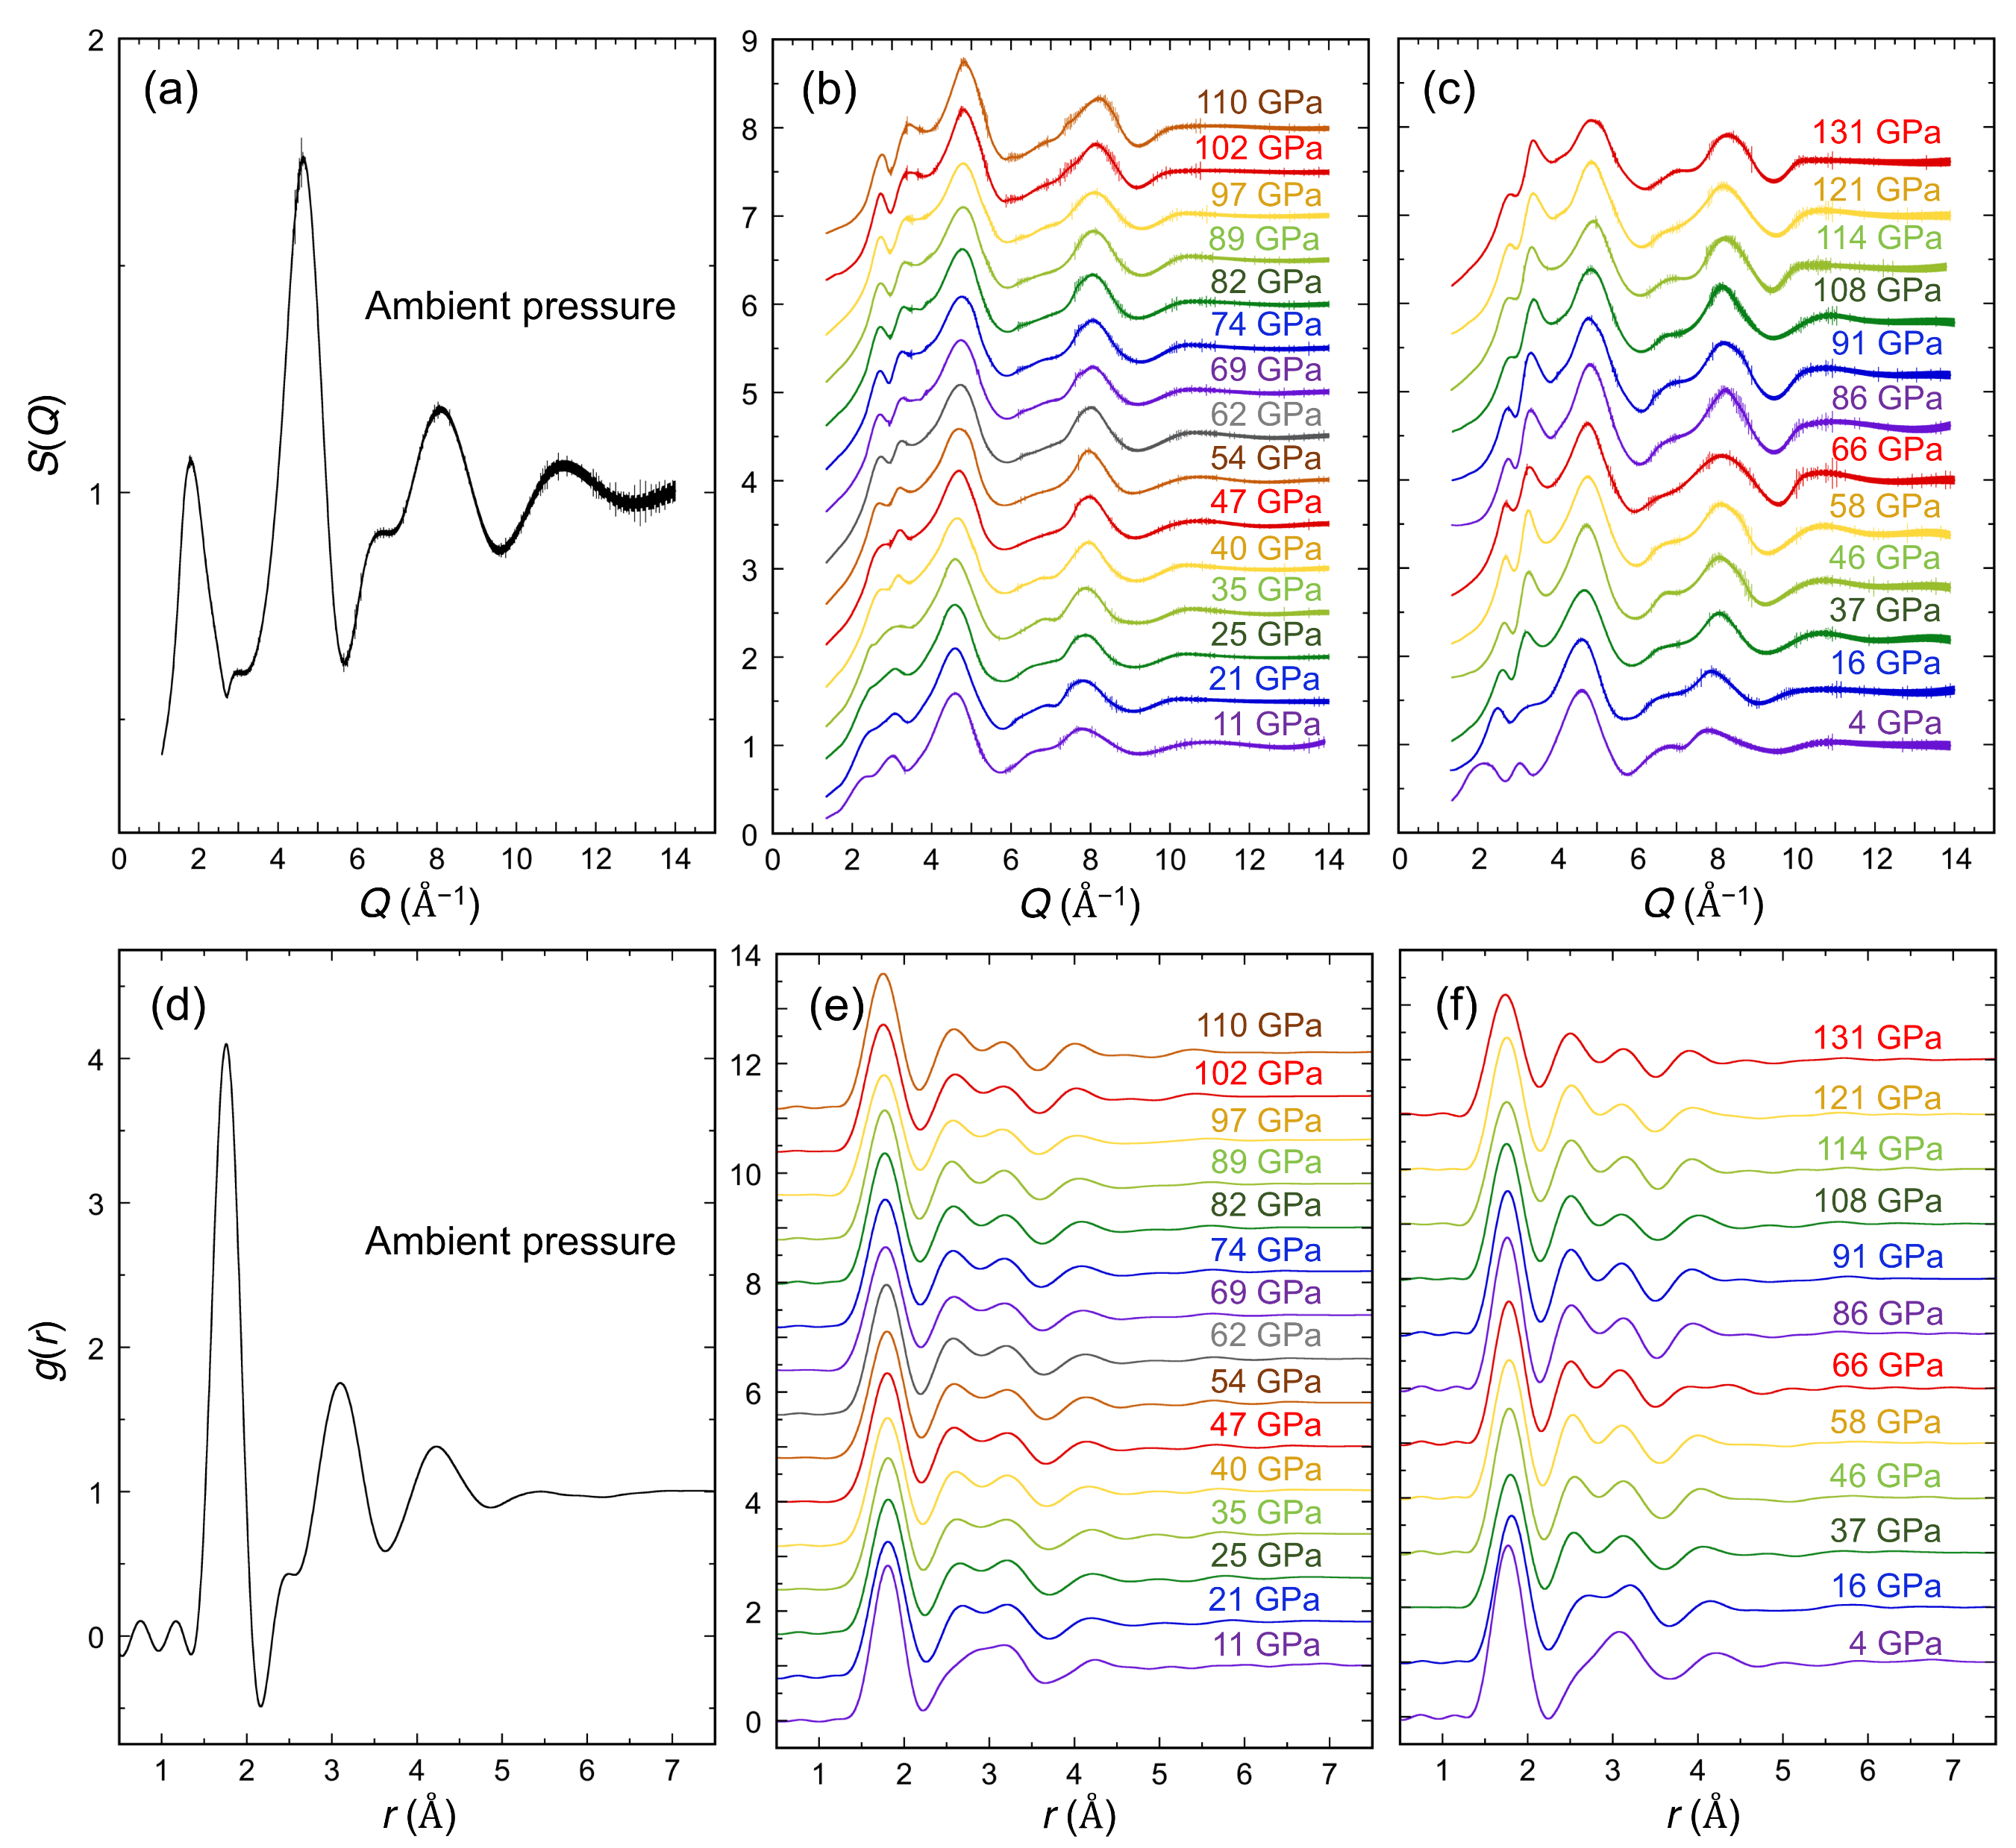
Ohira et al.
Ultrahigh pressure structural changes in a 60 mol. % Al₂O₃–40 mol. % SiO₂ glass
Figure 1 Structure factors, S(Q), determined at the Q range up to 14 Å⁻¹ and pair distribution functions, g(r), of the A40S glass up to 131 GPa. (a) S(Q) at ambient condition. (b-c) S(Q) at high pressures displayed by a vertical offset of 0.5 and 0.6 in (b) for experiment 1 and (c) for experiment 2, respectively. (d) g(r) at ambient condition. (e-f) g(r) at high pressures displayed by a vertical offset of 0.8 and 1.0 in (e) for experiment 1 and (f) for experiment 2, respectively.
© 2019 The Authors
Published by the European Association of Geochemistry
under Creative Commons License CC BY-NC-ND.
Ohira et al. (2019) Geochem. Persp. Let. 10, 41-45 | doi: 10.7185/geochemlet.1913
Notes:
Figure 1 Structure factors, S(Q), determined at the Q range up to 14 Å⁻¹ and pair distribution functions, g(r), of the A40S glass up to 131 GPa. (a) S(Q) at ambient condition. (b-c) S(Q) at high pressures displayed by a vertical offset of 0.5 and 0.6 in (b) for experiment 1 and (c) for experiment 2, respectively. (d) g(r) at ambient condition. (e-f) g(r) at high pressures displayed by a vertical offset of 0.8 and 1.0 in (e) for experiment 1 and (f) for experiment 2, respectively.

