Slide 1
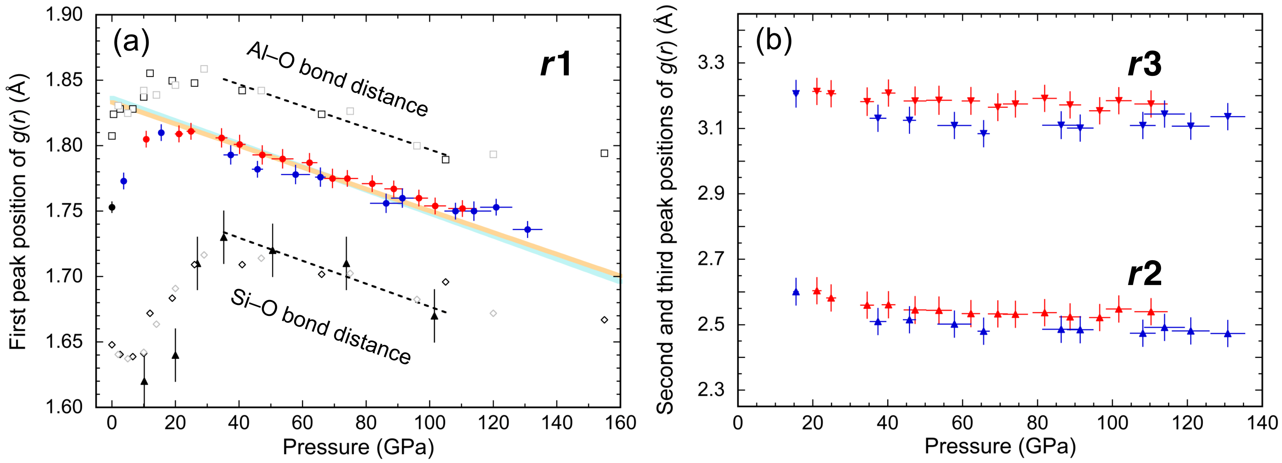
Ohira et al.
Ultrahigh pressure structural changes in a 60 mol. % Al₂O₃–40 mol. % SiO₂ glass
Figure 2 The first (r1), second (r2), and third (r3) peak positions of g(r) of the A40S glass. (a) Red, blue, and black circles indicate the r1 determined in the high pressure experiments 1 and 2, and at ambient pressure, respectively. Triangles indicate the Si–O bond distance in SiO₂ glass (Sato and Funamori, 2010). Open diamonds and squares indicate the Si–O and Al–O bond distance in CaAl₂Si₂O₈ glass, respectively, simulated with 416 (black) and 208 (gray) atom simulation cells (Ghosh and Karki, 2018). The black dash lines are obtained from fitting for …
© 2019 The Authors
Published by the European Association of Geochemistry
under Creative Commons License CC BY-NC-ND.
Ohira et al. (2019) Geochem. Persp. Let. 10, 41-45 | doi: 10.7185/geochemlet.1913
Notes:
Figure 2 The first (r1), second (r2), and third (r3) peak positions of g(r) of the A40S glass. (a) Red, blue, and black circles indicate the r1 determined in the high pressure experiments 1 and 2, and at ambient pressure, respectively. Triangles indicate the Si–O bond distance in SiO₂ glass (Sato and Funamori, 2010). Open diamonds and squares indicate the Si–O and Al–O bond distance in CaAl₂Si₂O₈ glass, respectively, simulated with 416 (black) and 208 (gray) atom simulation cells (Ghosh and Karki, 2018). The black dash lines are obtained from fitting for the Si–O and Al–O bond distances with CN = ~6. The light blue and orange lines are obtained from fitting the r1 of A40S glass at 35–102 GPa using the dr_{Si–O(6CN)}/dP and the dr_{Al–O(6CN)}/dP, respectively. The widths of lines indicate the fitting errors. (b) The r2 and r3 of the A40S glass determined in the experiments 1 (red) and 2 (blue), respectively.

