Slide 1
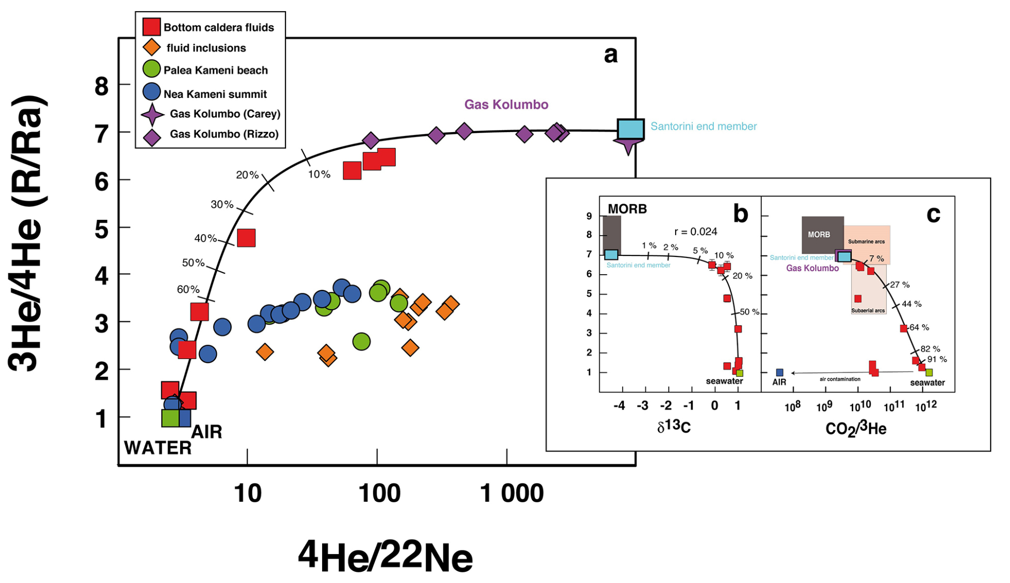
Moreira et al.
New insights into the plumbing system of Santorini using helium and carbon isotopes
Figure 2 (a) Mixing diagram showing the ³He/⁴He ratio reported against ⁴He/²²Ne (Ra is the helium atmospheric isotopic ratio). The mantle-derived end member has a ³He/⁴He ratio of ~ 7 Ra, identical to the value of the nearby Kolumbo volcano (Carey et al., 2013; Rizzo et al., 2016) suggesting a common mantle source. All samples from Palea or Nea Kameni (gases and fluid/melt inclusions in phenocrysts) show a different trend, with a lower ³He/⁴He ratio ...
© 2019 The Authors
Published by the European Association of Geochemistry
under Creative Commons License CC BY-NC-ND.
Moreira et al. (2019) Geochem. Persp. Let. 10, 46-50 | doi: 10.7185/geochemlet.1914
Notes:
Figure 2 (a) Mixing diagram showing the ³He/⁴He ratio reported against ⁴He/²²Ne (Ra is the helium atmospheric isotopic ratio). The mantle-derived end member has a ³He/⁴He ratio of ~ 7 Ra, identical to the value of the nearby Kolumbo volcano (Carey et al., 2013; Rizzo et al., 2016) suggesting a common mantle source. All samples from Palea or Nea Kameni (gases and fluid/melt inclusions in phenocrysts) show a different trend, with a lower ³He/⁴He ratio reflecting shallow crustal assimilation (Shimizu et al., 2005; Rizzo et al., 2015). The insert shows the ³He/⁴He ratio versus δ¹³C (b) and CO₂/³He (c). The strong hyperbolic curvature of the mixing curve reported in insert (b) reflects the (⁴He/CO₂)_{seawater}/(⁴He/CO₂)_{MORB} ratio of ~0.024, explaining why the δ¹³C does not show a mantle value whereas helium almost does. Percentages that are indicated on the mixing curves represent the fraction of seawater-derived helium.

