Slide 1
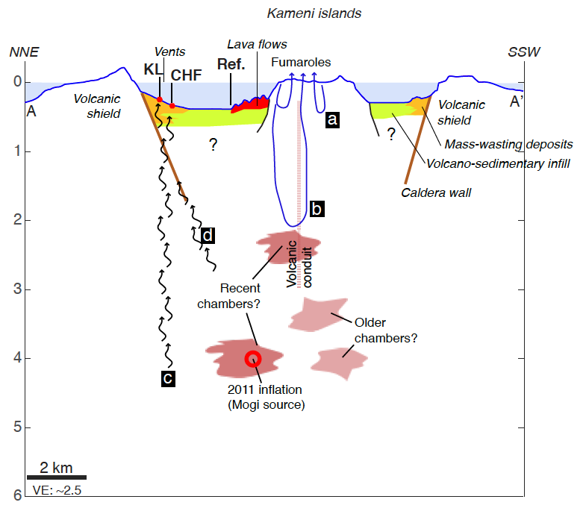
Moreira et al.
New insights into the plumbing system of Santorini using helium and carbon isotopes
Figure 3 Possible sources and transfer of magmatic CO₂ and He within the Santorini caldera. Gases from Nea Kameni derive from a shallow reservoir, which is degassed and has assimilated crustal rocks, sampled by hydrothermal circulation (a, b). A pristine mantle signature is sampled by fluids at the Kalisti Limnes and hydrothermal areas. These fluids may either percolate through the volcanic shield and the pre-volcanic basement (c), or be supplied from a more central area and in association with recent magma chambers, if the fluids migrate along caldera walls and associated caldera faults (d).
© 2019 The Authors
Published by the European Association of Geochemistry
under Creative Commons License CC BY-NC-ND.
Moreira et al. (2019) Geochem. Persp. Let. 10, 46-50 | doi: 10.7185/geochemlet.1914
Notes:
Figure 3 Possible sources and transfer of magmatic CO₂ and He within the Santorini caldera. Gases from Nea Kameni derive from a shallow reservoir, which is degassed and has assimilated crustal rocks, sampled by hydrothermal circulation (a, b). A pristine mantle signature is sampled by fluids at the Kalisti Limnes and hydrothermal areas. These fluids may either percolate through the volcanic shield and the pre-volcanic basement (c), or be supplied from a more central area and in association with recent magma chambers, if the fluids migrate along caldera walls and associated caldera faults (d).

