Slide 1
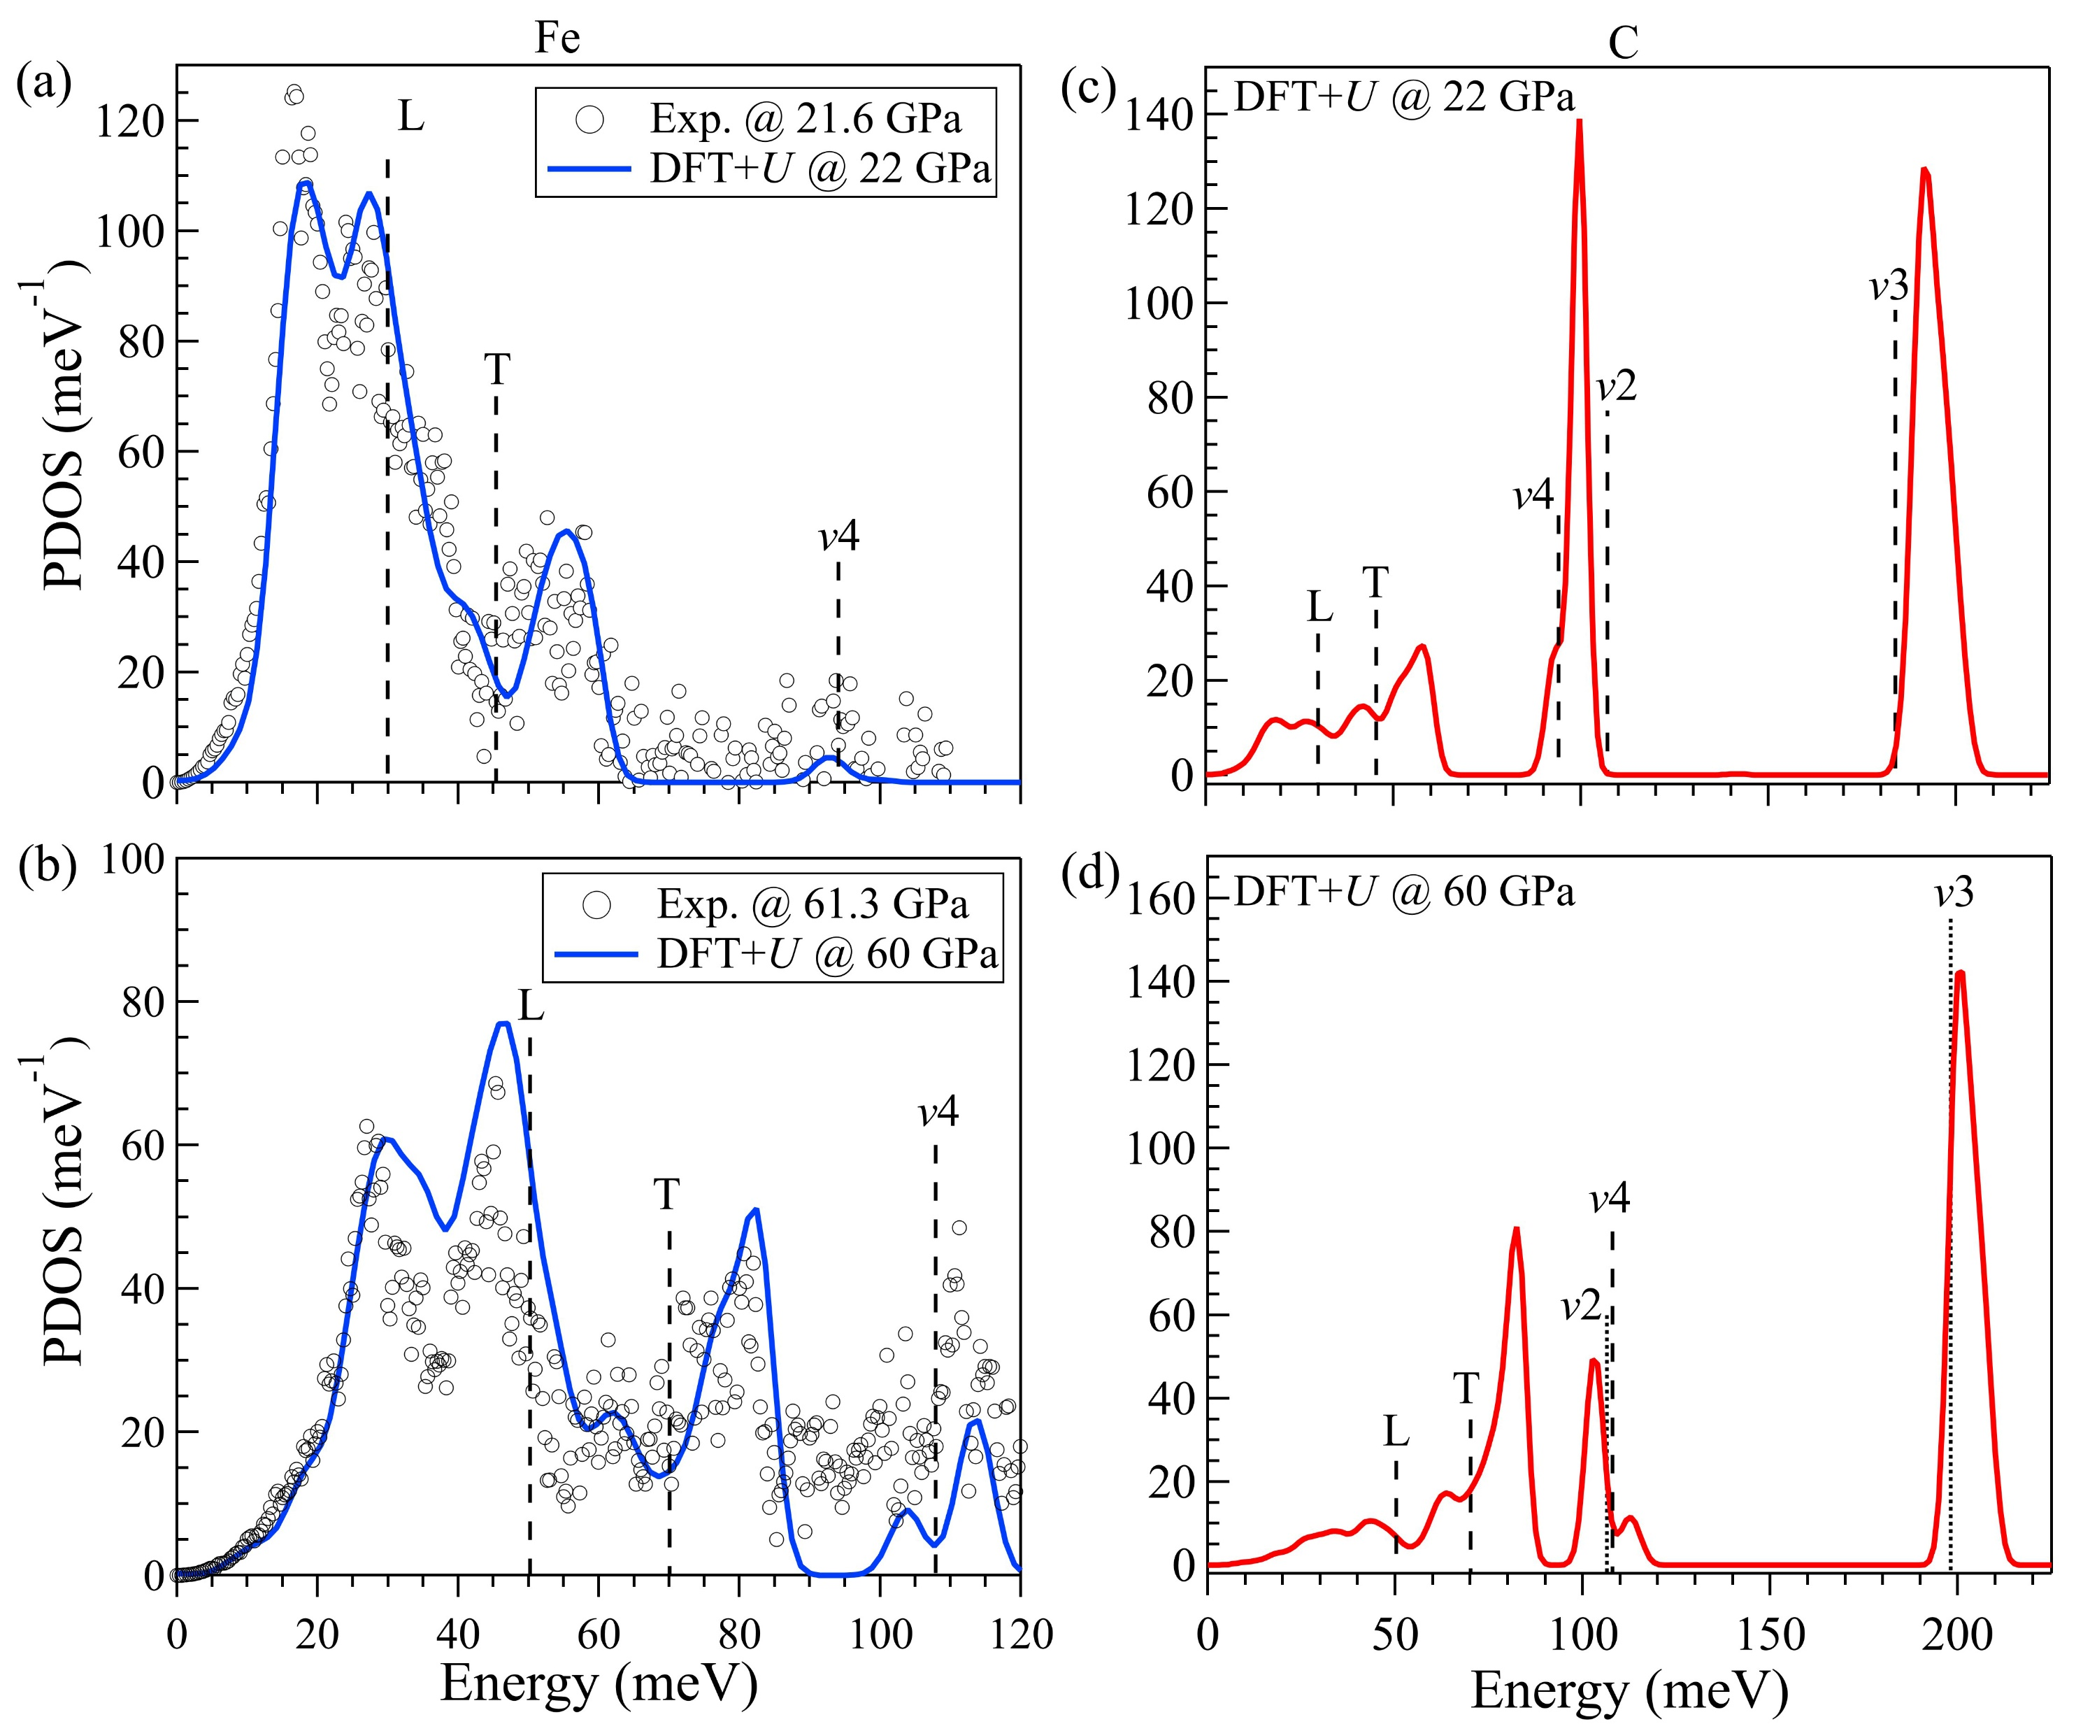
Liu et al.
Carbon isotopic signatures of super-deep diamonds mediated by iron redox chemistry
Figure 1 Partial phonon density of states (PDOS) of ⁵⁷Fe (a, b) and ¹²C (c, d) in FeCO₃ at high pressures. In (a) and (b), the open cycles are PDOS of Fe measured by NRIXS; the blue curves are calculated PDOS of Fe by DFT + U. The red curves in (c) and (d) are calculated PDOS of C. The lowest energy peak at 20-40 meV can be attributed to the acoustic phonons. According to previous high pressure Raman and infrared studies of FeCO₃ (Santillán and Williams, 2004; Lin et al., 2012), the other peaks can be assigned to librational mode (L), translational mode (T) and in-plane bending mode (v4), out of plane bending vibration (v2) and asymmetric stretch (v3) of CO₃²⁻ (marked as dashed vertical lines). The energies of v2 and v3 modes…
© 2019 The Authors
Published by the European Association of Geochemistry
under Creative Commons License CC BY-NC-ND.
Liu et al. (2019) Geochem. Persp. Let. 10, 51-55 | doi: 10.7185/geochemlet.1915
Notes:
Figure 1 Partial phonon density of states (PDOS) of ⁵⁷Fe (a, b) and ¹²C (c, d) in FeCO₃ at high pressures. In (a) and (b), the open cycles are PDOS of Fe measured by NRIXS; the blue curves are calculated PDOS of Fe by DFT + U. The red curves in (c) and (d) are calculated PDOS of C. The lowest energy peak at 20-40 meV can be attributed to the acoustic phonons. According to previous high pressure Raman and infrared studies of FeCO₃ (Santillán and Williams, 2004; Lin et al., 2012), the other peaks can be assigned to librational mode (L), translational mode (T) and in-plane bending mode (v4), out of plane bending vibration (v2) and asymmetric stretch (v3) of CO₃²⁻ (marked as dashed vertical lines). The energies of v2 and v3 modes (marked as dotted vertical lines) at 60 GPa are linearly extrapolated from those measured up to 50 GPa for FeCO₃ (Santillán and Williams, 2004). In the PDOS of Fe at 60 GPa (b), the splitting of v4 mode at approximately 100-120 meV has also been observed in a previous Raman study (Lin et al., 2012), which is explained as a result of the enhanced interaction between low-spin Fe²⁺ and neighbouring CO₃²⁻ units.

