Slide 1
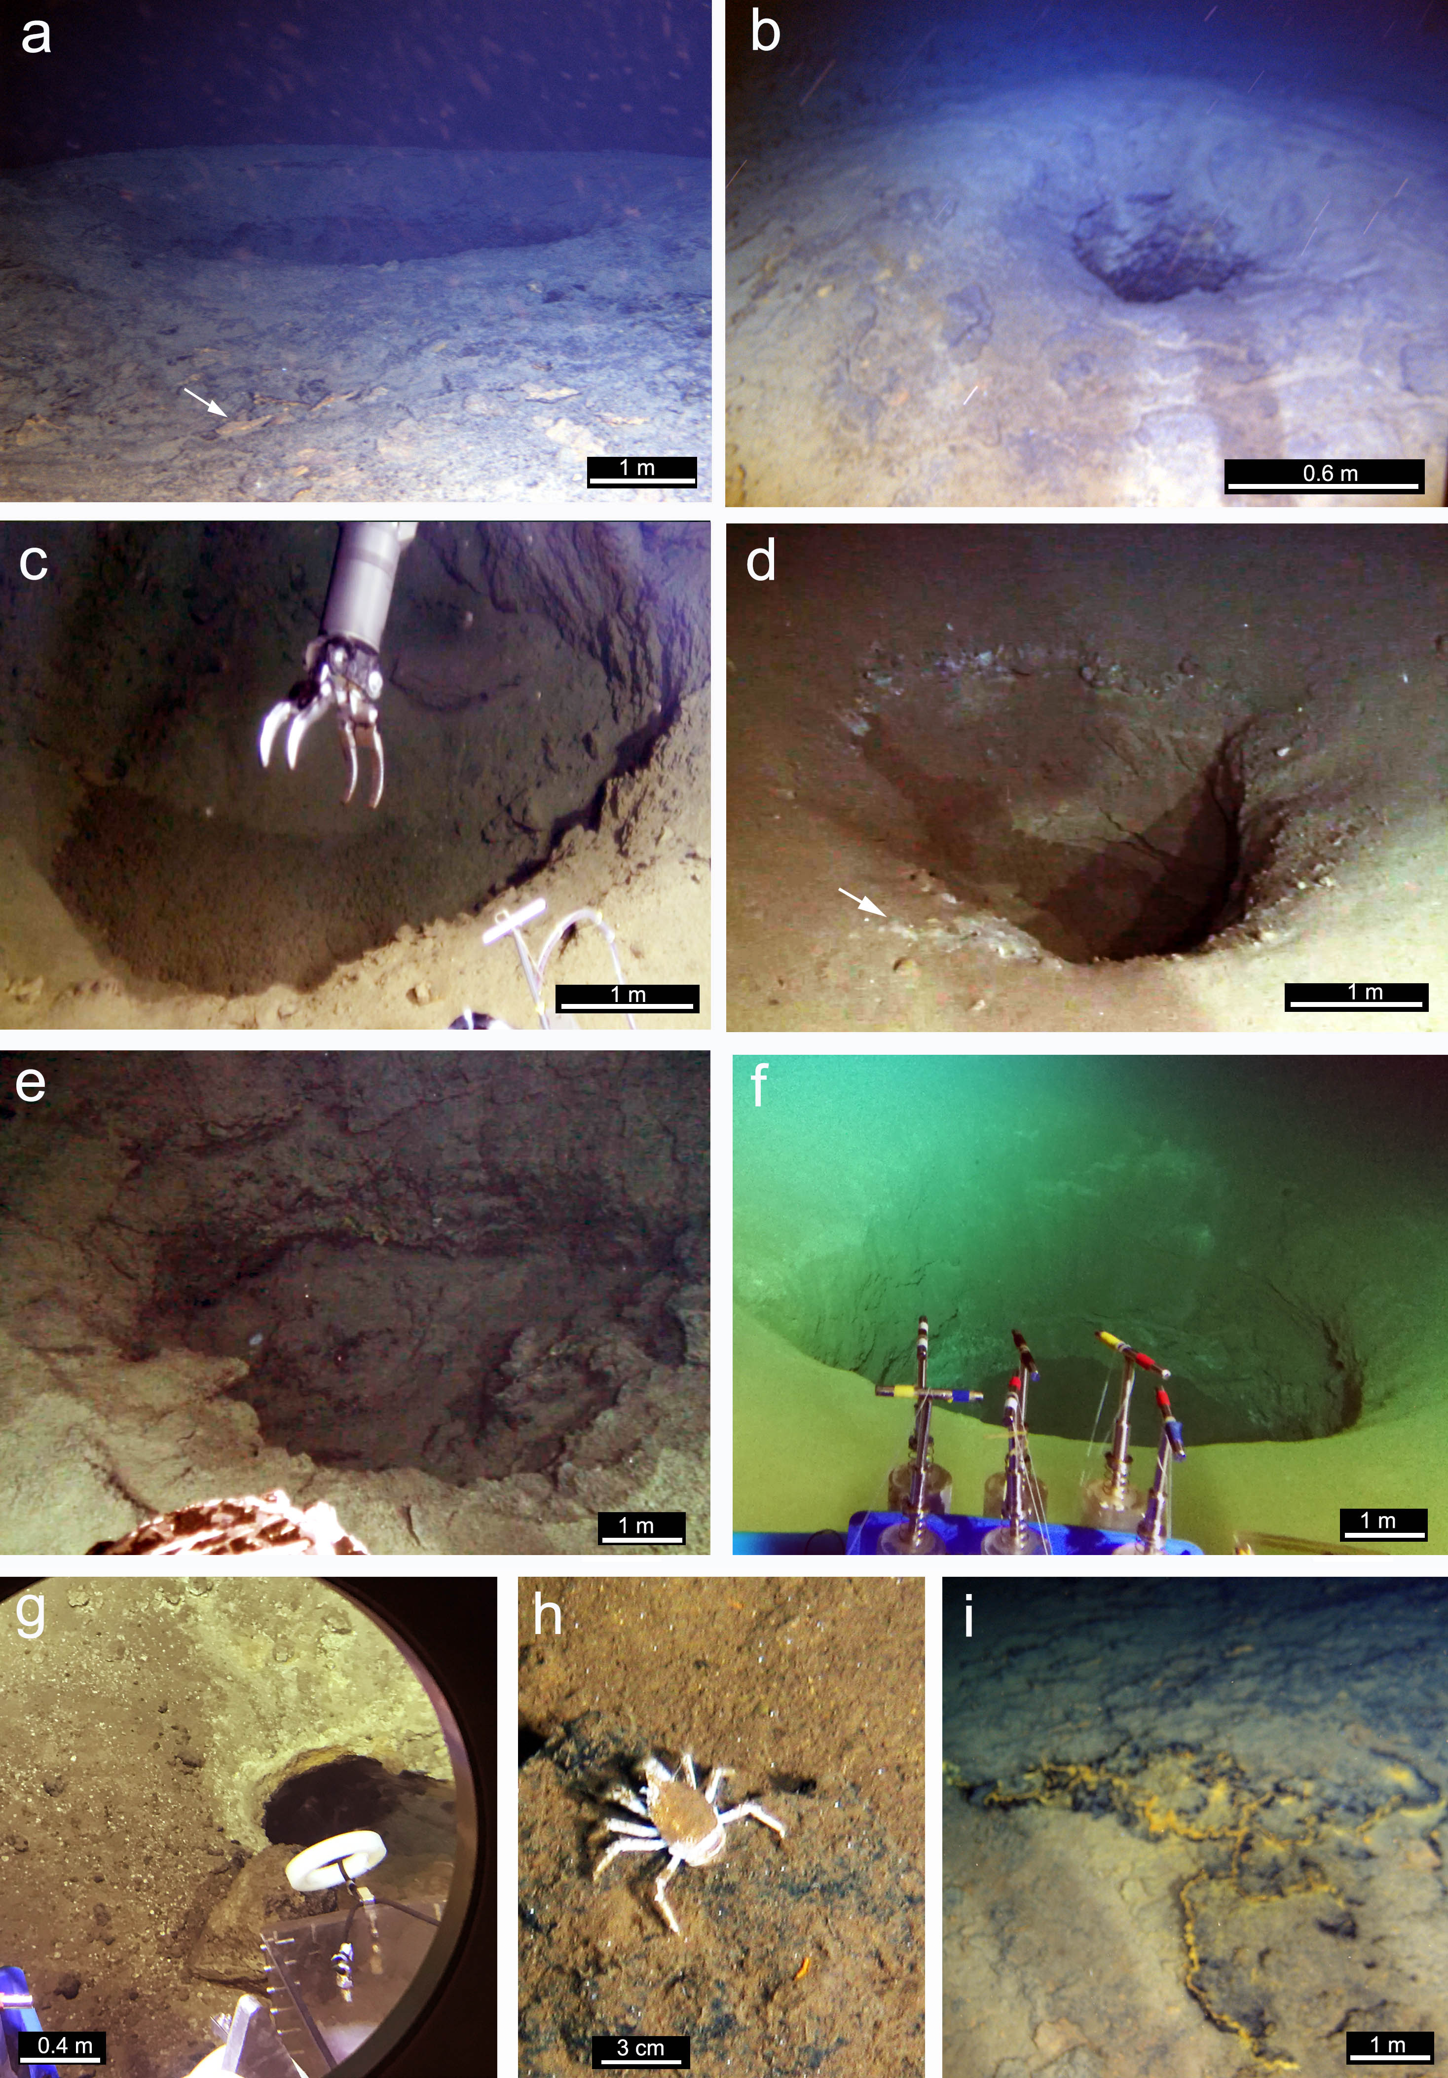
Du et al.
Fluid discharge linked to bending of the incoming plate at the Mariana subduction zone
Figure 2 Fluid discharge points and pockmarks in the southern Mariana trench. (a) A small fluid discharge point (#JL114-1 at 5445 m) in the eastern portion of site M. The yellow-reddish solidified materials marked by arrows at the margin of the crater consist mostly of iddingsite. (b) Close-up of the top of a fluid discharge point (#JL114-1 at 5445 m) showing a feeder channel with a diameter of ~ 0.6 m. (c) A pockmark (#JL115-1 at 5445 m) of ~5 m in diameter in the western portion of site M. The muds are primarily composed of iddingsite. (d) A shallow pockmark (#JL114-2 at 5445 m) that consists primarily of iddingiste in the western portion of site M. White materials marked by arrows are zeolites that are also low grade alteration products of basaltic rocks. (e) A fluid discharge point (#JL114-3 at 5445 m) with a blocked feeder channel in the eastern portion of site M. (f) An iddingsite pockmark (#JL144-1 at 6300 m) with a diameter of ~4 m and a depth of ~3 m at site N. (g) A small iddingsite pockmark (#JL146-1 at 6669 m) at site P. (h) A white Galatheid crab on a dark manganese crust that forms within iddingsite-rich muds at site M. (i) Blanket-like iddingsite muds with a dark manganese coating on the base of a fluid discharge point at site M.
© 2019 The Authors
Published by the European Association of Geochemistry
under Creative Commons License CC BY-NC-ND.
Du et al. (2019) Geochem. Persp. Let. 11, 1-5 | doi: 10.7185/geochemlet.1916
Notes:
Figure 2 Fluid discharge points and pockmarks in the southern Mariana trench. (a) A small fluid discharge point (#JL114-1 at 5445 m) in the eastern portion of site M. The yellow-reddish solidified materials marked by arrows at the margin of the crater consist mostly of iddingsite. (b) Close-up of the top of a fluid discharge point (#JL114-1 at 5445 m) showing a feeder channel with a diameter of ~ 0.6 m. (c) A pockmark (#JL115-1 at 5445 m) of ~5 m in diameter in the western portion of site M. The muds are primarily composed of iddingsite. (d) A shallow pockmark (#JL114-2 at 5445 m) that consists primarily of iddingiste in the western portion of site M. White materials marked by arrows are zeolites that are also low grade alteration products of basaltic rocks. (e) A fluid discharge point (#JL114-3 at 5445 m) with a blocked feeder channel in the eastern portion of site M. (f) An iddingsite pockmark (#JL144-1 at 6300 m) with a diameter of ~4 m and a depth of ~3 m at site N. (g) A small iddingsite pockmark (#JL146-1 at 6669 m) at site P. (h) A white Galatheid crab on a dark manganese crust that forms within iddingsite-rich muds at site M. (i) Blanket-like iddingsite muds with a dark manganese coating on the base of a fluid discharge point at site M.

