Slide 1
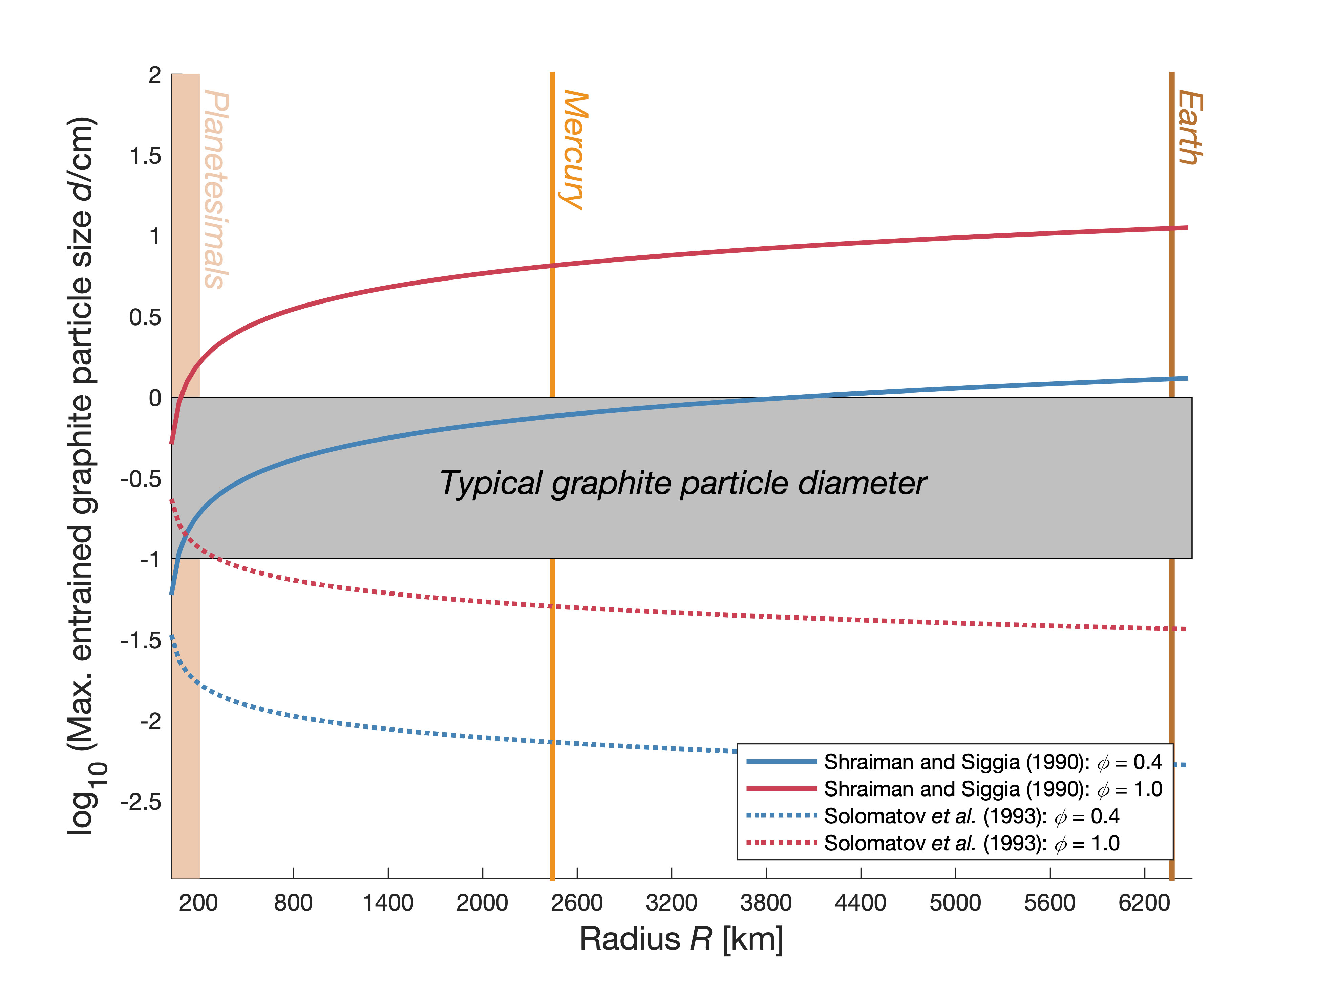
Keppler and Golabek
Graphite floatation on a magma ocean and the fate of carbon during core formation
Figure 2 Two estimates for the diameter of the largest graphite particles that can be entrained in both a partially (ϕ = 0.4) and a fully molten (ϕ = 1.0) convecting magma ocean for planetary objects ranging from 25 km radius up to Earth’s radius. The grey band indicates typical diameters of graphite particles found in meteorites.
© 2019 The Authors
Published by the European Association of Geochemistry
under Creative Commons License CC BY-NC-ND.
Keppler and Golabek (2019) Geochem. Persp. Let. 11, 12-17 | doi: 10.7185/geochemlet.1918
Notes:
Figure 2 Two estimates for the diameter of the largest graphite particles that can be entrained in both a partially (ϕ = 0.4) and a fully molten (ϕ = 1.0) convecting magma ocean for planetary objects ranging from 25 km radius up to Earth’s radius. The grey band indicates typical diameters of graphite particles found in meteorites.

