Slide 1
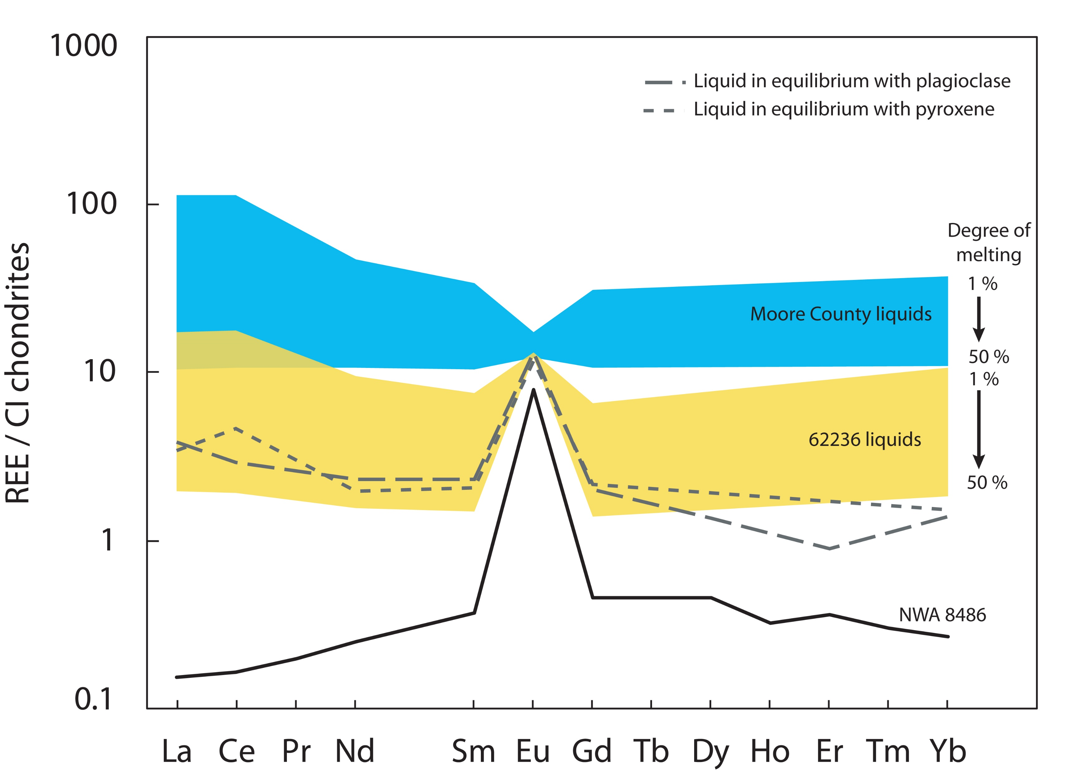
Frossard et al.
Evidence for anorthositic crust formed on an inner solar system planetesimal
Figure 3 REE composition of liquids in equilibrium with NWA 8486 minerals (in grey dashed lines) compared to liquids modelled with compositions of the cumulate eucrite Moore County and the pyroxene-rich lunar anorthosite Apollo 62236, normalised to CI chondrites (Anders and Grevesse, 1989). A non-modal melting is considered, in agreement with petrological constraints, of eutectic proportions of 42 % plagioclase and 58 % pyroxene (Osborn, 1942). The range of composition of the liquids from 1 % to 50 % degree of melting is represented for each source composition. NWA 8486 whole rock composition is shown (black line) for comparison. See Supplementary Information for details on the model.
© 2019 The Authors
Published by the European Association of Geochemistry
under Creative Commons License CC BY-NC-ND.
Frossard et al. (2019) Geochem. Persp. Let. 11, 28-32 | doi: 10.7185/geochemlet.1921
Notes:
Figure 3 REE composition of liquids in equilibrium with NWA 8486 minerals (in grey dashed lines) compared to liquids modelled with compositions of the cumulate eucrite Moore County and the pyroxene-rich lunar anorthosite Apollo 62236, normalised to CI chondrites (Anders and Grevesse, 1989). A non-modal melting is considered, in agreement with petrological constraints, of eutectic proportions of 42 % plagioclase and 58 % pyroxene (Osborn, 1942). The range of composition of the liquids from 1 % to 50 % degree of melting is represented for each source composition. NWA 8486 whole rock composition is shown (black line) for comparison. See Supplementary Information for details on the model.

