Slide 1
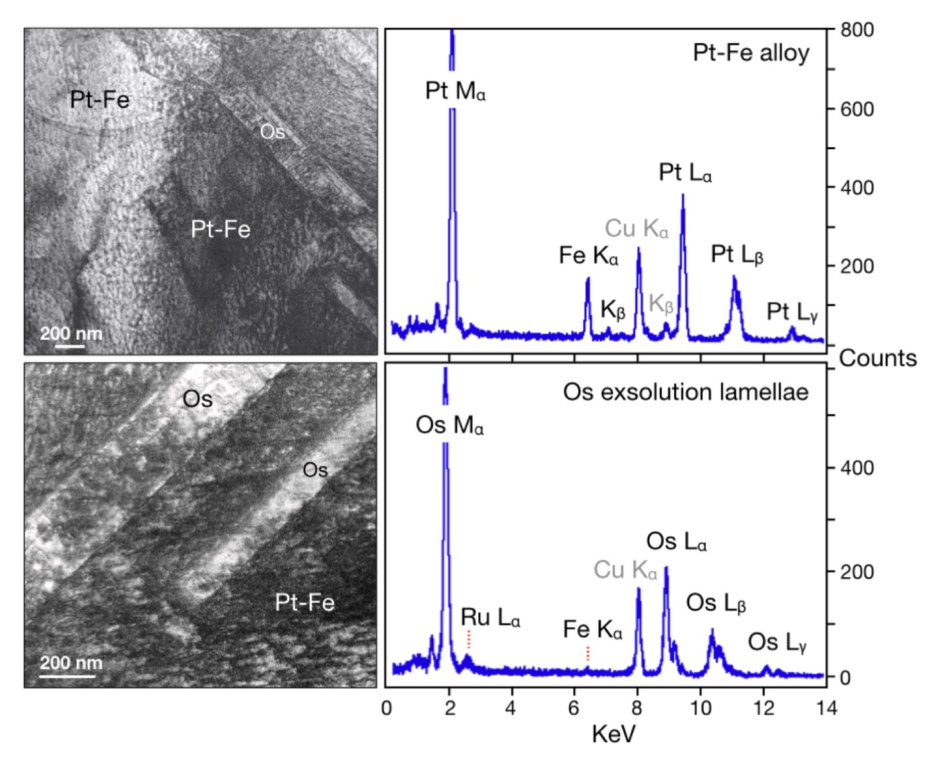
Luguet et al.
¹⁹⁰Pt-¹⁸⁶Os geochronometer reveals open system behaviour of ¹⁹⁰Pt-⁴He isotope system
Figure 1 Bright field image and EDS spectra of Kondyor Pt-Fe alloys and their pure Os exsolution lamellae (FIB-TEM image, GFZ, Potsdam, Germany). The Cu peaks on the EDS spectra are due to the Cu grid that carries the FIB section.
© 2019 The Authors
Published by the European Association of Geochemistry
under Creative Commons License CC BY-NC-ND.
Luguet et al. (2019) Geochem. Persp. Let. 11, 44-48 | doi: 10.7185/geochemlet.1924
Notes:
Figure 1 Bright field image and EDS spectra of Kondyor Pt-Fe alloys and their pure Os exsolution lamellae (FIB-TEM image, GFZ, Potsdam, Germany). The Cu peaks on the EDS spectra are due to the Cu grid that carries the FIB section.

