Slide 1
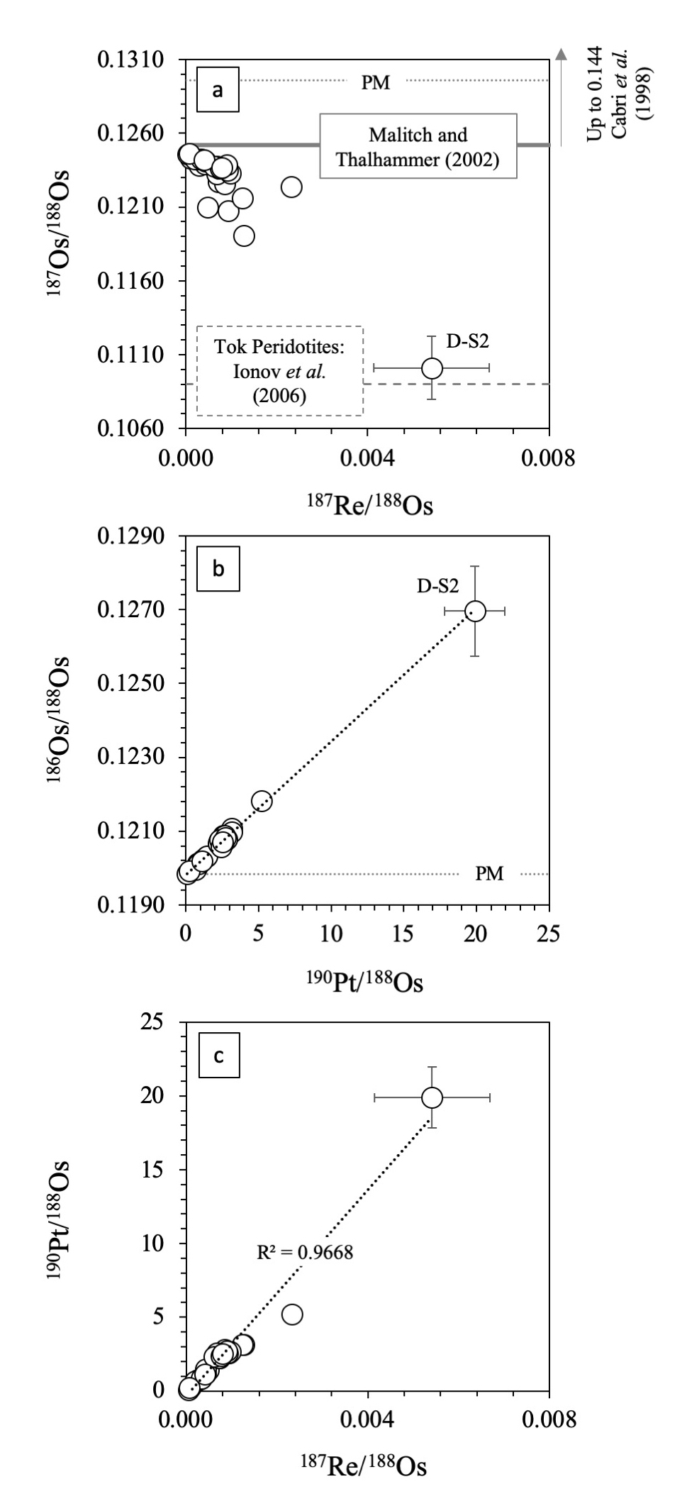
Luguet et al.
¹⁹⁰Pt-¹⁸⁶Os geochronometer reveals open system behaviour of ¹⁹⁰Pt-⁴He isotope system
Figure 2 (a) Variations of ¹⁸⁷Os/¹⁸⁸Os vs. ¹⁸⁷Re/¹⁸⁸Os, (b) of ¹⁸⁶Os/¹⁸⁸Os vs. ¹⁹⁰Pt/¹⁸⁸Os and (c) of ¹⁹⁰Os/¹⁸⁸Os vs. ¹⁸⁷Re/¹⁸⁸Os. The primitive mantle (PM) ¹⁸⁶Os/¹⁸⁸Os and ¹⁸⁷Os/¹⁸⁸Os values are respectively from Day et al. (2017) and Meisel et al. (2001). If the positive correlation between ¹⁸⁶Os/¹⁸⁸Os vs. ¹⁹⁰Pt/¹⁸⁸Os is considered to be an isochronous relationship, it yields an age of 249.8 ± 12 Ma and an intercept of 0.119821 ± 0.000024 (2 sigma) (MSWD = 0.81).
© 2019 The Authors
Published by the European Association of Geochemistry
under Creative Commons License CC BY-NC-ND.
Luguet et al. (2019) Geochem. Persp. Let. 11, 44-48 | doi: 10.7185/geochemlet.1924
Notes:
Figure 2 (a) Variations of ¹⁸⁷Os/¹⁸⁸Os vs. ¹⁸⁷Re/¹⁸⁸Os, (b) of ¹⁸⁶Os/¹⁸⁸Os vs. ¹⁹⁰Pt/¹⁸⁸Os and (c) of ¹⁹⁰Os/¹⁸⁸Os vs. ¹⁸⁷Re/¹⁸⁸Os. The primitive mantle (PM) ¹⁸⁶Os/¹⁸⁸Os and ¹⁸⁷Os/¹⁸⁸Os values are respectively from Day et al. (2017) and Meisel et al. (2001). If the positive correlation between ¹⁸⁶Os/¹⁸⁸Os vs. ¹⁹⁰Pt/¹⁸⁸Os is considered to be an isochronous relationship, it yields an age of 249.8 ± 12 Ma and an intercept of 0.119821 ± 0.000024 (2 sigma) (MSWD = 0.81).

