Slide 1
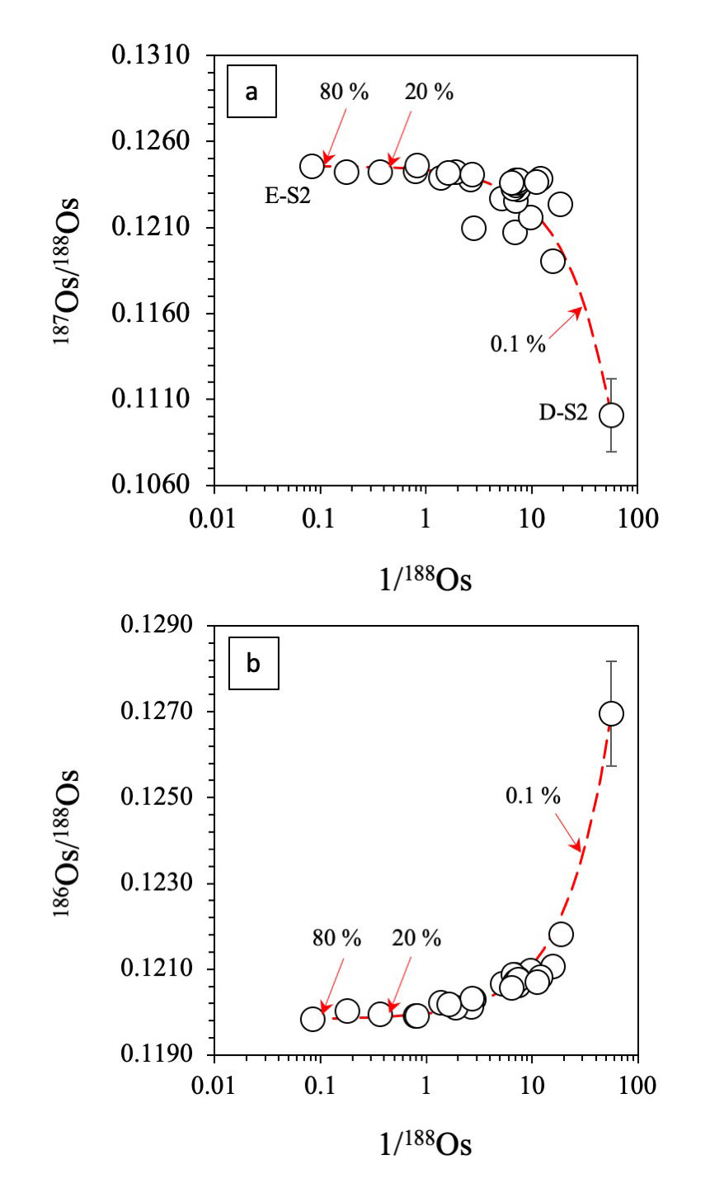
Luguet et al.
¹⁹⁰Pt-¹⁸⁶Os geochronometer reveals open system behaviour of ¹⁹⁰Pt-⁴He isotope system
Figure 3 (a) ¹⁸⁶Os/¹⁸⁸Os and (b) ¹⁸⁷Os/¹⁸⁸Os variations with the Os concentrations (1/¹⁸⁸Os beam). Red dotted line represents the overprinting of the most pristine Pt-alloy D-S2 by an Os-rich contaminant characterised by ¹⁸⁷Os/¹⁸⁸Os and ¹⁸⁶Os/¹⁸⁸Os signatures of Pt-alloy E-S2 (0.12457 and 0.119851, respectively).
© 2019 The Authors
Published by the European Association of Geochemistry
under Creative Commons License CC BY-NC-ND.
Luguet et al. (2019) Geochem. Persp. Let. 11, 44-48 | doi: 10.7185/geochemlet.1924
Notes:
Figure 3 (a) ¹⁸⁶Os/¹⁸⁸Os and (b) ¹⁸⁷Os/¹⁸⁸Os variations with the Os concentrations (1/¹⁸⁸Os beam). Red dotted line represents the overprinting of the most pristine Pt-alloy D-S2 by an Os-rich contaminant characterised by ¹⁸⁷Os/¹⁸⁸Os and ¹⁸⁶Os/¹⁸⁸Os signatures of Pt-alloy E-S2 (0.12457 and 0.119851, respectively).

