Slide 1
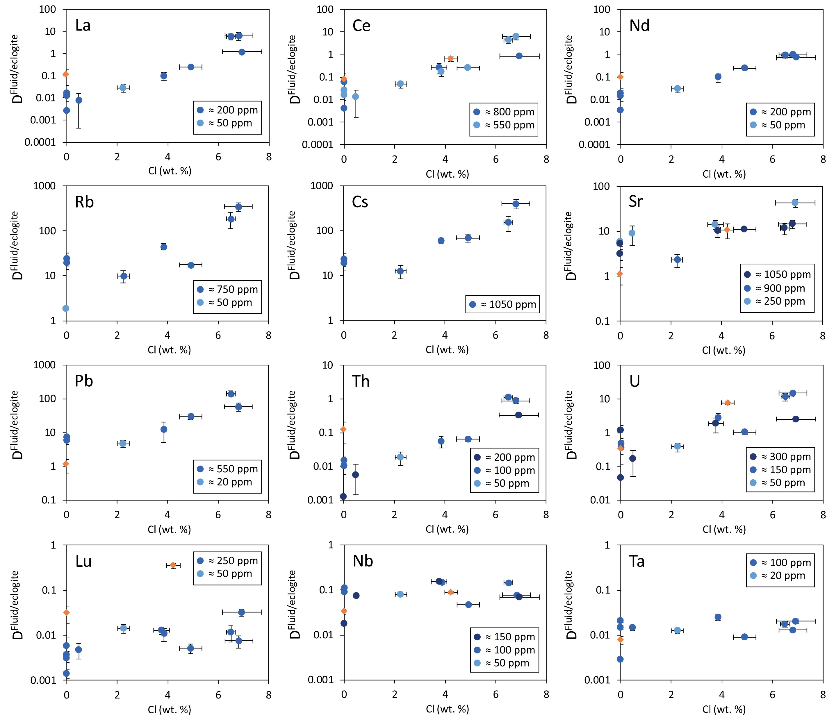
Rustioni et al.
Experimental evidence for fluid-induced melting in subduction zones
Figure 2 Effect of chloride on fluid/eclogite partition coefficients of trace elements at 4 GPa and 800 ˚C. Blue data points are the results from “forward” experiments, where the trace elements were initially doped into the solid starting material, while orange data points are from “reversed” experiments, which started with all trace elements dissolved in the fluid. For the forward experiments, results for different initial trace element concentrations in the starting material are given. Error bars are one standard deviation. Data for these and additional elements are given in Tables S-1 to S-8.
© 2019 The Authors
Published by the European Association of Geochemistry
under Creative Commons License CC BY-NC-ND.
Rustioni et al. (2019) Geochem. Persp. Let. 11, 49-54 | doi: 10.7185/geochemlet.1925
Notes:
Figure 2 Effect of chloride on fluid/eclogite partition coefficients of trace elements at 4 GPa and 800 ˚C. Blue data points are the results from “forward” experiments, where the trace elements were initially doped into the solid starting material, while orange data points are from “reversed” experiments, which started with all trace elements dissolved in the fluid. For the forward experiments, results for different initial trace element concentrations in the starting material are given. Error bars are one standard deviation. Data for these and additional elements are given in Tables S-1 to S-8.

