Slide 1
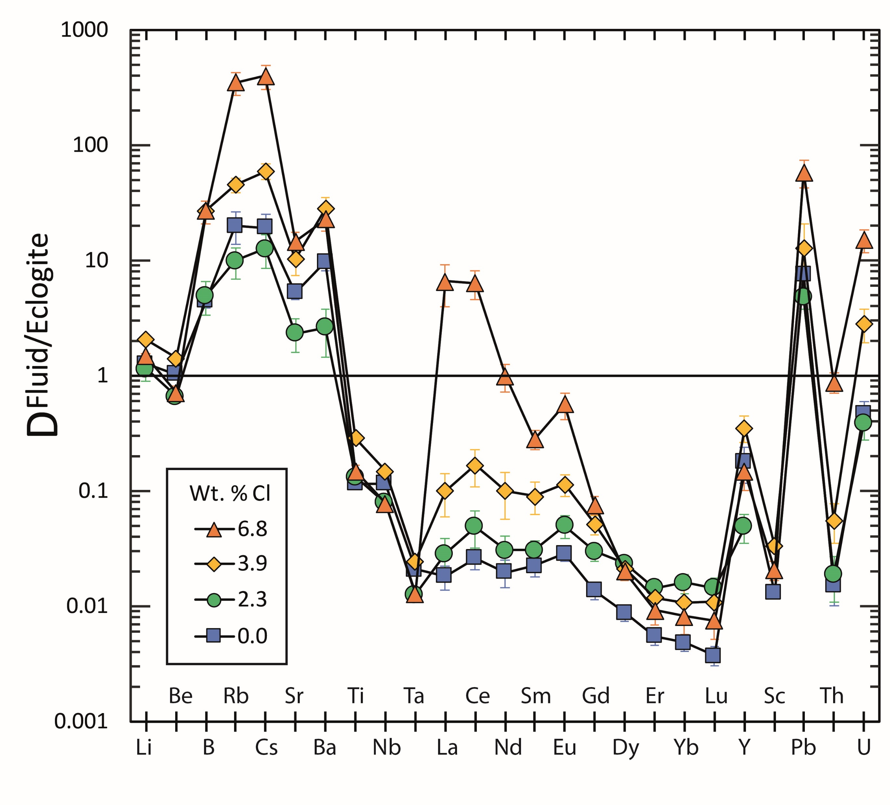
Rustioni et al.
Experimental evidence for fluid-induced melting in subduction zones
Figure 4 Trace element enrichment patterns in fluids from fluid/eclogite partitioning experiments at 4 GPa and 800 ˚C. Error bars are one standard deviation. Data for these and additional elements are given in Tables S-1 to S-8.
© 2019 The Authors
Published by the European Association of Geochemistry
under Creative Commons License CC BY-NC-ND.
Rustioni et al. (2019) Geochem. Persp. Let. 11, 49-54 | doi: 10.7185/geochemlet.1925
Notes:
Figure 4 Trace element enrichment patterns in fluids from fluid/eclogite partitioning experiments at 4 GPa and 800 ˚C. Error bars are one standard deviation. Data for these and additional elements are given in Tables S-1 to S-8.

