Slide 1
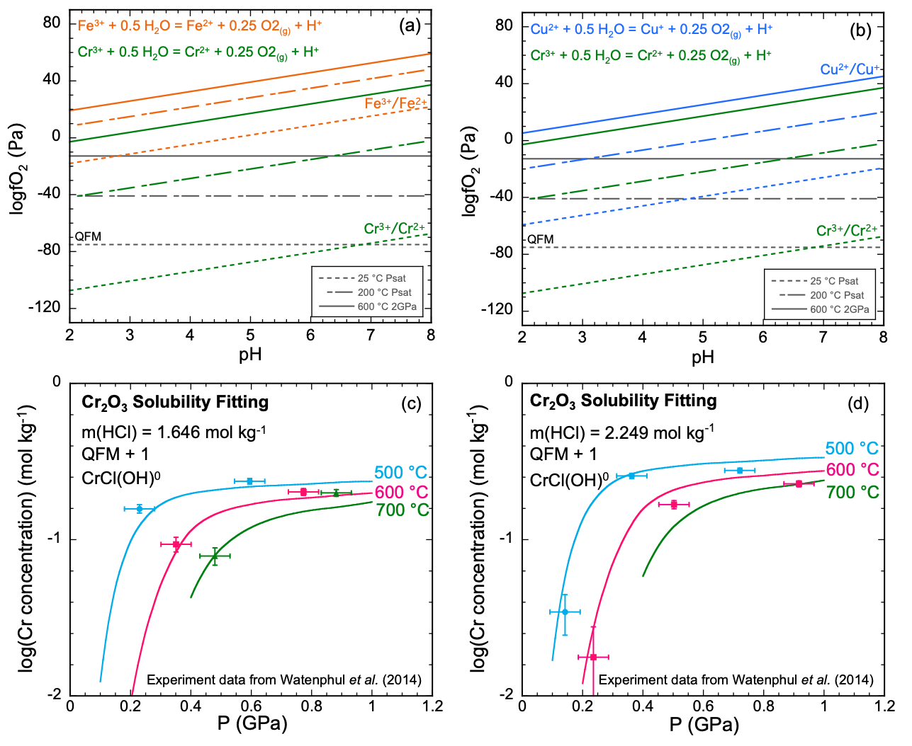
Huang et al.
Mobility of chromium in high temperature crustal and upper mantle fluids
Figure 1 (a, b) Effect of temperature and pressure on the valence state of ions at 25 °C and Psat (dashed lines), 200 °C and Psat (dotted dashed lines) and 600 °C and 2.0 GPa (solid lines). Horizontal lines represent the QFM buffer (black): (a) Fe³⁺/Fe²⁺ (orange) and Cr³⁺/Cr²⁺ (green) (b) Cu²⁺/Cu⁺ (blue) and Cr³⁺/Cr²⁺ (green). (c, d) Experimental Cr₂O₃ solubilities in HCl-rich fluids at 500–700 °C and 0.1–1.0 GPa. (c) HCl = 1.646 mol kg⁻¹. (d) HCl = 2.249 mol kg⁻¹. Solid curves are fitted to the experimental data at QFM + 1.
© 2019 The Authors
Published by the European Association of Geochemistry
under Creative Commons License CC BY-NC-ND.
Huang et al. (2019) Geochem. Persp. Let. 12, 1-6 | doi: 10.7185/geochemlet.1926
Notes:
Figure 1 (a, b) Effect of temperature and pressure on the valence state of ions at 25 °C and Psat (dashed lines), 200 °C and Psat (dotted dashed lines) and 600 °C and 2.0 GPa (solid lines). Horizontal lines represent the QFM buffer (black): (a) Fe³⁺/Fe²⁺ (orange) and Cr³⁺/Cr²⁺ (green) (b) Cu²⁺/Cu⁺ (blue) and Cr³⁺/Cr²⁺ (green). (c, d) Experimental Cr₂O₃ solubilities in HCl-rich fluids at 500–700 °C and 0.1–1.0 GPa. (c) HCl = 1.646 mol kg⁻¹. (d) HCl = 2.249 mol kg⁻¹. Solid curves are fitted to the experimental data at QFM + 1.

