Slide 1
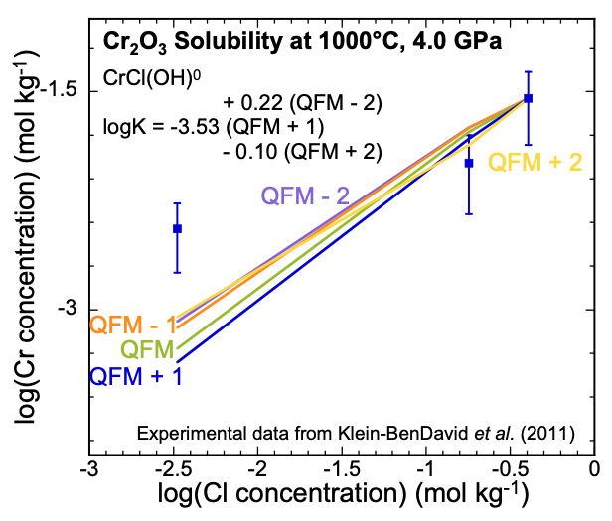
Huang et al.
Mobility of chromium in high temperature crustal and upper mantle fluids
Figure 2 Experimental Cr₂O₃ solubilities in KCl fluids at 1000 °C and 4.0 GPa. Curves were fit to the highest two KCl points from QFM - 2 to QFM + 2.
© 2019 The Authors
Published by the European Association of Geochemistry
under Creative Commons License CC BY-NC-ND.
Huang et al. (2019) Geochem. Persp. Let. 12, 1-6 | doi: 10.7185/geochemlet.1926
Notes:
Figure 2 Experimental Cr₂O₃ solubilities in KCl fluids at 1000 °C and 4.0 GPa. Curves were fit to the highest two KCl points from QFM - 2 to QFM + 2.

