Slide 1
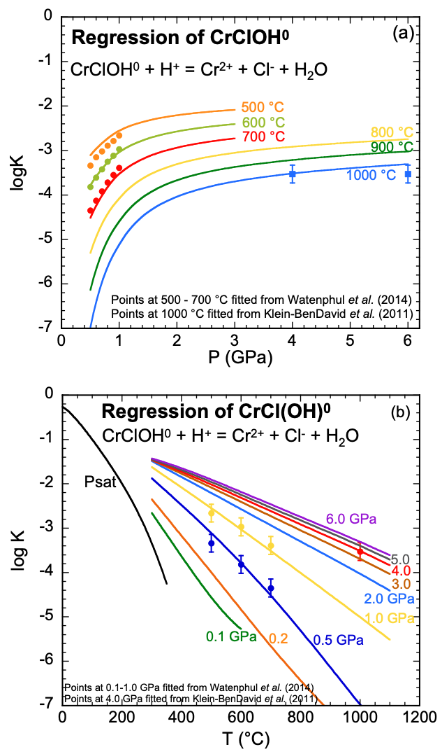
Huang et al.
Mobility of chromium in high temperature crustal and upper mantle fluids
Figure 3 Regression of log K for CrCl(OH)⁰ for dissociation reaction versus (a) pressure and (b) temperature up to 6.0 GPa and 1100 °C.
© 2019 The Authors
Published by the European Association of Geochemistry
under Creative Commons License CC BY-NC-ND.
Huang et al. (2019) Geochem. Persp. Let. 12, 1-6 | doi: 10.7185/geochemlet.1926
Notes:
Figure 3 Regression of log K for CrCl(OH)⁰ for dissociation reaction versus (a) pressure and (b) temperature up to 6.0 GPa and 1100 °C.

