Slide 1
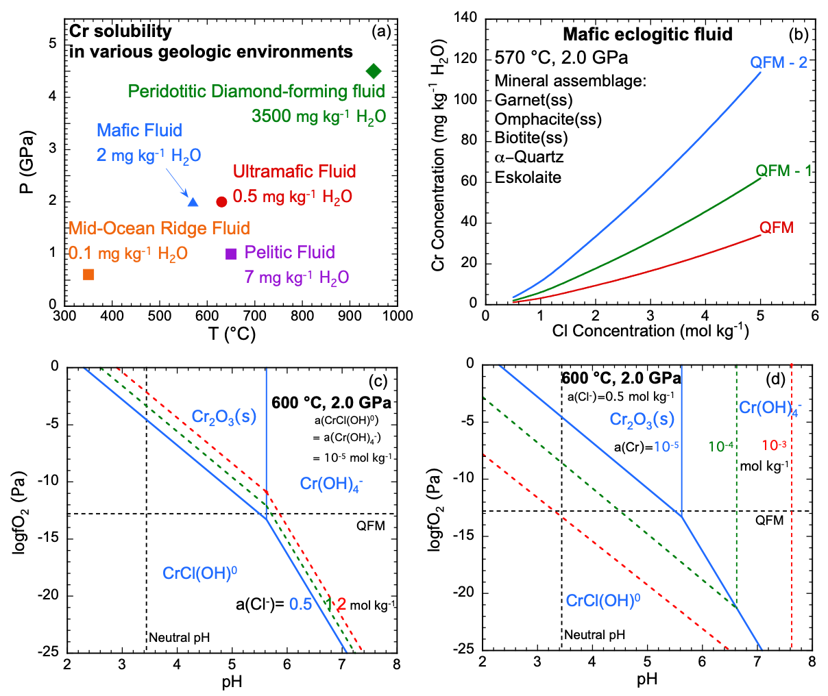
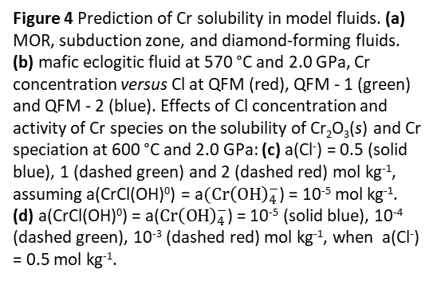
Huang et al.
Mobility of chromium in high temperature crustal and upper mantle fluids
Figure 4 Prediction of Cr solubility in model fluids. (a) MOR, subduction zone, and diamond-forming fluids. (b) mafic eclogitic fluid at 570 °C and 2.0 GPa, Cr concentration versus Cl at QFM (red), QFM - 1 (green) and QFM - 2 (blue). Effects of Cl concentration and activity of Cr species on the solubility of Cr₂O₃(s) and Cr speciation at 600 °C and 2.0 GPa: (c) a(Cl⁻) = 0.5 (solid blue), 1 (dashed green) and 2 (dashed red) mol kg⁻¹, assuming a(CrCl(OH)⁰) = a$(Cr{\left(OH\right)}_{4}^{−}$) = 10⁻⁵ mol kg⁻¹. (d) a(CrCl(OH)⁰) = a($Cr{\left(OH\right)}_{4}^{−}$) = 10⁻⁵ (solid blue), 10⁻⁴ (dashed green), 10⁻³ (dashed red) mol kg⁻¹, when a(Cl⁻) = 0.5 mol kg⁻¹.
© 2019 The Authors
Published by the European Association of Geochemistry
under Creative Commons License CC BY-NC-ND.
Huang et al. (2019) Geochem. Persp. Let. 12, 1-6 | doi: 10.7185/geochemlet.1926
Notes:
Figure 4 Prediction of Cr solubility in model fluids. (a) MOR, subduction zone, and diamond-forming fluids. (b) mafic eclogitic fluid at 570 °C and 2.0 GPa, Cr concentration versus Cl at QFM (red), QFM - 1 (green) and QFM - 2 (blue). Effects of Cl concentration and activity of Cr species on the solubility of Cr₂O₃(s) and Cr speciation at 600 °C and 2.0 GPa: (c) a(Cl⁻) = 0.5 (solid blue), 1 (dashed green) and 2 (dashed red) mol kg⁻¹, assuming a(CrCl(OH)⁰) = a$(Cr{\left(OH\right)}_{4}^{−}$) = 10⁻⁵ mol kg⁻¹. (d) a(CrCl(OH)⁰) = a($Cr{\left(OH\right)}_{4}^{−}$) = 10⁻⁵ (solid blue), 10⁻⁴ (dashed green), 10⁻³ (dashed red) mol kg⁻¹, when a(Cl⁻) = 0.5 mol kg⁻¹.

