Slide 1
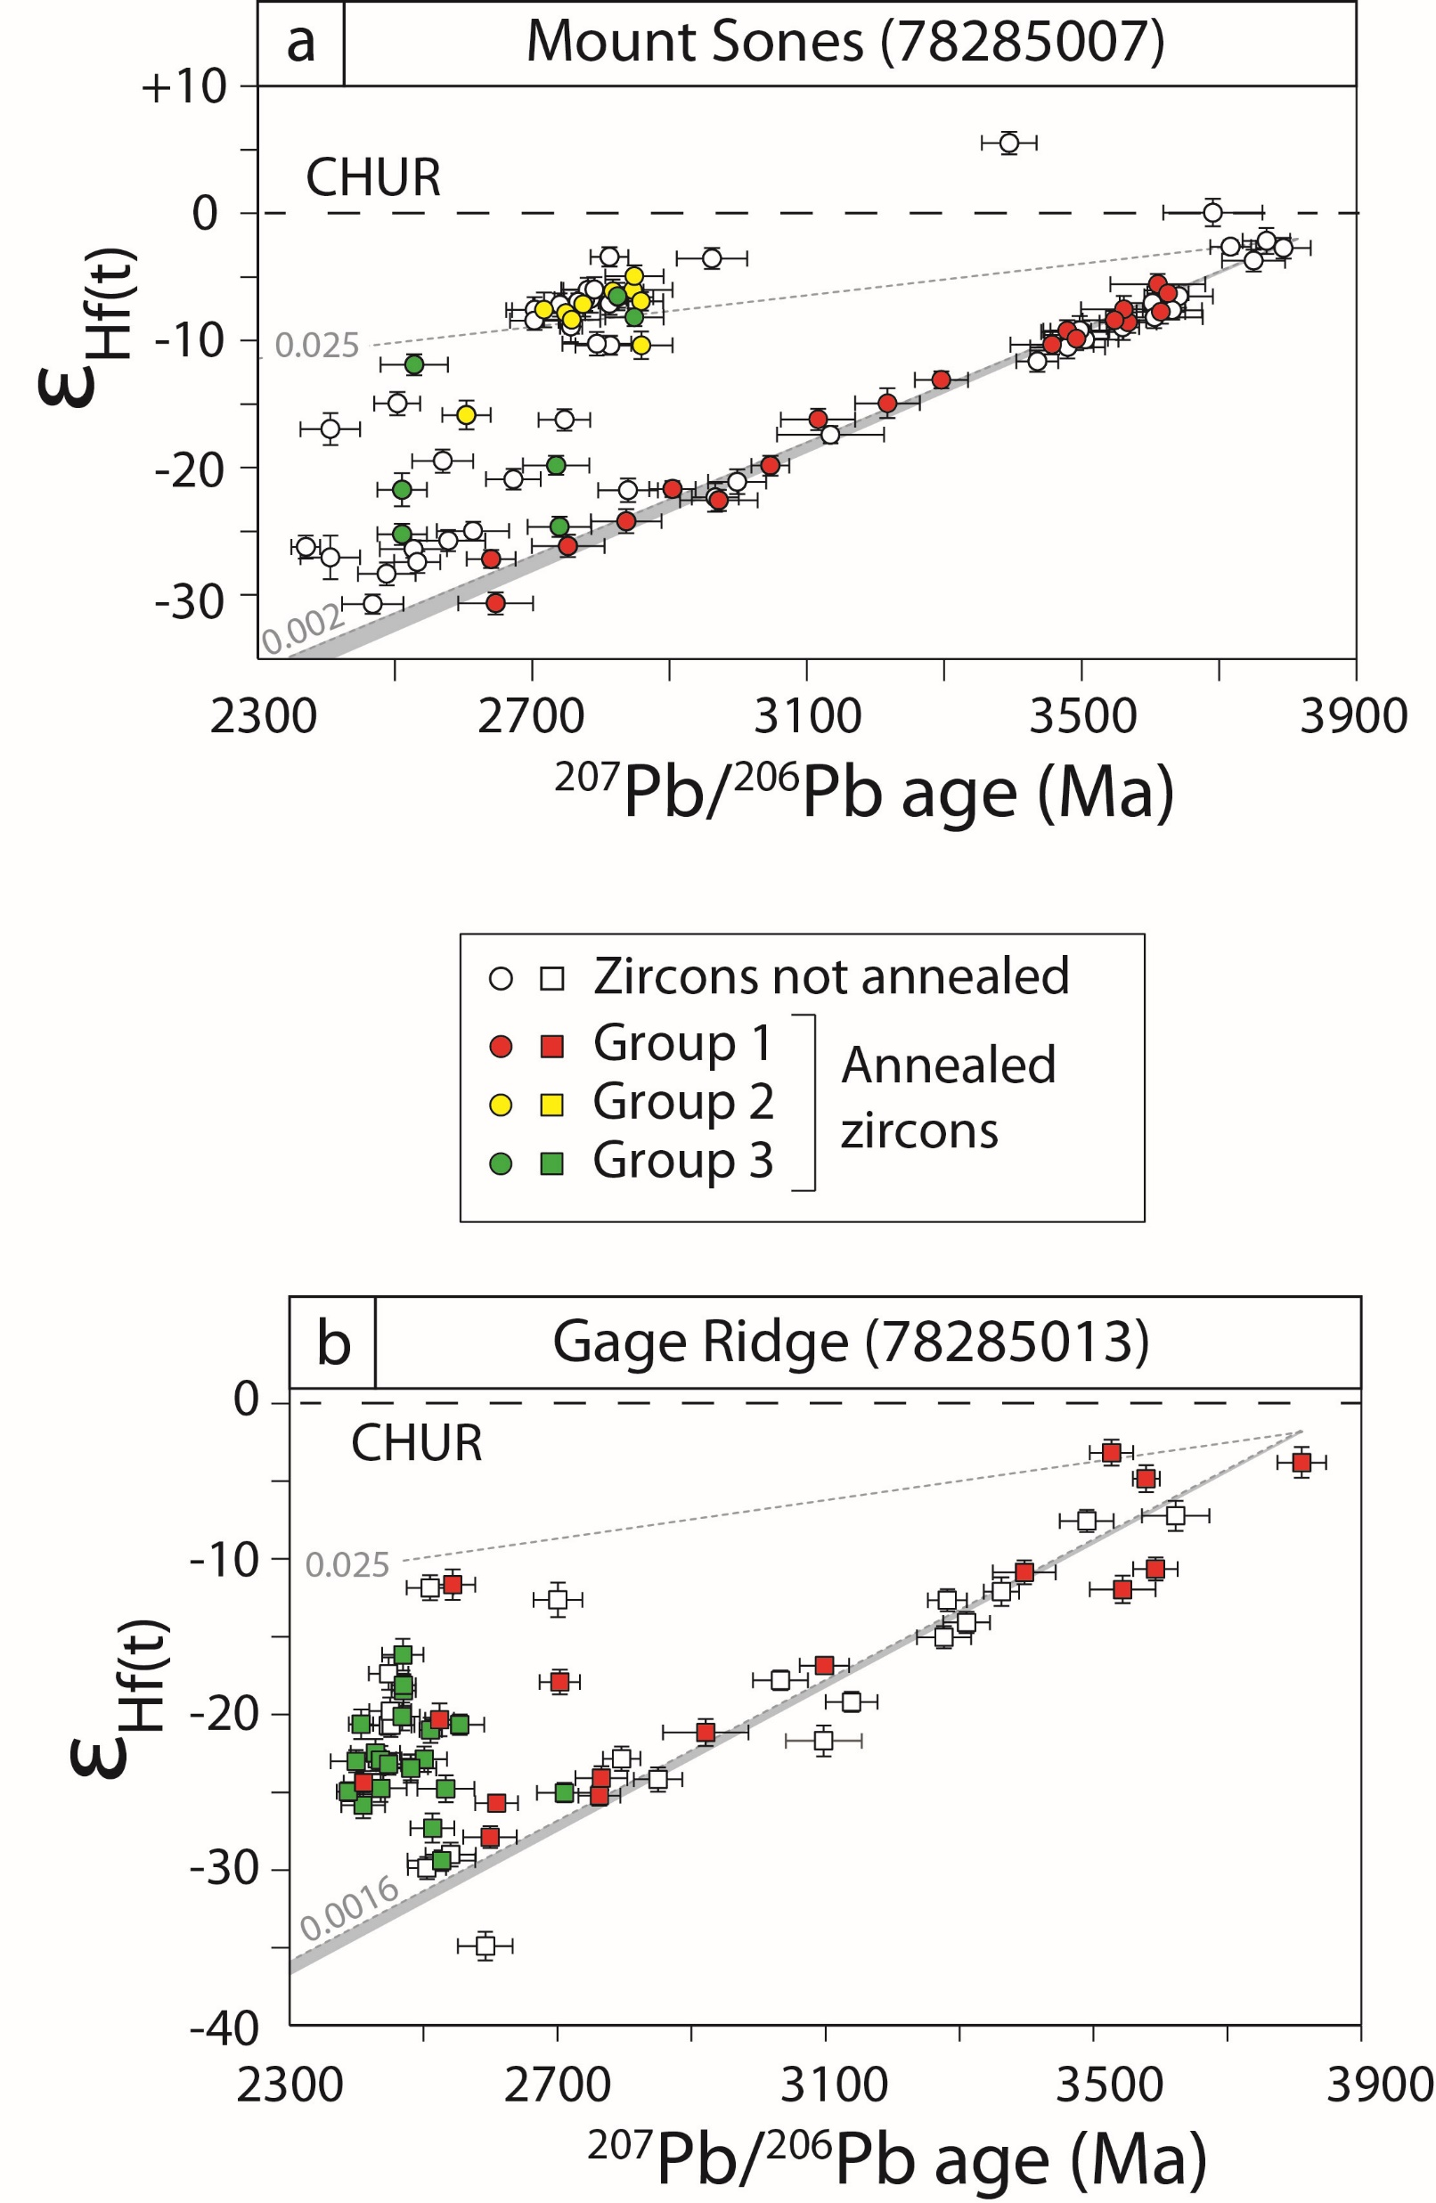
Guitreau et al.
Hadean protocrust reworking at the origin of the Archean Napier Complex (Antarctica)
Figure 2 ɛ_{Hf} versus ²⁰⁷Pb/²⁰⁶Pb age diagrams for Mount Sones and Gage Ridge zircons. Black dashed lines represent the time-evolution of a CHUR reservoir (Iizuka et al., 2015) formed at 4568 Ma (Bouvier and Wadhwa, 2010). Black dotted lines correspond to reservoirs that started with group 1 initial ¹⁷⁶Hf/¹⁷⁷Hf and evolved with ¹⁷⁶Lu/¹⁷⁷Hf ratios that are indicated on the left of the diagrams (e.g., 0.025). The values of 0.002 and 0.0016 correspond to ¹⁷⁶Lu/¹⁷⁷Hf measured in whole rock powders of Mount Sones and Gage Ridge orthogneisses, respectively. The grey fields…
© 2019 The Authors
Published by the European Association of Geochemistry
under Creative Commons License CC BY-NC-ND.
Guitreau et al. (2019) Geochem. Persp. Let. 12, 7-11 | doi: 10.7185/geochemlet.1927
Notes:
Figure 2 ɛ_{Hf} versus ²⁰⁷Pb/²⁰⁶Pb age diagrams for Mount Sones and Gage Ridge zircons. Black dashed lines represent the time-evolution of a CHUR reservoir (Iizuka et al., 2015) formed at 4568 Ma (Bouvier and Wadhwa, 2010). Black dotted lines correspond to reservoirs that started with group 1 initial ¹⁷⁶Hf/¹⁷⁷Hf and evolved with ¹⁷⁶Lu/¹⁷⁷Hf ratios that are indicated on the left of the diagrams (e.g., 0.025). The values of 0.002 and 0.0016 correspond to ¹⁷⁶Lu/¹⁷⁷Hf measured in whole rock powders of Mount Sones and Gage Ridge orthogneisses, respectively. The grey fields encompass evolutions of Napier zircons based on highest and lowest ¹⁷⁶Lu/¹⁷⁷Hf measured in Mount Sones and Gage Ridge zircon populations. The general positive correlation of data for group 1 highlights typical artefacts of ancient Pb loss (e.g., Guitreau et al., 2012). Therefore, the original Hf isotope signatures of corresponding zircon populations are indicated by the oldest (and most concordant) crystals, which happen to be sub-chondritic for both samples. Data are fully consistent between annealed and not-annealed zircons, hence, demonstrating that annealing did not influence any of the measured systematics.

