Slide 1
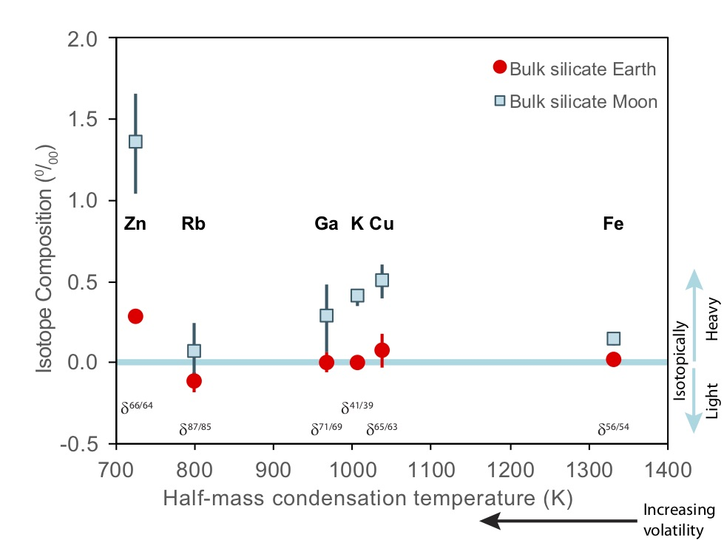
Xia et al.
The effect of core segregation on the Cu and Zn isotope composition of the silicate Moon
Figure 1 Run products from high pressure experiments. (a) Cross section of a sample capsule after an experiment (image width 5 mm). A white layer of diamond powder is sandwiched between the silicate sample. The red arrow points to a laser ablation trace. (b) Backscatter electron image of the silicate part of a sample, consisting mostly of omphacite (Omp) and garnet (Grt) with minor kyanite (Ky) and rutile (Rt). In the centre of some garnet crystals, remnants of the garnet seeds are visible. (c) Laser ablation analysis of frozen fluid in the diamond trap, demonstrating the homogeneity of the sample.
© 2019 The Authors
Published by the European Association of Geochemistry
under Creative Commons License CC BY 4.0.
Xia et al. (2019) Geochem. Persp. Let. 12, 12-17 | doi: 10.7185/geochemlet.1928
Notes:
Figure 1 Run products from high pressure experiments. (a) Cross section of a sample capsule after an experiment (image width 5 mm). A white layer of diamond powder is sandwiched between the silicate sample. The red arrow points to a laser ablation trace. (b) Backscatter electron image of the silicate part of a sample, consisting mostly of omphacite (Omp) and garnet (Grt) with minor kyanite (Ky) and rutile (Rt). In the centre of some garnet crystals, remnants of the garnet seeds are visible. (c) Laser ablation analysis of frozen fluid in the diamond trap, demonstrating the homogeneity of the sample.

