Slide 1
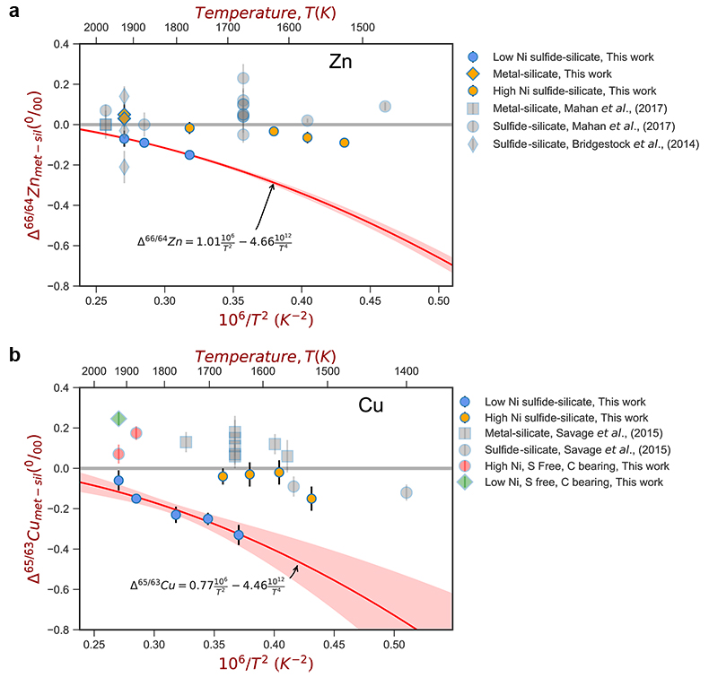
Xia et al.
The effect of core segregation on the Cu and Zn isotope composition of the silicate Moon
Figure 2 (a,b) Zn and Cu isotope fractionation factors between liquid metal-silicate and sulfide-silicate as a function of temperature. Both increasing temperature and Ni content of sulfide decrease the Zn and Cu isotope fractionation, with the result that low Ni sulfides all exhibit a temperature dependent excess of isotopically light Cu and Zn. The pale-red band is the 95 % confidence interval for the regression shown.
© 2019 The Authors
Published by the European Association of Geochemistry
under Creative Commons License CC BY 4.0.
Xia et al. (2019) Geochem. Persp. Let. 12, 12-17 | doi: 10.7185/geochemlet.1928
Notes:
Figure 2 (a,b) Zn and Cu isotope fractionation factors between liquid metal-silicate and sulfide-silicate as a function of temperature. Both increasing temperature and Ni content of sulfide decrease the Zn and Cu isotope fractionation, with the result that low Ni sulfides all exhibit a temperature dependent excess of isotopically light Cu and Zn. The pale-red band is the 95 % confidence interval for the regression shown.

