Slide 1
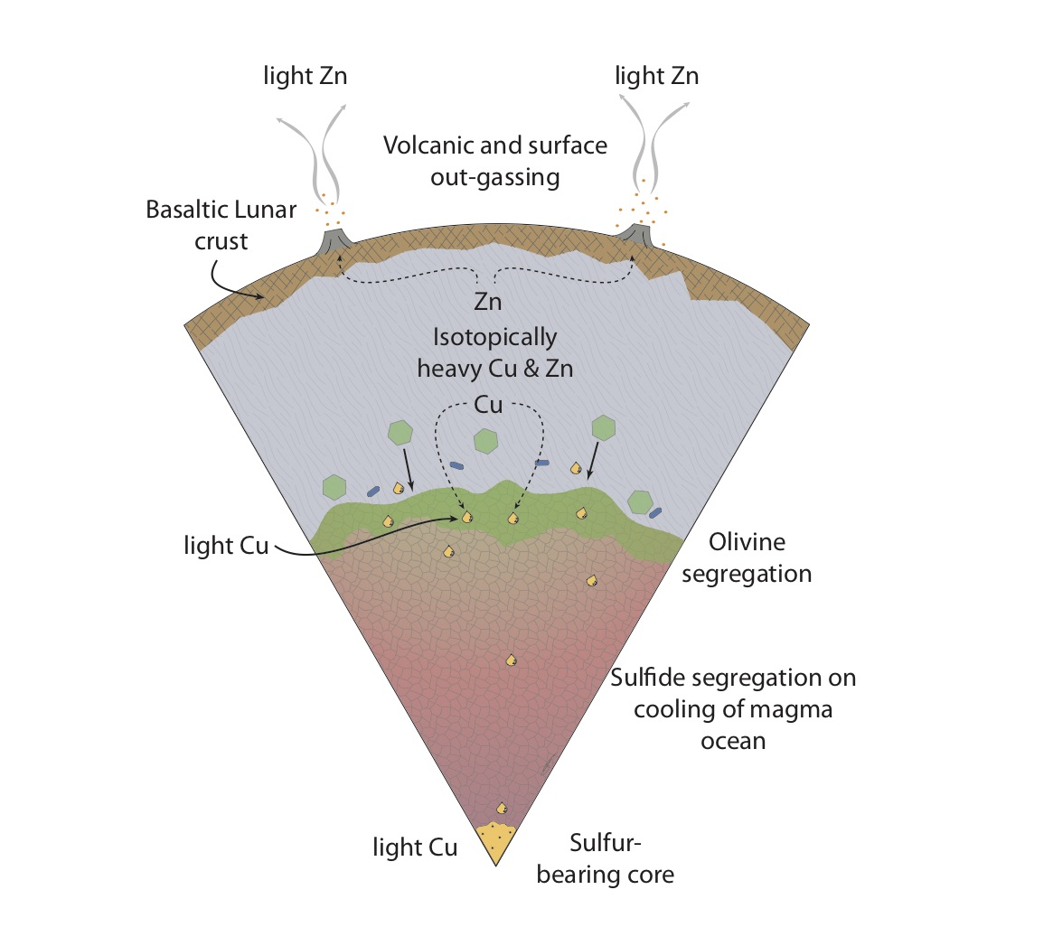
Xia et al.
The effect of core segregation on the Cu and Zn isotope composition of the silicate Moon
Figure 4 Cu is hosted in lunar sulfides as a consequence of its significantly higher preference for the sulfide phase over silicate during LMO cooling and the consequent decreasing solubility of sulfide in the melt. Zn, however, is little affected implying the BSM Zn isotopic content is set by element volatility during Moon formation and LMO degassing. The BSM’s Cu isotopic composition reflects sulfide loss to the lunar core.
© 2019 The Authors
Published by the European Association of Geochemistry
under Creative Commons License CC BY 4.0.
Xia et al. (2019) Geochem. Persp. Let. 12, 12-17 | doi: 10.7185/geochemlet.1928
Notes:
Figure 4 Cu is hosted in lunar sulfides as a consequence of its significantly higher preference for the sulfide phase over silicate during LMO cooling and the consequent decreasing solubility of sulfide in the melt. Zn, however, is little affected implying the BSM Zn isotopic content is set by element volatility during Moon formation and LMO degassing. The BSM’s Cu isotopic composition reflects sulfide loss to the lunar core.

