Slide 1
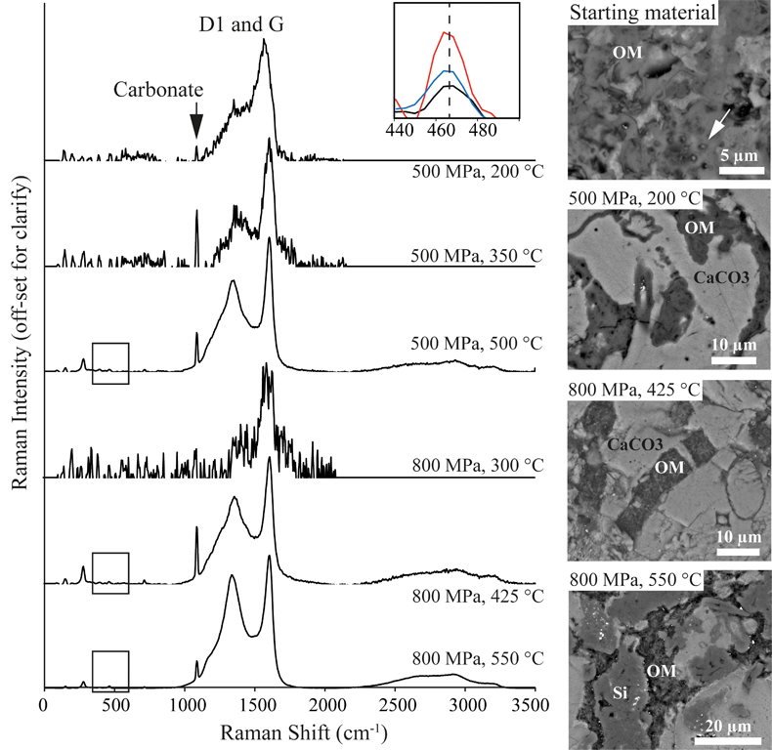
Cousins et al.
Metamorphic evolution of carbonate-hosted microbial biosignatures
Figure 2 Evolution of D1 (~1360 cm⁻¹) and G (~1610 cm⁻¹) Raman peaks from experimental samples, and the increasing 467 cm⁻¹ quartz peak at 425, 500, and 550 °C (box inset); and corresponding SEM images showing the textural evolution of OM mineralisation within the carbonate (CaCO₃) matrix and siliceous (Si) phases Individual cells in the amorphous organic matrix can be seen in the starting material (arrows). Unprocessed Raman spectra are given in Figure S-3.
© 2020 The Authors
Published by the European Association of Geochemistry
under Creative Commons License CC BY-NC-ND.
Cousins et al. (2019) Geochem. Persp. Let. 12, 40-45 | doi: 10.7185/geochemlet.2002
Notes:
Figure 2 Evolution of D1 (~1360 cm⁻¹) and G (~1610 cm⁻¹) Raman peaks from experimental samples, and the increasing 467 cm⁻¹ quartz peak at 425, 500, and 550 °C (box inset); and corresponding SEM images showing the textural evolution of OM mineralisation within the carbonate (CaCO₃) matrix and siliceous (Si) phases Individual cells in the amorphous organic matrix can be seen in the starting material (arrows). Unprocessed Raman spectra are given in Figure S-3.

