Slide 1
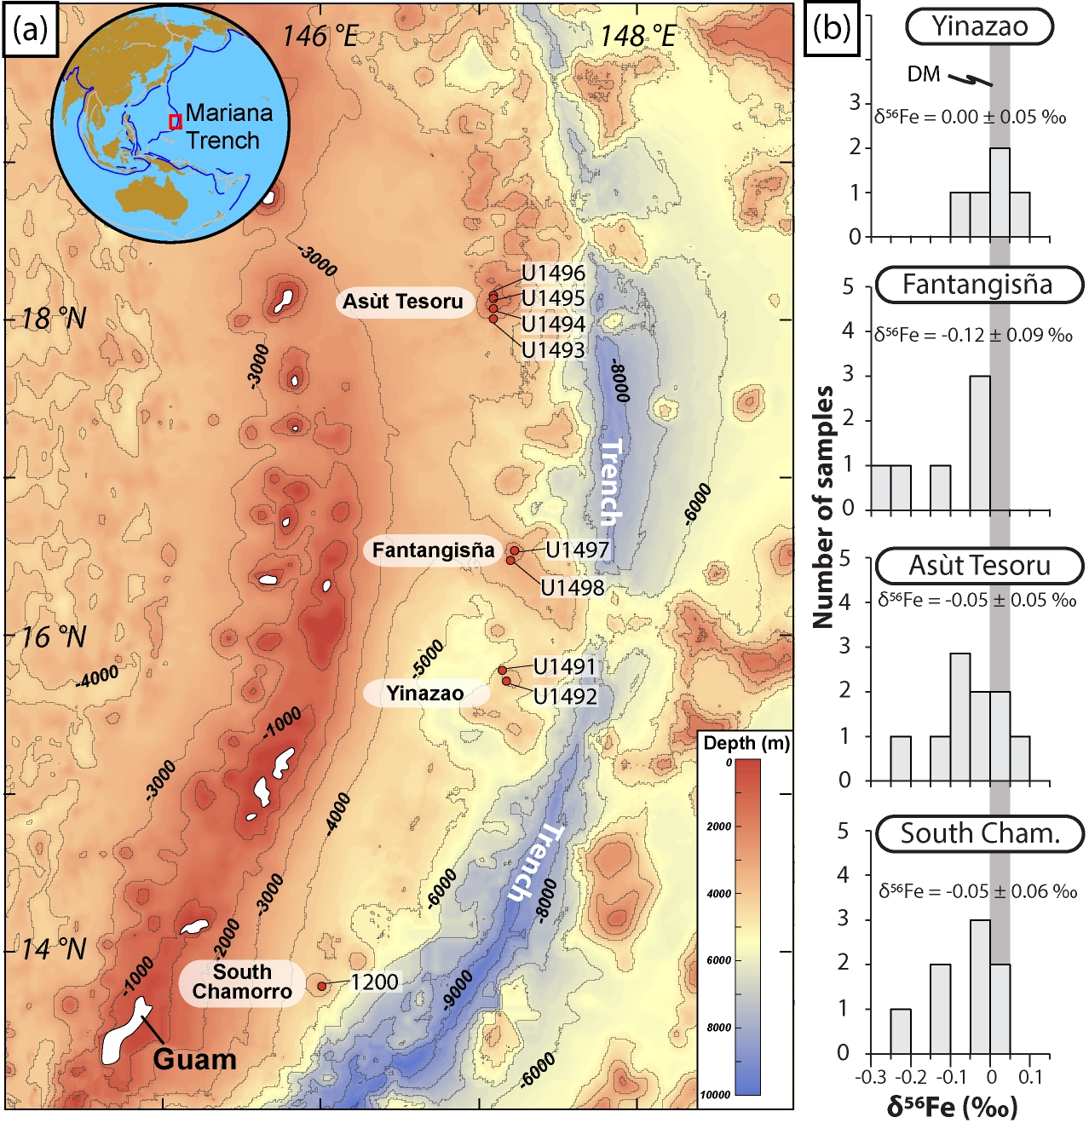
Debret et al.
Redox transfer at subduction zones: insights from Fe isotopes in the Mariana forearc
Figure 1 Distribution of δ⁵⁶Fe values in forearc serpentinites. (a) Bathymetry map of the Mariana subduction system showing the locations of the mud volcanoes drilled during IODP Expedition 366 and the ODP Leg 195. Hole locations are indicated in red circles. (b) Iron isotope compositions of bulk ultramafic clasts from the Mariana forearc, organised according to the distance from the trench. DM: Depleted Mantle (Craddock et al., 2013).
© 2020 The Authors
Published by the European Association of Geochemistry
under Creative Commons License CC BY-NC-ND.
Debret et al. (2020) Geochem. Persp. Let. 12, 46-51 | doi: 10.7185/geochemlet.2003
Notes:
Figure 1 Distribution of δ⁵⁶Fe values in forearc serpentinites. (a) Bathymetry map of the Mariana subduction system showing the locations of the mud volcanoes drilled during IODP Expedition 366 and the ODP Leg 195. Hole locations are indicated in red circles. (b) Iron isotope compositions of bulk ultramafic clasts from the Mariana forearc, organised according to the distance from the trench. DM: Depleted Mantle (Craddock et al., 2013).

