Slide 1
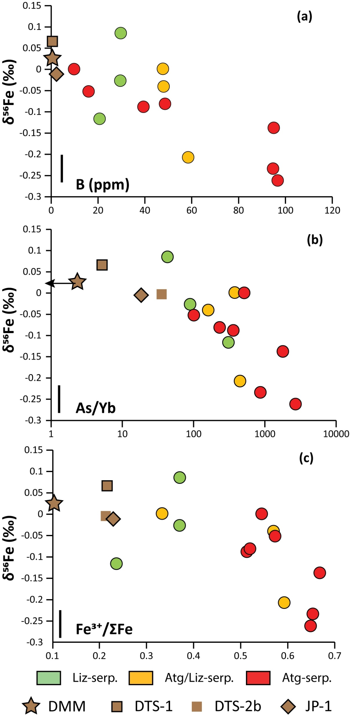
Debret et al.
Redox transfer at subduction zones: insights from Fe isotopes in the Mariana forearc
Figure 2 Plots of δ⁵⁶Fe versus (a) B concentrations, (b) As/Yb and (c) Fe³⁺/ΣFe ratios in Mariana ultramafic clasts. The black bar represents the FeCl standard reproducibility during analyses. DTS-1, DTS-2b, JP-1: dunite-like reference materials.
© 2020 The Authors
Published by the European Association of Geochemistry
under Creative Commons License CC BY-NC-ND.
Debret et al. (2020) Geochem. Persp. Let. 12, 46-51 | doi: 10.7185/geochemlet.2003
Notes:
Figure 2 Plots of δ⁵⁶Fe versus (a) B concentrations, (b) As/Yb and (c) Fe³⁺/ΣFe ratios in Mariana ultramafic clasts. The black bar represents the FeCl standard reproducibility during analyses. DTS-1, DTS-2b, JP-1: dunite-like reference materials.

