Slide 1
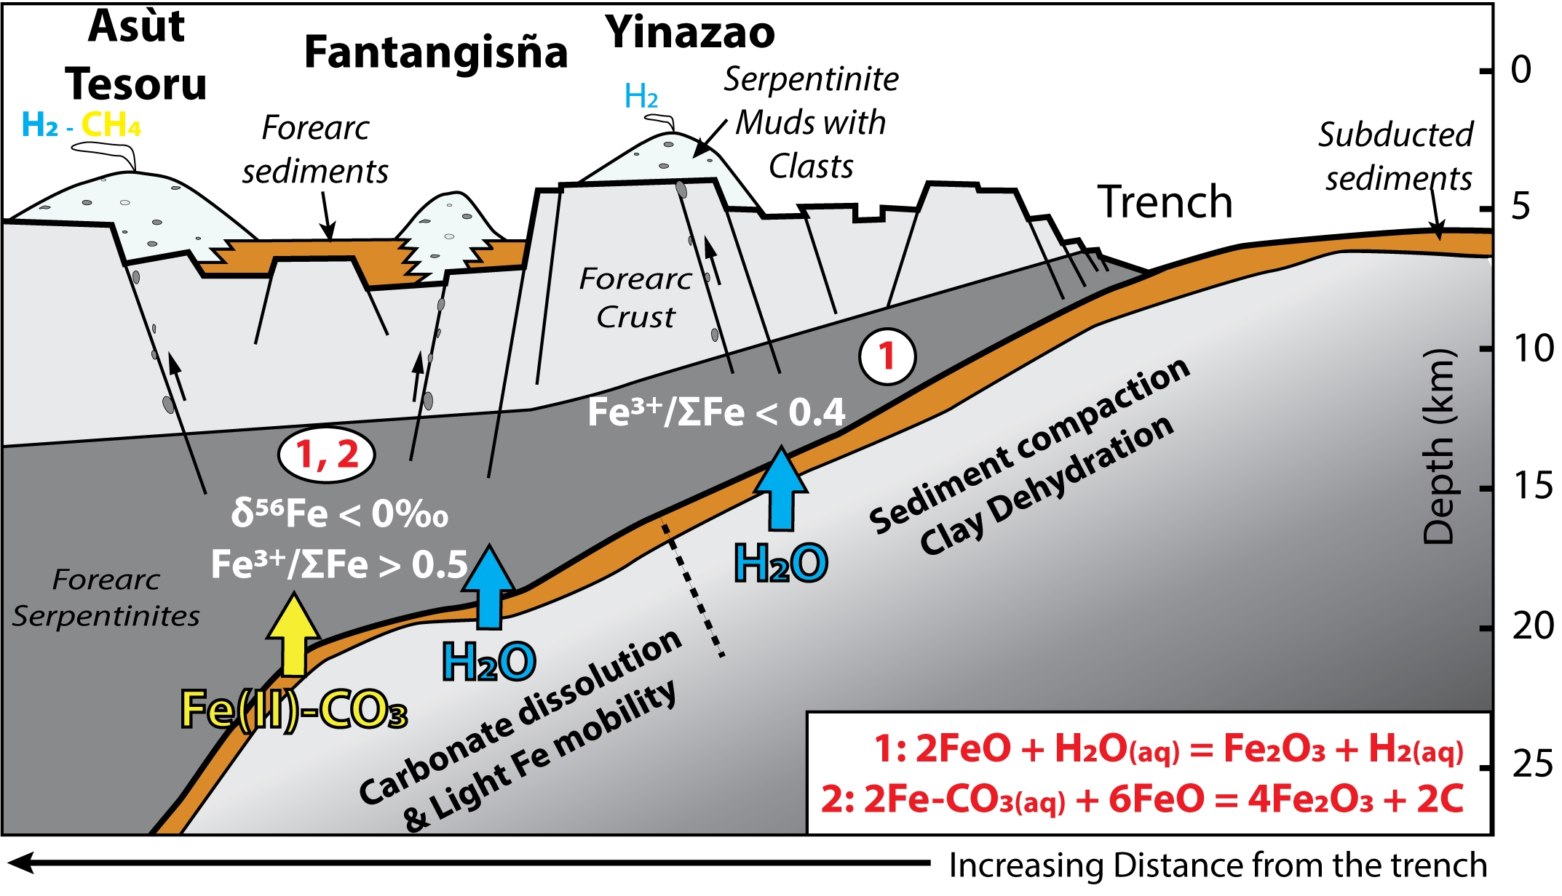
Debret et al.
Redox transfer at subduction zones: insights from Fe isotopes in the Mariana forearc
Figure 3 Cartoon illustrating redox and isotopic transfers between the slab and the forearc mantle wedge.
© 2020 The Authors
Published by the European Association of Geochemistry
under Creative Commons License CC BY-NC-ND.
Debret et al. (2020) Geochem. Persp. Let. 12, 46-51 | doi: 10.7185/geochemlet.2003
Notes:
Figure 3 Cartoon illustrating redox and isotopic transfers between the slab and the forearc mantle wedge.

