Slide 1
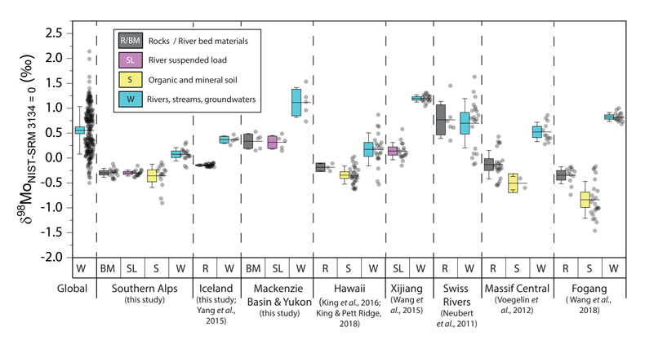
Horan et al.
Unravelling the controls on the molybdenum isotope ratios of river waters
Figure 1 Molybdenum isotope ratios (δ^{98/95}Mo, NIST-SRM3134 = 0 ‰) for this study (Southern Alps, Iceland, Mackenzie Basin and Yukon), alongside published measurements with: R = rocks, BM = river bed materials (grey); SL = suspended load (pink); S = soils (yellow); W = water (blue). Measurements are shown as grey dots, bars show the ±2 s.e. and whiskers ±2 s.d.
© 2020 The Authors
Published by the European Association of Geochemistry
under Creative Commons License CC BY 4.0.
Horan et al. (2020) Geochem. Persp. Let. 13, 1-6 | doi: 10.7185/geochemlet.2005
Notes:
Figure 1 Molybdenum isotope ratios (δ^{98/95}Mo, NIST-SRM3134 = 0 ‰) for this study (Southern Alps, Iceland, Mackenzie Basin and Yukon), alongside published measurements with: R = rocks, BM = river bed materials (grey); SL = suspended load (pink); S = soils (yellow); W = water (blue). Measurements are shown as grey dots, bars show the ±2 s.e. and whiskers ±2 s.d.

