Slide 1
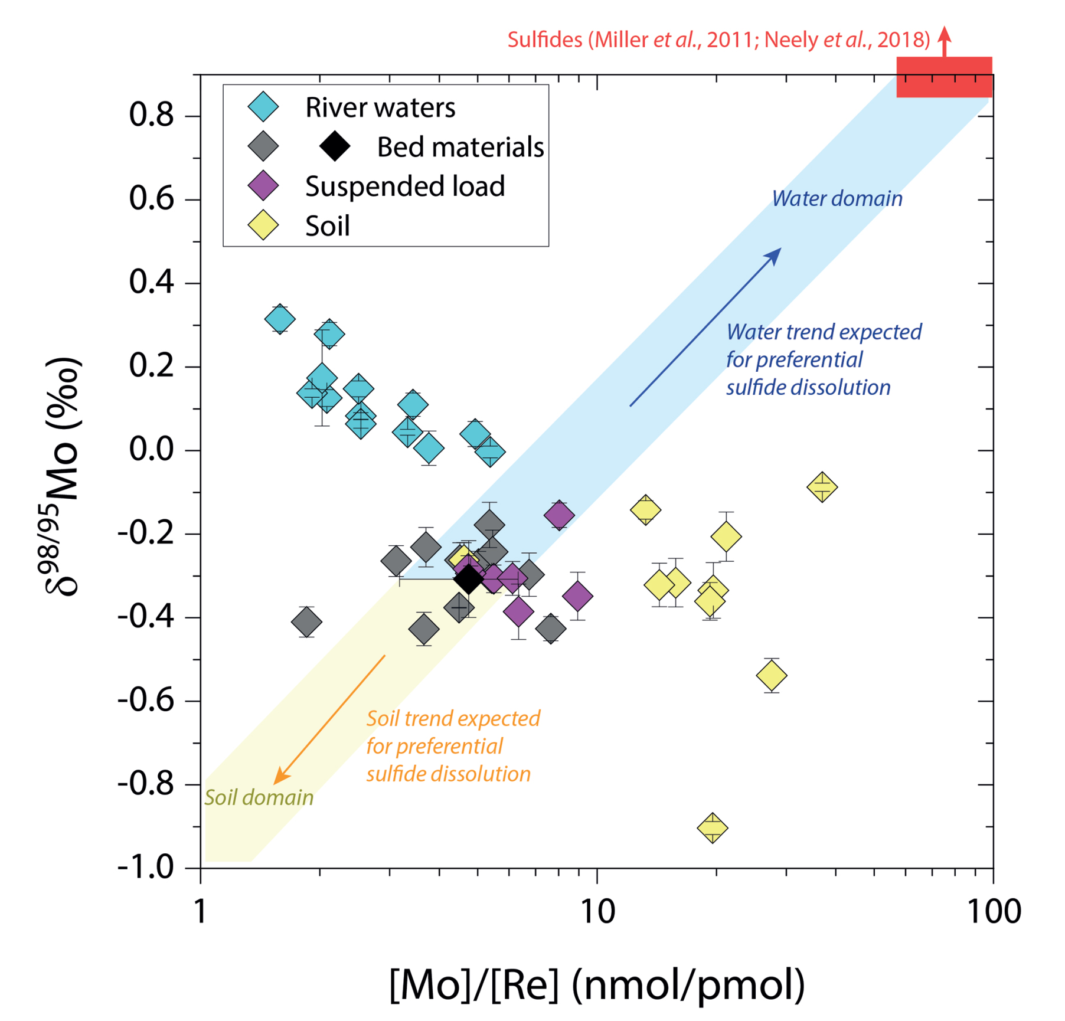
Horan et al.
Unravelling the controls on the molybdenum isotope ratios of river waters
Figure 2 The Mo isotope ratios of materials from the western Southern Alps, New Zealand, versus the Mo to Re concentration ratios for river waters (light blue), river bed materials (grey), suspended load (purple) and soils (yellow). Black diamond is the mean of the bed material samples. Shaded domains show the expected fields of soil and water compositions if preferential dissolution of sulfides was occuring, but data lie perpendicular to this trend implying an alternative mechanism is responsible for fractionation patterns observed.
© 2020 The Authors
Published by the European Association of Geochemistry
under Creative Commons License CC BY 4.0.
Horan et al. (2020) Geochem. Persp. Let. 13, 1-6 | doi: 10.7185/geochemlet.2005
Notes:
Figure 2 The Mo isotope ratios of materials from the western Southern Alps, New Zealand, versus the Mo to Re concentration ratios for river waters (light blue), river bed materials (grey), suspended load (purple) and soils (yellow). Black diamond is the mean of the bed material samples. Shaded domains show the expected fields of soil and water compositions if preferential dissolution of sulfides was occuring, but data lie perpendicular to this trend implying an alternative mechanism is responsible for fractionation patterns observed.

