Slide 1
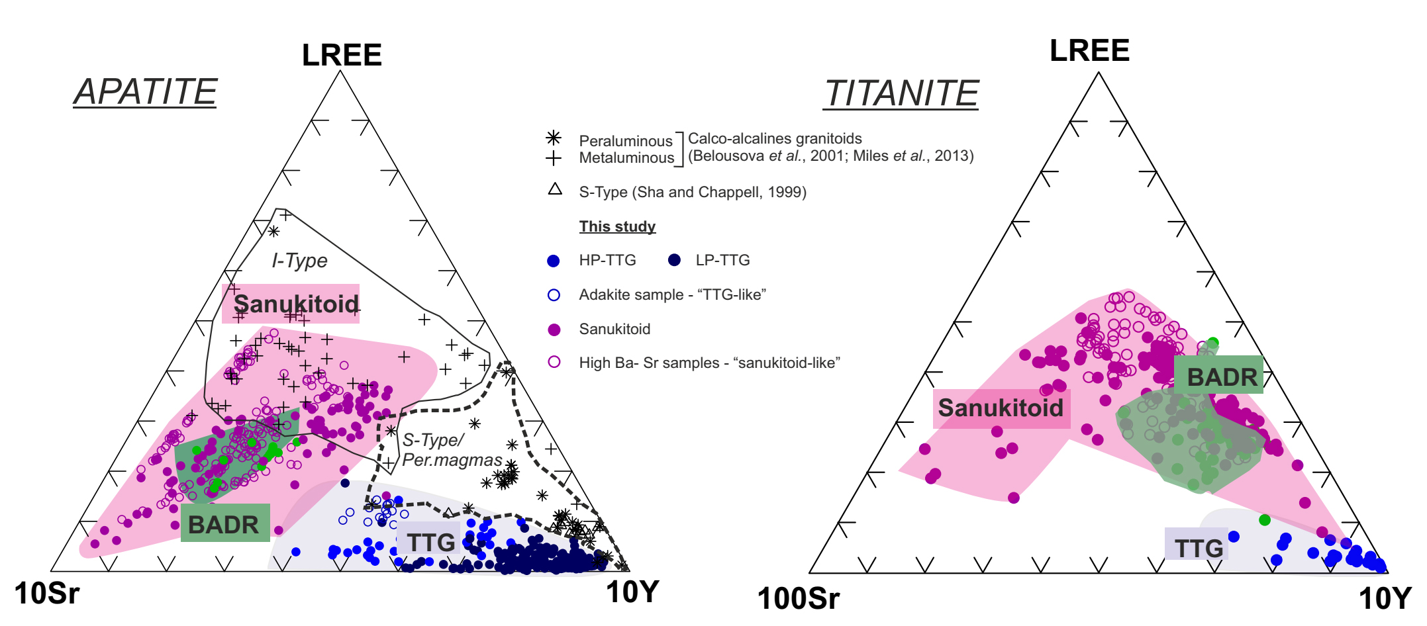
Bruand et al.
Accessory mineral constraints on crustal evolution: elemental fingerprints for magma discrimination
Figure 3 Ternary discrimination diagrams; 10*Sr-LREE-10*Y for apatite and 100*Sr-LREE-10*Y for titanite.
© 2020 The Authors
Published by the European Association of Geochemistry
under Creative Commons License CC BY-NC-ND.
Bruand et al. (2020) Geochem. Persp. Let. 13, 7-12 | doi: 10.7185/geochemlet.2006
Notes:
Figure 3 Ternary discrimination diagrams; 10*Sr-LREE-10*Y for apatite and 100*Sr-LREE-10*Y for titanite.

