Slide 1
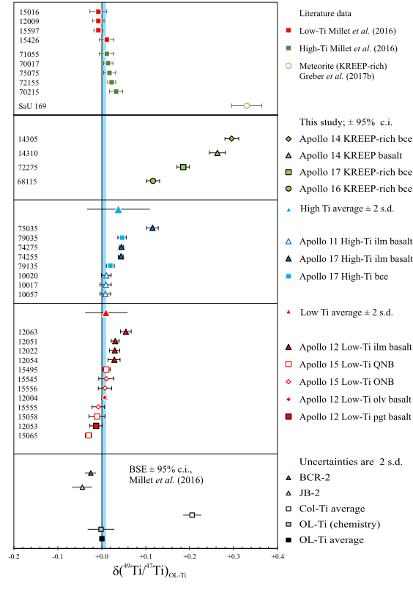
Kommescher et al.
Unravelling lunar mantle source processes via the Ti isotope composition of lunar basalts
Figure 1 Measured Ti isotope compositions of lunar samples. All uncertainties unless stated otherwise are 95 % confidence interval (c.i.) of at least 6 measurements of the same aliquot. See main text and Supplementary Information for details. bce = breccia, ilm = ilmenite; QNB = quartz-normative basalt, olv = olivine, pgt = pigeonite.
© 2020 The Authors
Published by the European Association of Geochemistry
under Creative Commons License CC BY-NC-ND.
Kommescher et al. (2020) Geochem. Persp. Let. 13, 13-18 | doi: 10.7185/geochemlet.2007
Notes:
Figure 1 Measured Ti isotope compositions of lunar samples. All uncertainties unless stated otherwise are 95 % confidence interval (c.i.) of at least 6 measurements of the same aliquot. See main text and Supplementary Information for details. bce = breccia, ilm = ilmenite; QNB = quartz-normative basalt, olv = olivine, pgt = pigeonite.

